Slide 1
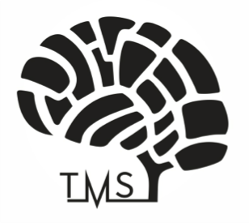
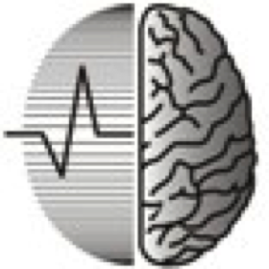
Pre-surgical mapping of motor area brain tumours with navigated transcranial magnetic stimulation: first Russian experience
Research Centre of Neurology
Russian Academy of Medical Science;
City Clinical Hospital named after S.P. Botkin
(Moscow, Russia)
A.V. Chervyakov, O.N. Dubrovina, M.S. Semenov, D.V. Vakatov, A.G. Poydasheva, A.O. Gushcha, A.V. Goroganin, M.A. Piradov
Berlin, 13.12.13

Slide 2
Introduction
Navigated transcranial magnetic stimulation (nTMS) is a novel technology in the field of neurosurgery that is used for non-invasive pre-surgical cortical functional mapping.
Intra-operative direct cortical stimulation (DCS) is the gold standard for the brain function mapping,
Correlation of nTMS and DCS has already been reported in motor mapping in previous studies (Picht et al., // Neurosurgery 69:581–589, 2011).
The aim of this work was to approve nTMS for pre-surgical mapping and compare this method with DCS.

Slide 3
Design
Nine patients with brain tumours in the motor area were enrolled in the study [age, 44.89 ± 11.02 years].
nTMS was performed in all patients with a NBS eXimia Nexstim device.
The primary motor areas of all of the patients with brain tumours were mapped pre-operatively with nTMS at 110% of the individual resting motor threshold. Intra-operative DCS data were available for all patients.
DCS was assessed with a neuro-navigation system.
Clinical outcome was assessed with the Eastern Cooperative Oncology Group-World Health Organization (ECOG-WHO) scale.
Name | Diagnosis | Sex | Age | Facial (%) | Delt (%) | Ext (%) | APB (%) | TA (%) | ECOG
Vi | Astr. | F | 30 |  |  |  | 30 | 36 | 0
Ov | Mening. | M | 35 | 80 | 45 |  | 50 | 58 | 1
Vo | Mening. | M | 35 |  | 44 |  | 35 | 58 | 1
Al | Astr. | M | 55 | 62 | 50 |  | 42 | 58 | 2
Er | Glioblast. | F | 48 |  |  |  | 32 |  | 1
Bor | Astr. | M | 36 |  |  | 30 | 30 |  | 0
Ka | Mening. | M | 49 |  | 42 | 43 | 42 | 70 | 2
Sa | Mening. | F | 57 |  | 65 | 46 | 50 |  | 1
Se | Glioblast. | F | 59 |  | 78 |  | 78 | 80 | 1
Mean |  |  | 44,89 | 71,00 | 54,00 | 39,67 | 43,22 | 60,00 | 1,00
StD. |  |  | 11,02 | 12,73 | 14,41 | 8,50 | 15,20 | 14,75 | 0,71
Notes:
For brain mapping, motor-evoked potentials were recorded in different combinations from the m. abductor pollicis brevis (APB), m. orbicularis oris (OO), m. deltoideus (Delt), m. extensor digitorum communis (Ext), and m. tibialis anterior (TA).

Slide 4
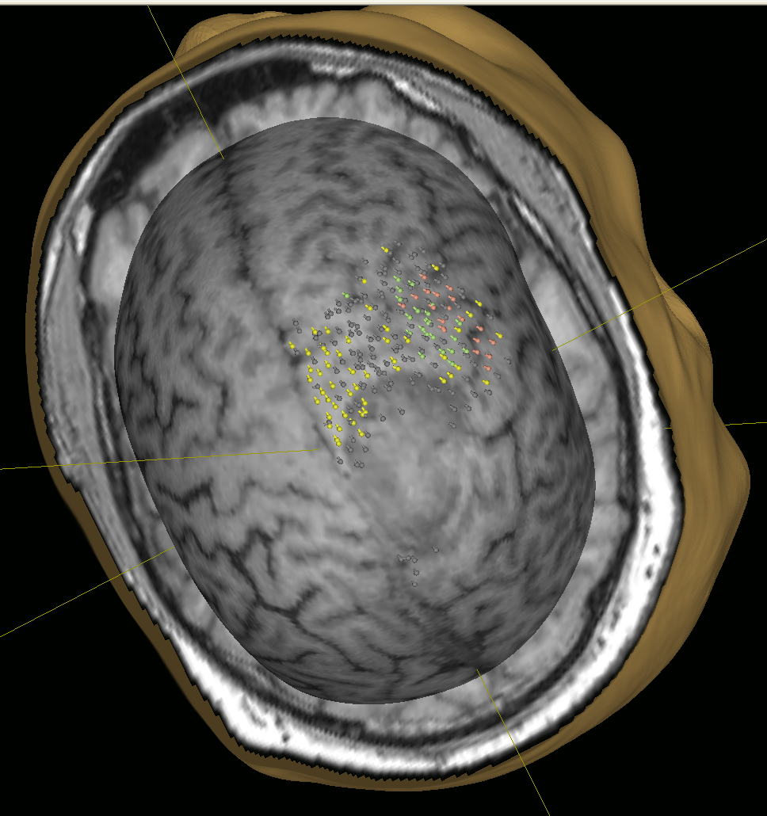
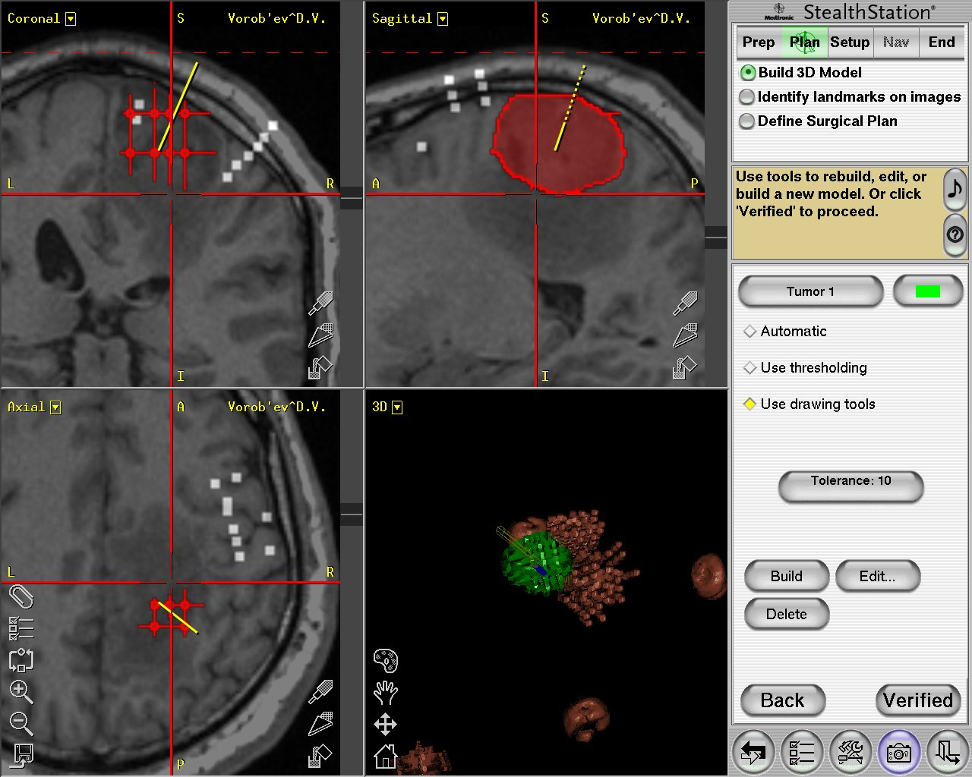
Results
Motor area
Tumor
Pre-operation mapping
Surgical neuro-navigated system
The nTMS and DCS hotspots were located in the same area and in the same region in all patients.
The mean ± SD motor threshold of the maximum stimulator intensity was 43.2 ± 15.2% at the APB hotspot, 71.1 ± 12.7% at OO, 54.0 ± 14.4% at Delt, 39.7 ± 8.5% at Ext, and 60.0 ± 14.8% at TA.
The mean clinical outcome was assessed at 1 point on the ECOG-WHO scale after the operation with pre-surgical mapping.

Slide 5
Conclusion
Both nTMS and DCS are highly reliable for mapping the core region of a given target muscle;
Pre-surgical nTMS mapping is very important in operation planning: subtotal/total tumour removal or biopsy;
Pre-surgical mapping improves the clinical outcome of patients.

Slide 6
Thanks a lot for your attention!

