Slide 1
Detection of proteins, viruses, bacteria using scanning probe microscopy
Akhmetova Assel
Lomonosov Moscow State University

Slide 2
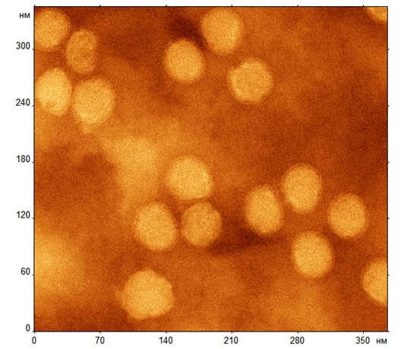
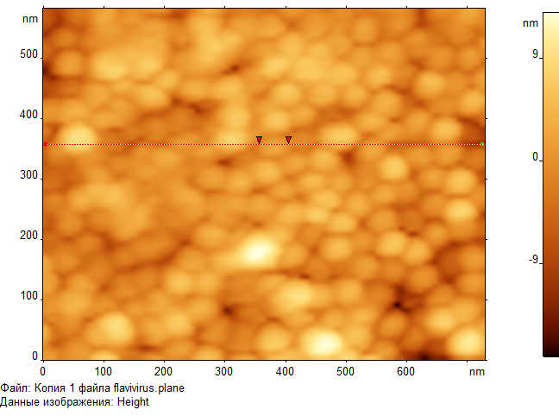
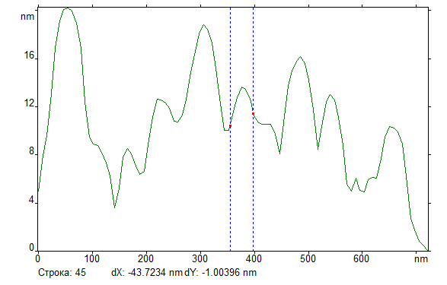
Atomic force microscopy of viruses
Tick-borne encephalitis virus,
TEM and SPM images

Slide 3
1. Atomic Balances: resonant weighing
Mechanical system:
1 – cantilever;
2 – laser;
3 – photodiode;
4 – cell;
5 – syringe.
Electronic unit:
6 – RMS preamplifier;
7 – AC generator.

Slide 4
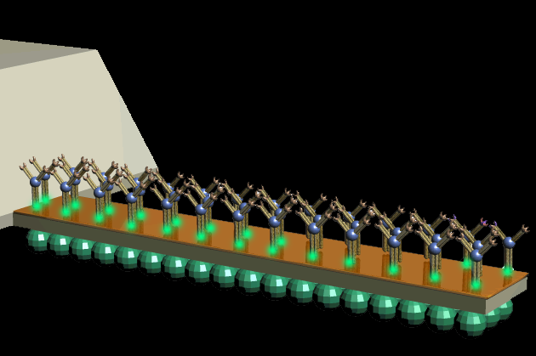
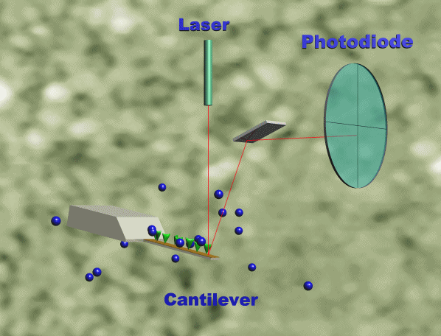
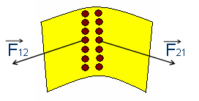
2. Static deflection
Δσ – mechanical stress in monolayer, где l и t – cantilever length and thickness, ν и E – Poisson coefficient and Young modulus, Δz – cantilever deflection
laser
photodiode
Stresses can be pulling and pushing
cantilever

Slide 5
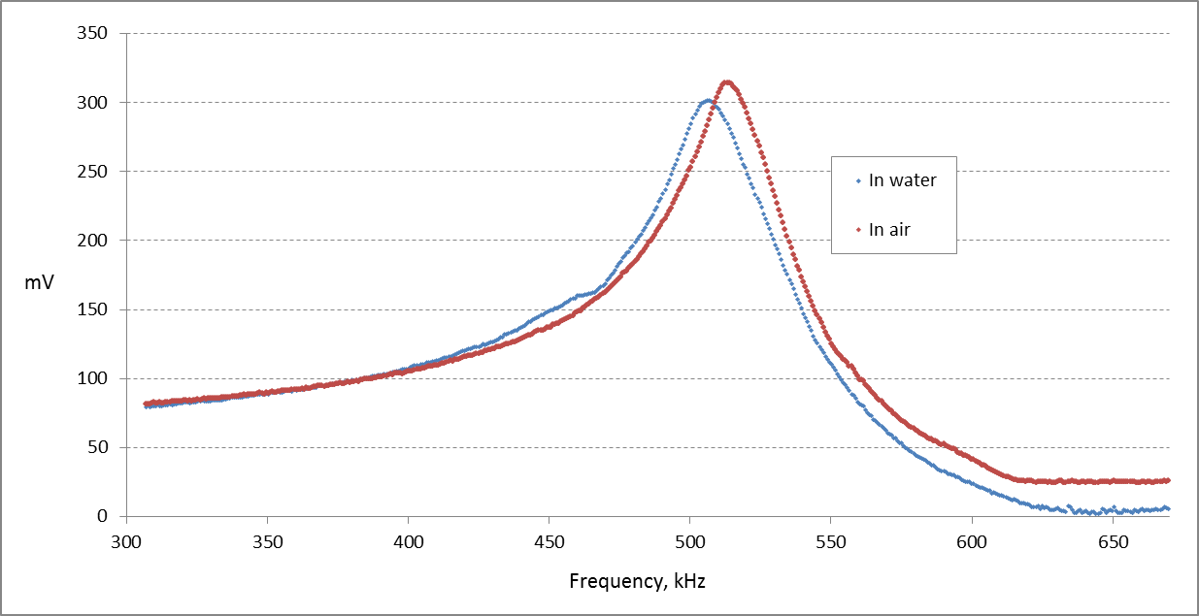
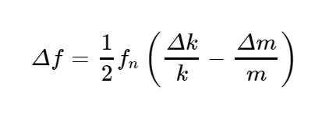
Δf=12fn(Δkk−Δmm)
3. Dynamic mode
Radial oscillations have advantages to bending modes due to higher Q-factor and sensitivity in liquid. No need of laser system.
Schematic representation of a disks first radial mode
Typical resonance curves of piezodisk:
red one – in air and blue one – in water

Slide 6
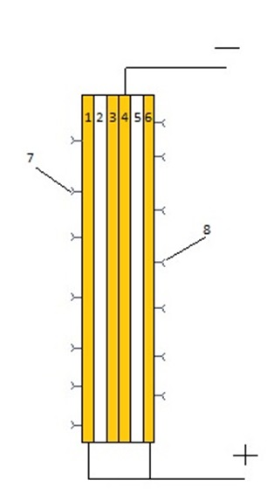
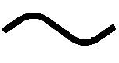
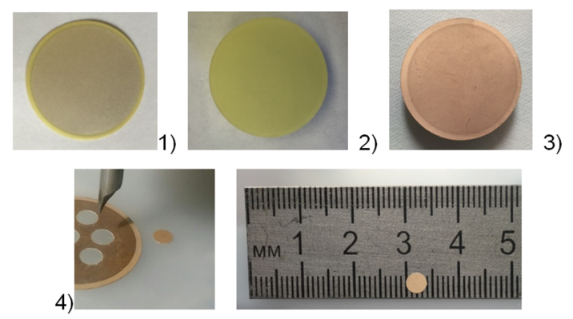
Piezoceramic biochip
7, 8 – receptor layers
1) Piezoceramic plates with silver-plated electrodes on both sides 2) Plate after incubation in 100% nitric acid 3) A plate with a sprayed gold layer of 50 nm deposited on both sides 4) Billets for biochips with a diameter of 4 mm are prepared from the plate
Conductive layer
Piezoceramic layer
A. Akhmetova, G. Meshkov, I. Nazarov, A. Sagitova, I. Yaminsky // Biosensor device for detecting biological micro and nano-objects. Patent 2636048, 2017

Slide 7
Microalbumin detection
Control measurement of biosensor response in PBST buffer. For 1000 sec, the average value of the resonant frequency has shifted by 0.3 kHz
Piezoceramic discs coated with a layer of gold.

Slide 8
Microalbumin detection
The binding curve of the conjugate of goat antibodies against mouse antibodies with immobilized antibodies on the surface of the biochip.
A piezoceramic disk (gold + aminothiophenol substrate + H-C15 antibodies to albumin) is placed in a flow cell. 0.25 ml of conjugate with buffer with a ratio of 1: 1,000,000 was added to the volume of 0.75 ml PBST buffer.
For 1000 sec. the frequency shift was 0.8 kHz.

Slide 9
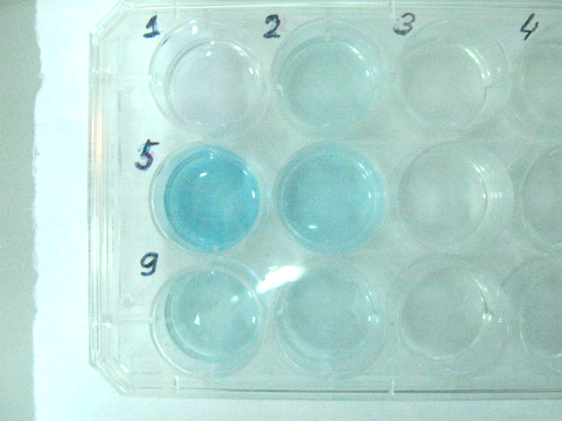
Enzyme immunoassay results
Aminothiophenol
Mercaptoethylamine
The best binding occurred on the surface of an aminothiophenol-modified disk at an antibody concentration of 50 μg / ml.
To modify the surface of the carrier, it is better to use aminothiophenol.
100 мкг/мл
50 мкг/мл
5 мкг/мл

Slide 10
Conclusion
The biosensor can be used to identify biological particles in a liquid and determine their concentration A technique for covalent immobilization of antibodies on the gold surfaces of the cantilever has been developed. Reducing the geometric dimensions of the biochip will increase the sensitivity of the method - up to single particles
akhmetova@nanoscopy.ru
+7 925 092 6757

