Slide 1
PT VAINT
Evgenii Churiulin, Merja Tölle, Vladimir Kopeykin,
Markus Übel, Juergen Helmert and Jean-Marie Bettems

Slide 2
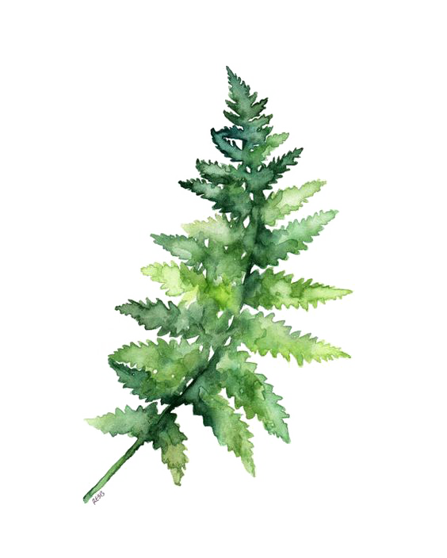
PT VAINT
SubTask1: Implementation of new photosynthesis/phenology scheme:
a) The canopy photosynthesis and stomatal regulation module (done);
b) The carbon allocation and plant growth module (in progress);
c) The heterotrophic respiration and litter/soil carbon module (in progress);
SubTask2: Validation of new photosynthesis/phenology scheme:
a) Run cosmo_v5.0_clm16 (without changes) and cosmo_v5.0_clm16 (with updates) (in progress);
b) Run cosmo_v5.0.8 (without changes) (in progress);
c) Run cosmo-ccl and cosmo with SubTask1 (b and c) (not started)
SubTask3: Validation of implementation (in progress)
SubTask4: Documentation (in progress)
a) The block schemes for source files (src_terra_multlay and scr_radiation) (done);
https://github.com/users/merajtoelle/projects/1#column-12685832
b) The first version of documentation with new updates (done);
https://github.com/users/merajtoelle/projects/1#column-12685824

Slide 3
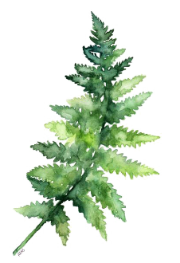
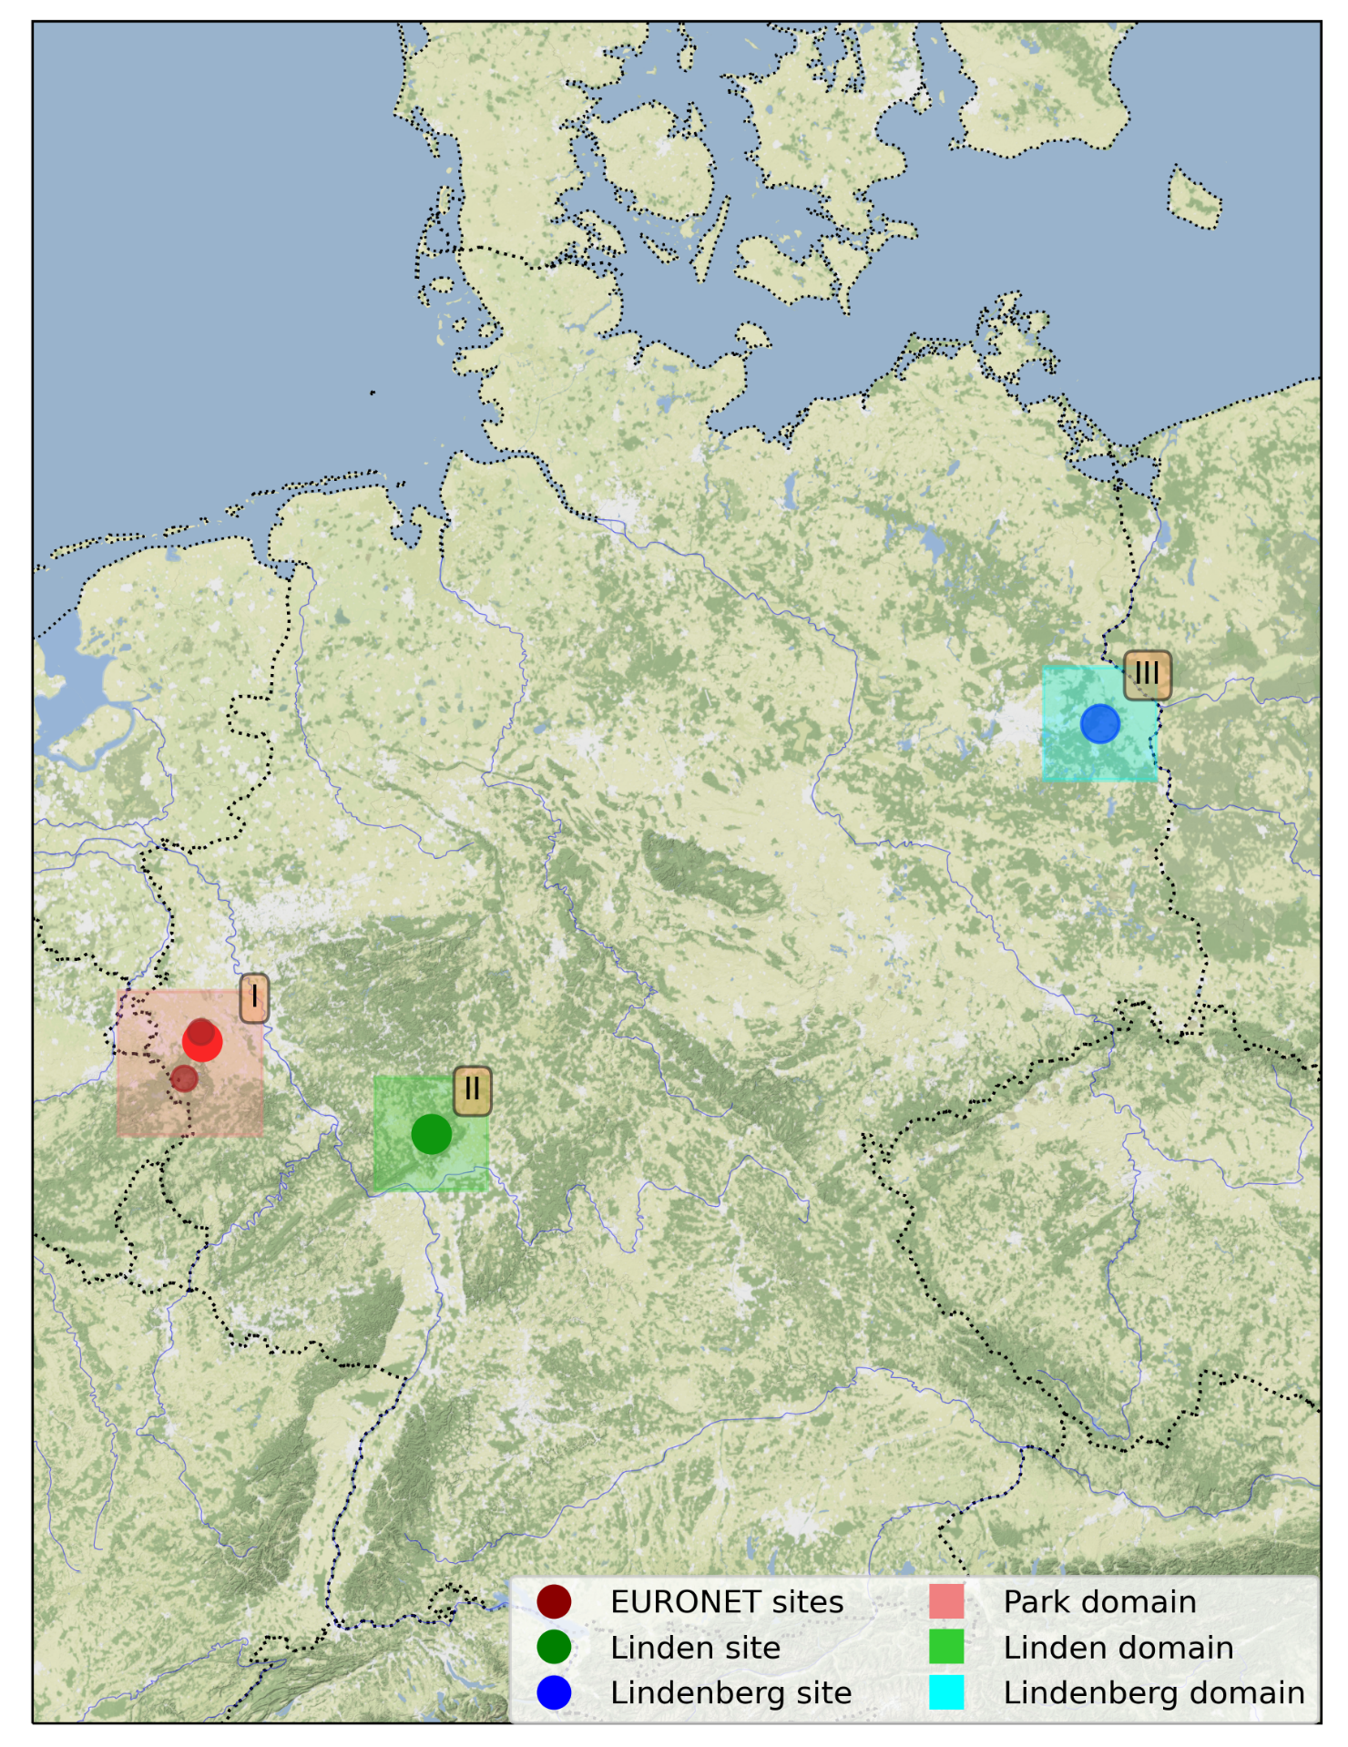
Research domains
COSMO-CLM parameters:
Research period: from 1999 to 2017
Time increment: 1 hour
Spatial resolution: 2.2 km
Grid size: 25 * 25
Numbers of vertical layers: 50
Numbers of soil layers: 9
 | Parc | Linden | Lindenberg
STARTLAT_TOT | 0.37125 | -0.12375 | 1.25125
STARTLON_TOT | -7.57125 | -6.16875 | -2.64875
POLLAT | 39.25
POLLON | -162
POLGAM | 0

Slide 4
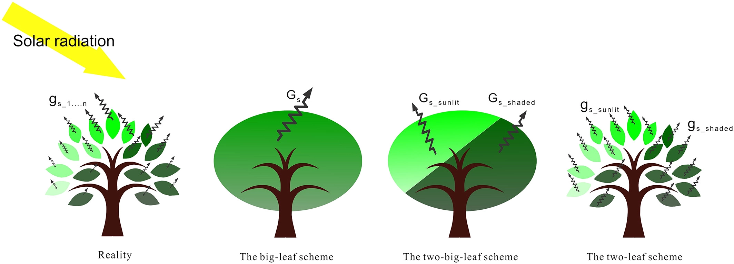
Differences in approach
The new algorithm for “2-leaf” canopy (sunlit and shaded leaves)
Sunlit ($f_{sun}$) and shaded ($f_{sha}$) fraction of canopy:
$$f_{sun}=1−\frac{e^{−KL}}{KL}$$
$f_{sha}=1−f_{sun}$
Sunlit ($L^{sun}$) and shaded ($L^{sha}$) leaf area indices:
$$L^{sun}=f_{sun}L$$
$$L^{sha}=f_{sha}L$$
Figure: Luo et. al, 2018
where:
$e^{−KL}$ – the fractional area of sun flecks on a horizontal plane below the leaf area index – L;
$K$ – the light extinction coefficient;

Slide 5
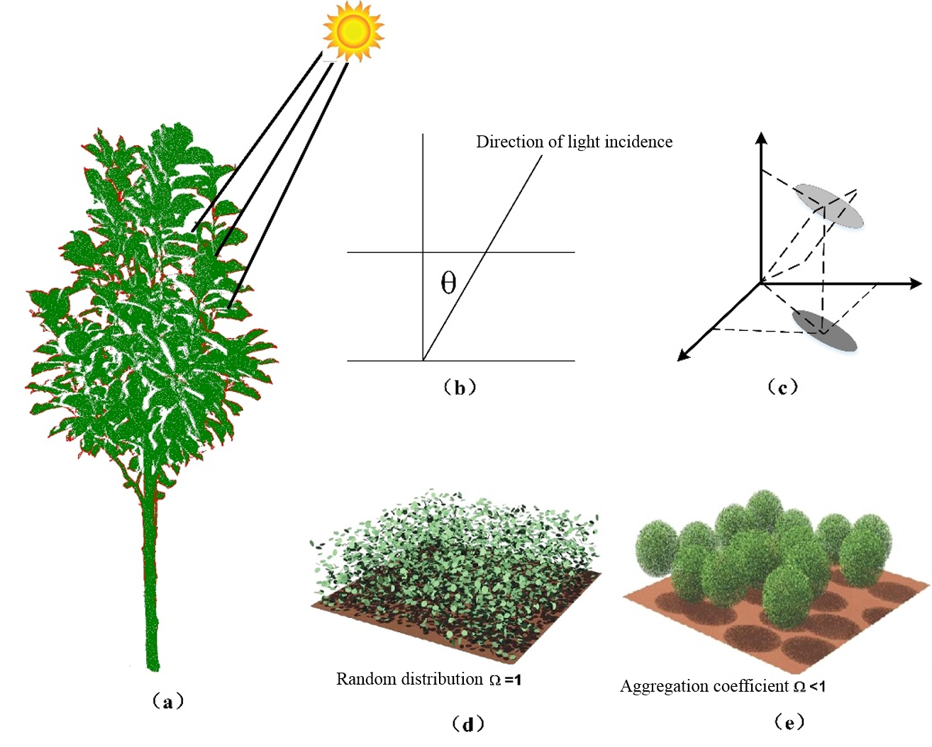
Differences in approach
The new algorithm for “2-leaf” canopy (sunlit and shaded leaves)
Specific leaf area indices
for sunlit (SLA^{sun}) and shaded (SLA^{sha}) leaves:
where:
$$SLA$$
– the specific leaf area indices
$$L, S$$
– the leaf and stem area indices
$$SLA_{m}$$
– the linear slope coefficient
$$SLA_{o}$$
– the value for SLA at the top of the canopy
Figure: Chen et. al, 1991

Slide 6
Differences in approach
The new algorithm for photosynthesis (sunlit and shaded leaves)
C3 plants based on Farquhar model (1980)
C4 plants based on Collatz model (1992)
$$A=A^{sun}L^{sun}+A^{sha}L^{sha}$$
$$A^{sun, sha}=min(w_{c}, w_{j}, w_{e})$$
$$w_{c}=\left\{\begin{aligned}\frac{V_{cmax} (c_{i} − Γ_{∗})}{c_{i}+K_{c} (1+\frac{O_{i}}{K_{0}})}, for C_{3} plants \\ V_{cmax } , for C_{4 }plants\end{aligned}\right.$$
$$w_{j}=\left\{\begin{aligned}\frac{\left(c_{i} − Γ_{∗}\right) 4.6 α φ}{c_{i}+2 Γ_{∗}}, for C_{3} plants \\ 4.6 α φ , for C_{4 }plants\end{aligned}\right.$$
$$w_{e}=\left\{\begin{aligned} 0.5 V_{cmax}, for C_{3} plants \\ 4000 V_{cmax}\frac{c_{i}}{P_{atm}}, for C_{4 }plants\end{aligned}\right.$$
where:
$$w_{c}, w_{j}, w_{e}$$
$$− the limited rates of carboxylatio, the light and carboxylase$$
$$α$$
$− \text{the} \text{quantum} \text{efficiency}$ coefficient
$$V_{cmax}$$
$$− \text{the} \text{maximum} \text{rate} \text{of} \text{carboxylation}$$
$$φ$$
$$− \text{the} \text{absorbed} \text{PAR}$$
$$K_{c}; K_{o}$$
$$− \text{the} \text{Michaelis}\text{−}\text{Menten} \text{constants} \text{for} \text{CO}\text{2} \text{and} \text{O}\text{2}$$
$$Γ_{∗}$$
$$− \text{the} \text{CO}\text{2} \text{compensation} \text{point}$$
$$A, { A}_{sun}, A_{sha}$$
$$−$$
the leaf photosynthesis for: canopy; sunlit and shaded l$eaves$
$$c_{i}$$
$− \text{the} \text{internal} \text{leaf} \text{CO}\text{2}$ partial pressure
$$O_{i}$$
$− \text{the} \text{O}\text{2}$ partial pressure

Slide 7
Differences in approach
TERRA_ML
vs
TERRA_ML (updated)
Stomatal behavior represented based on empirical
Jarvis approach (Jarvis et. al., 1976)
Stomatal conductance explicitly related to photosynthetic assimilation model using Ball-Berry approach (Collatz et. al., 1991)
$$g_{st}^{can}=\frac{1}{r_{max}}+\left(\frac{1}{r_{min}} −\frac{1}{r_{max}}\right)[F_{rad}F_{wat}F_{tem}F_{hum}]$$
$$g_{st}^{can}=g_{st}^{sun}L^{sun}+g_{st}^{sha}L^{sha}$$
$$g_{st}^{sun, sha}=\frac{1}{r_{s}^{sun, sha}}=m\frac{A^{sun, sha}e_{s}}{c_{s}e_{i}}P_{atm}+b$$
where:
$$F_{rad}$$
̶ the influence on the stomatal resistance of radiation
$r_{s}^{sun}$ and $r_{s}^{sha}$
̶ stomatal resistance for sun and sha leaves
$g_{st}^{sun}$ and $g_{st}^{sha}$
̶ stomatal conductance for sun and sha leaves
$$F_{wat}$$
̶ soil water content
$$e_{s}$$
̶ the vapor pressure at the leaf surface
$$F_{tem}$$
̶ ambient temperature
$$e_{i}$$
̶ the saturation vapor pressure inside the leaf at the skin temperature
$$F_{hum}$$
̶ ambient specific humidity
$$r_{max}$$
̶ maximal stomatal resistance
$$c_{s}$$
̶ the CO₂ partial pressure at the leaf surface
$$r_{min}$$
̶ minimal stomatal resistance
$$A$$
$$− the leaf photosynthesis$$
b
$−$ is the minimum stomatal conductance
m
$−$ slope parameter

Slide 8
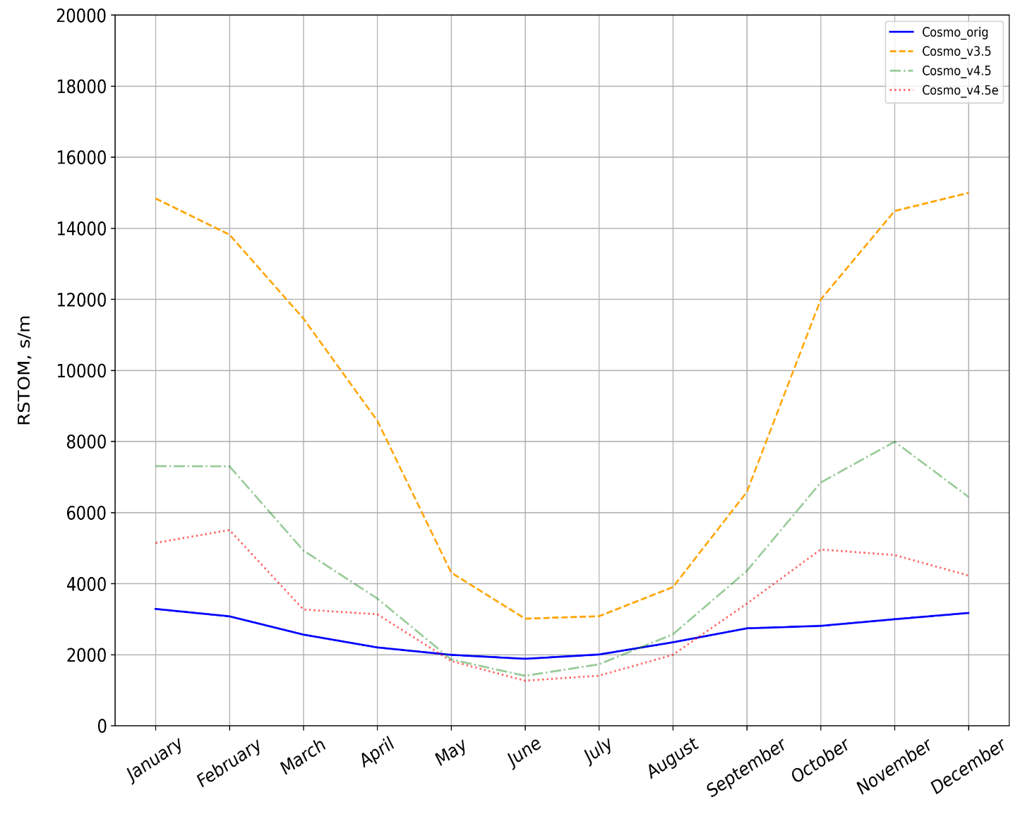
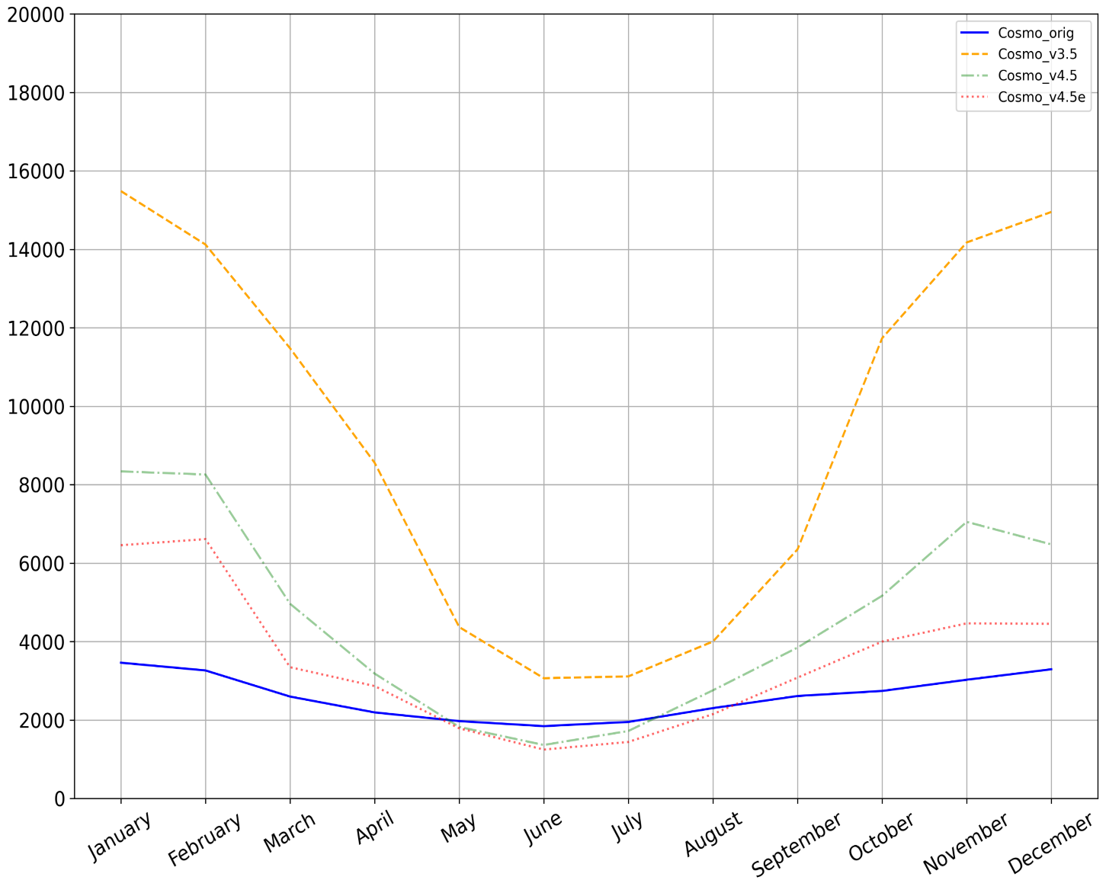
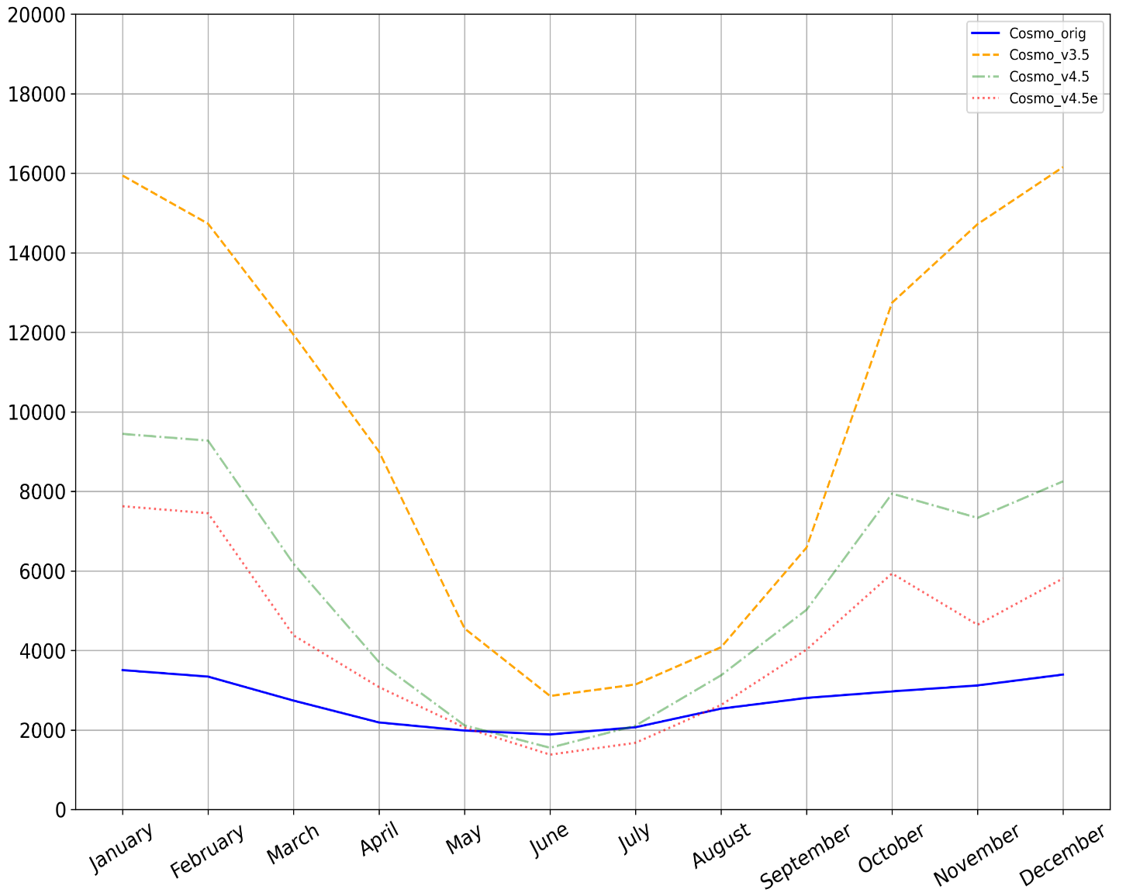
Stomatal resistance (RSTOM)
vs
TERRA_ML
(Jarvis approach – Jarvis et al., 1976)
TERRA_ML (updated)
(Ball-Berry approach – Collatz et al., 1991)
$$g_{st}^{can}=g_{st}^{sun}L^{sun}+g_{st}^{sha}L^{sha}$$
$$g_{st}^{can}=\frac{1}{r_{max}}+\left(\frac{1}{r_{min}} −\frac{1}{r_{max}}\right)[F_{rad}F_{wat}F_{tem}F_{hum}]$$
$$g_{st}^{sun, sha}=\frac{1}{r_{s}^{sun, sha}}=m\frac{A^{sun,sha}e_{s}}{c_{s}e_{i}}P_{atm}+b$$
I
II
III
COSMO_orig
COSMO_v3.5
COSMO_v4.5
COSMO_v4.5e
I – Parc, II – Linden, III – Lindenberg
Notes:
Jarvis approach:
$F_{rad}$ - the influence on the stomatal resistance of radiation;$F_{wat}$ - soil water content; $F_{tem}$ - ambient temperature; $F_{hum}$ - ambient specific humidity; $r_{max}$ and $r_{min}$ - max and min stomatal resistance
Ball-Berry approach:
$r_{s}^{sun}$ and $r_{s}^{sha}$ - stomatal resistance for sun and sha leaves; $A$ - $the leaf photosynthesis$
$g_{st}^{sun}$ and $g_{st}^{sha}$ - stomatal conductance for sun and sha leaves ; b - is the minimum stomatal conductance; m - parameter;
$e_{s}$ - the vapor pressure at the leaf surface;
$e_{i}$ - the saturation vapor pressure inside the leaf at the skin temperature ;
$c_{s}$ - ̶ the CO₂ partial pressure at the leaf surface;

Slide 9
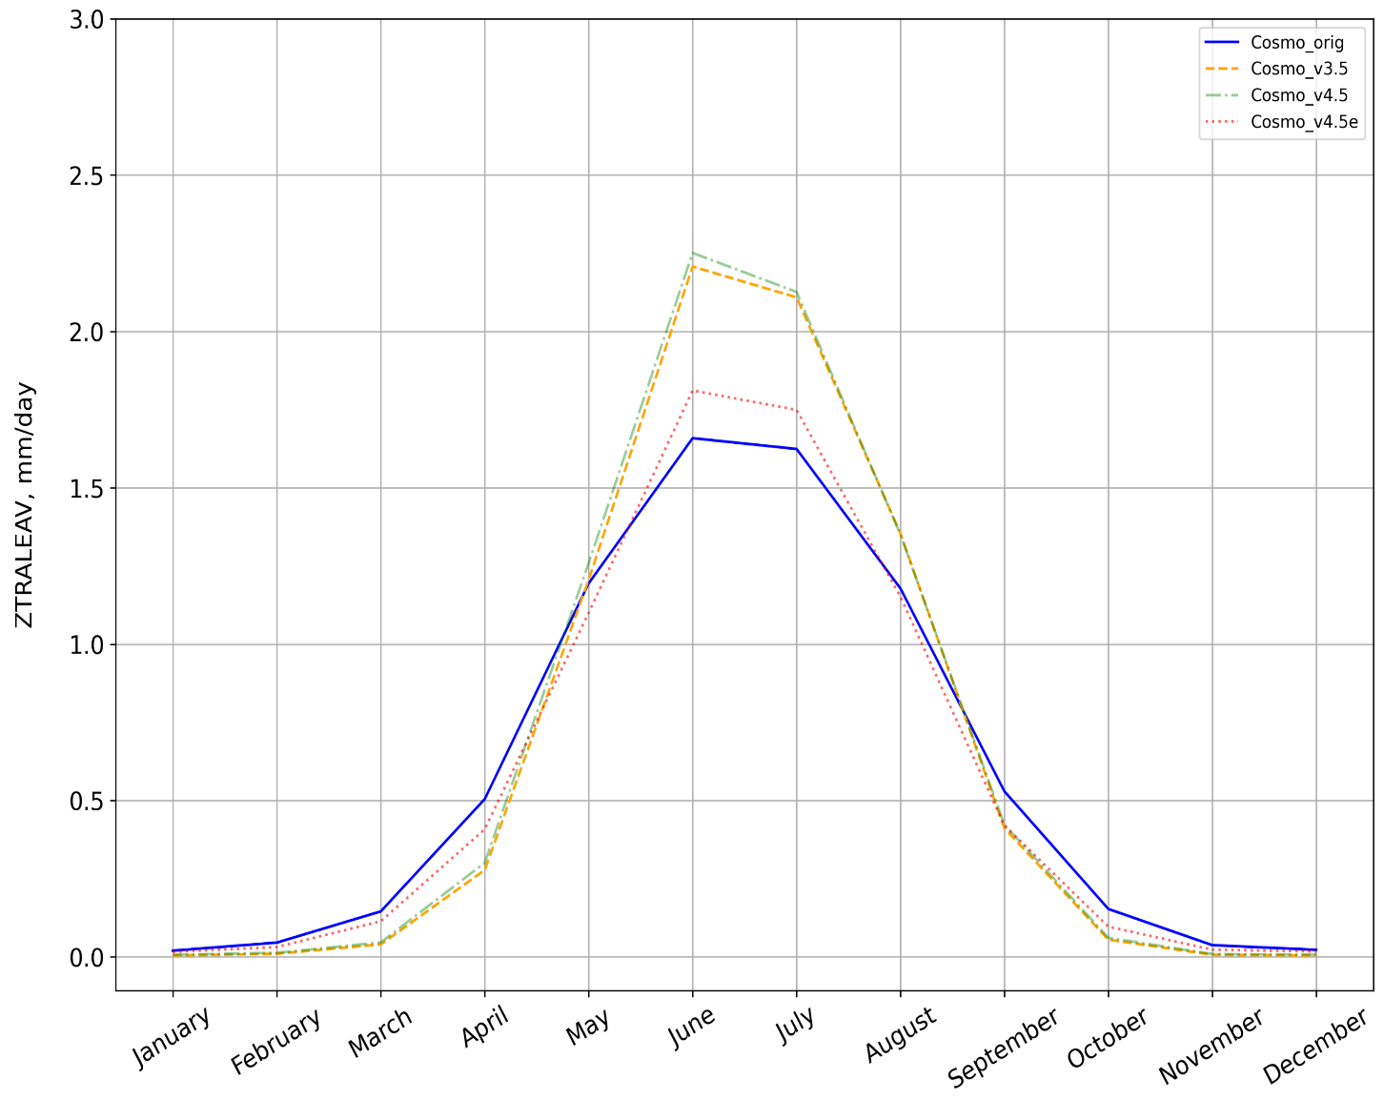
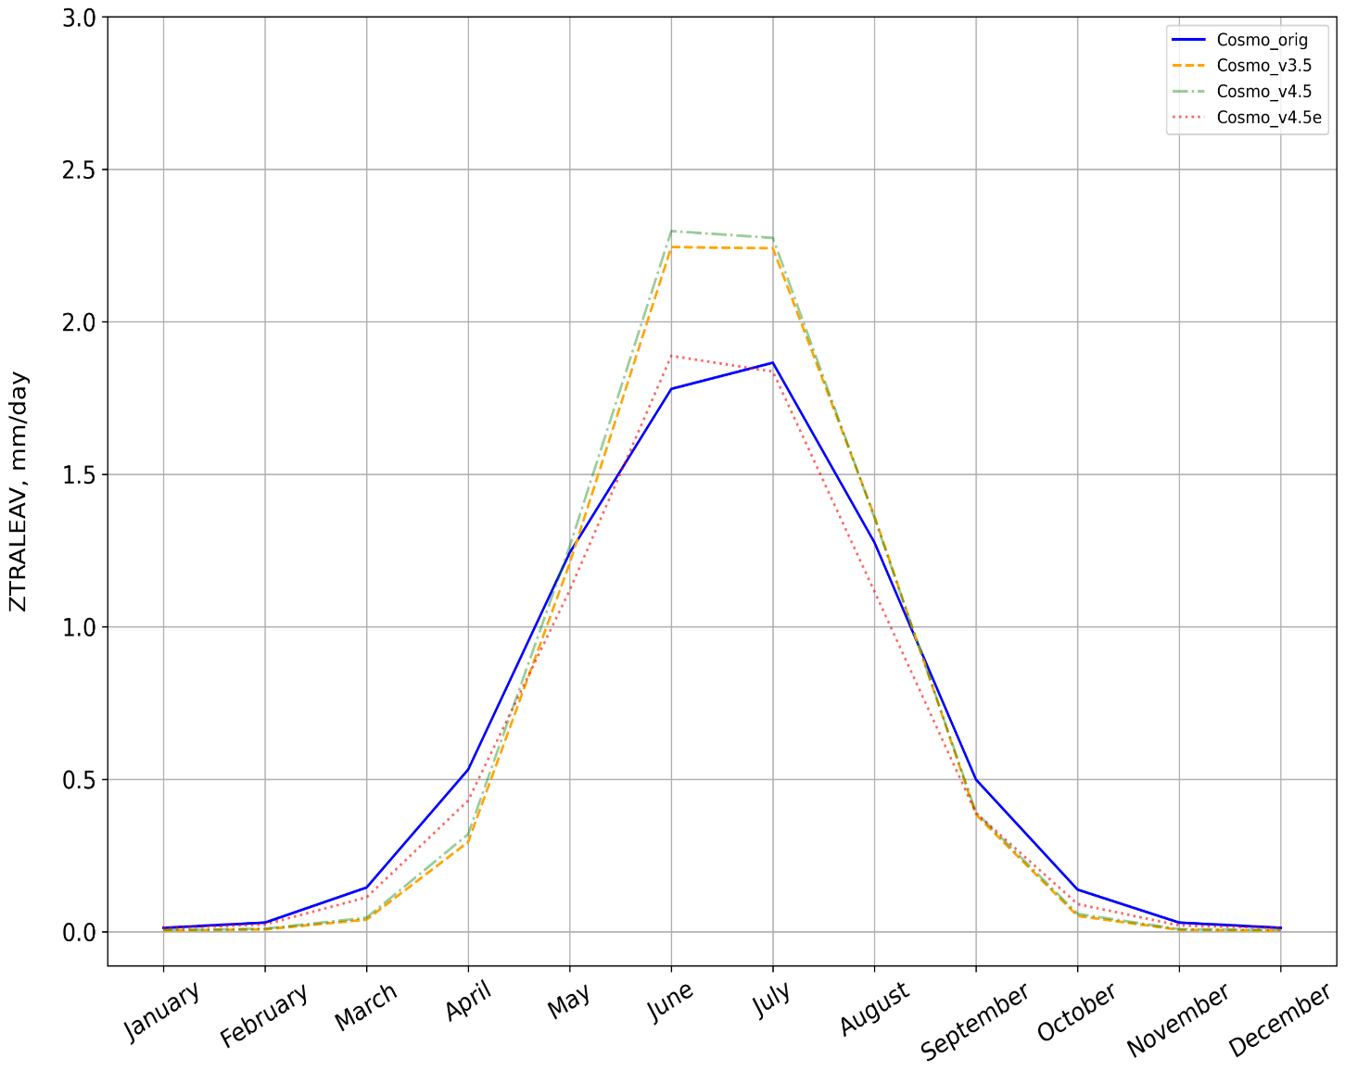
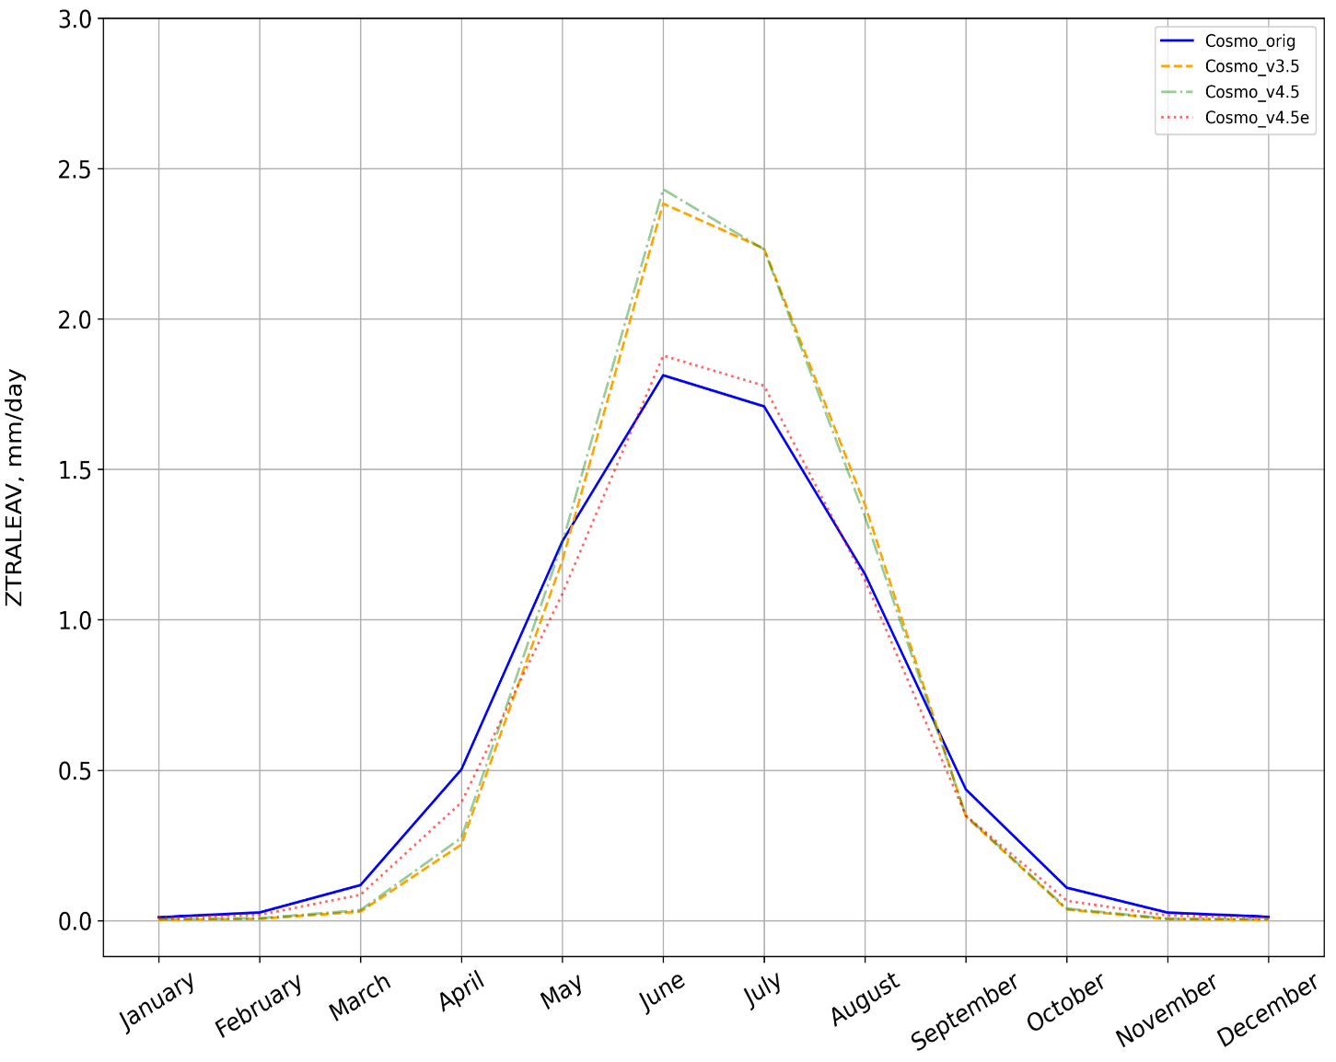
Transpiration rate of dry leaves (ZTRALEAV)
$$ZTRALEAV=\frac{E_{pot\left(T_{sfc}\right)}∗TAI}{SAI∗\left(r_{a}+r_{s}\right)∗C_{A}}$$
$$ZTRALEAV=E_{pot\left(T_{sfc}\right)}C_{V}{\left(C_{A}+C_{V}\right)}^{−1}$$
* according to COSMO-CLM code
* according to COSMO documentation
where:
$$E_{pot\left(T_{sfc}\right)}$$
̶ potential evaporation
$$r_{a},r_{s}$$
̶ atmospheric and stomatal resistance
$$TAI$$
̶ transpiration area index (EXTPAR)
$$C_{A},C_{V}$$
̶ atmospheric and stomatal transfer coefficients
$$SAI$$
̶ surface area index (EXTPAR)
I
II
III
COSMO_orig
COSMO_v3.5
COSMO_v4.5
COSMO_v4.5e
Gleam_v3.5a
Gleam_v3.5b
I – Parc, II – Linden, III – Lindenberg

Slide 10
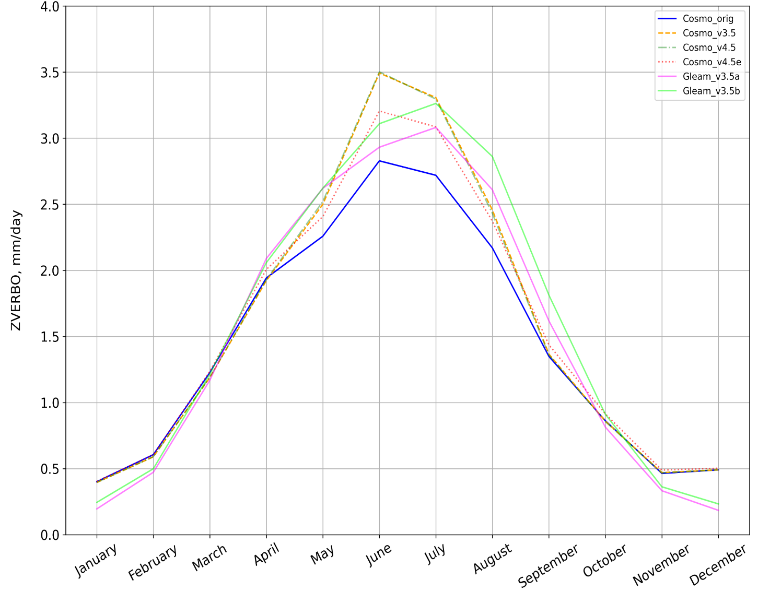
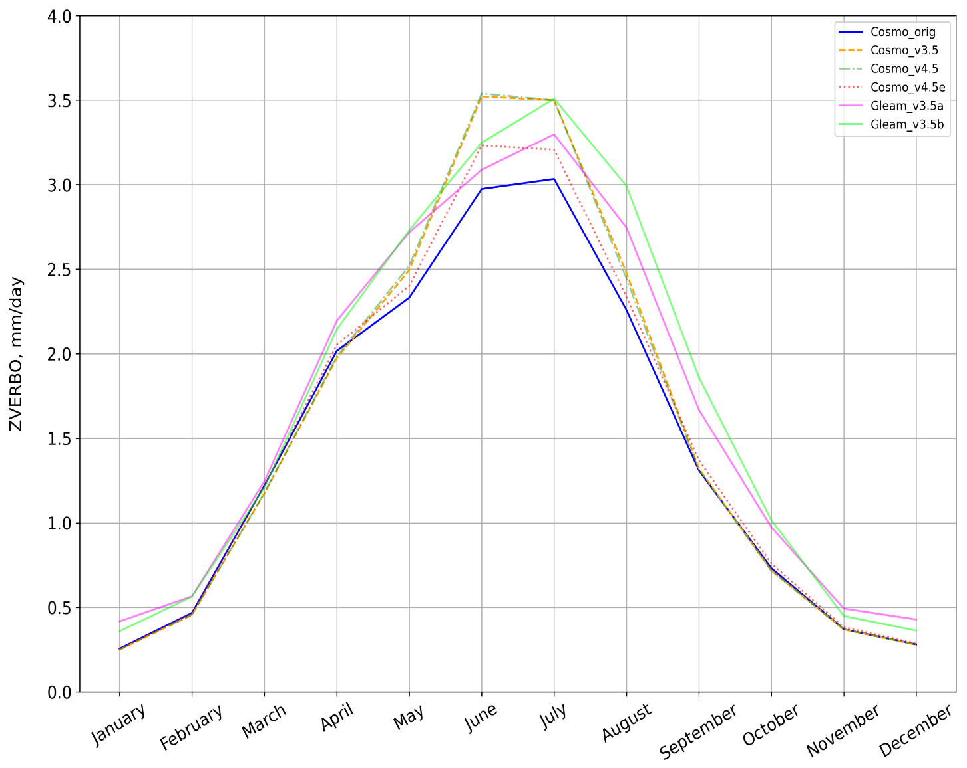
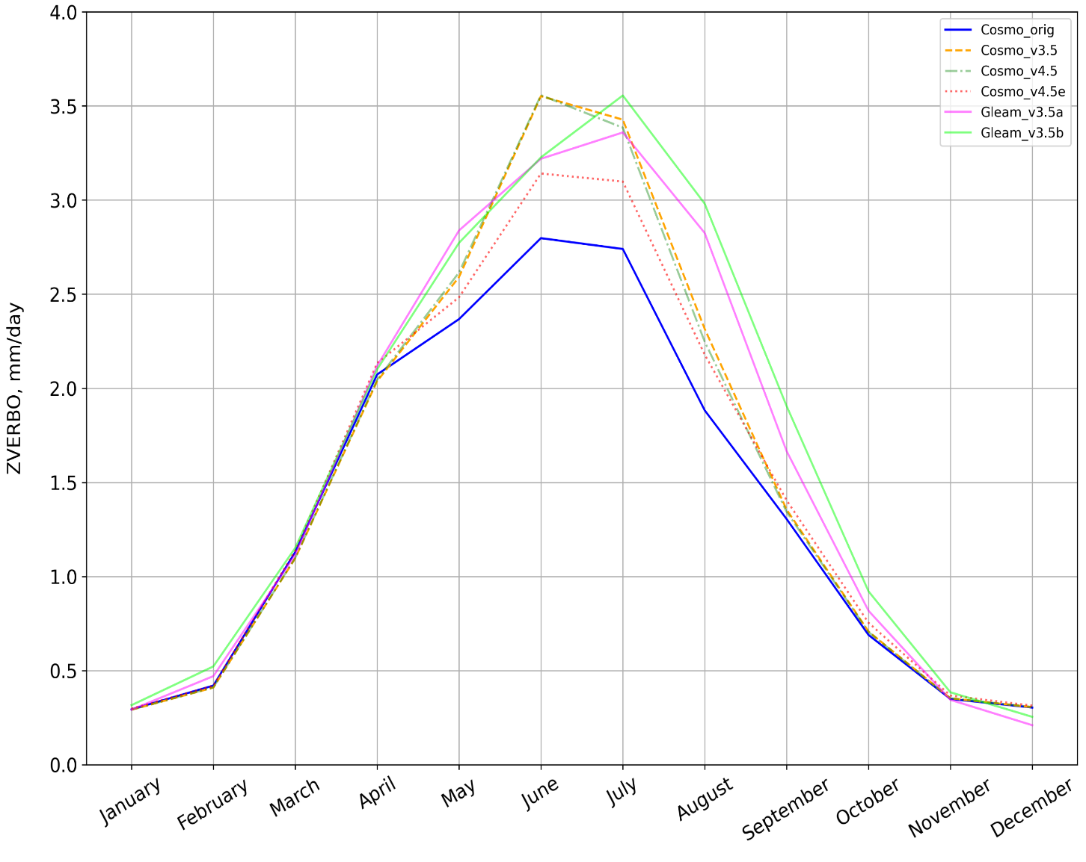
Total evapotranspiration (ZVERBO)
$$ET_{total}=E_{i }+E_{b}+ \sum_{k=1}^{ke_{soil,hy}}{Tr_{k}}+\left(1−f_{snow}\right)∗(ZRR+ZRS)$$
$${ZRR}_{ }$$
̶ formation of dew
where:
$$E_{i }$$
̶ evaporation from interception store
$$\sum_{k=1}^{ke_{soil,hy}}{Tr_{k}}$$
̶ transpiration from all soil layers
$${ZRS}_{ }$$
̶ formation of rime
$$E_{b}$$
̶ evaporation from bare soil
$$f_{snow}$$
̶ snow covered fraction
I
II
III
COSMO_orig
COSMO_v3.5
COSMO_v4.5
COSMO_v4.5e
Gleam_v3.5a
Gleam_v3.5b
I – Parc, II – Linden, III – Lindenberg

Slide 11
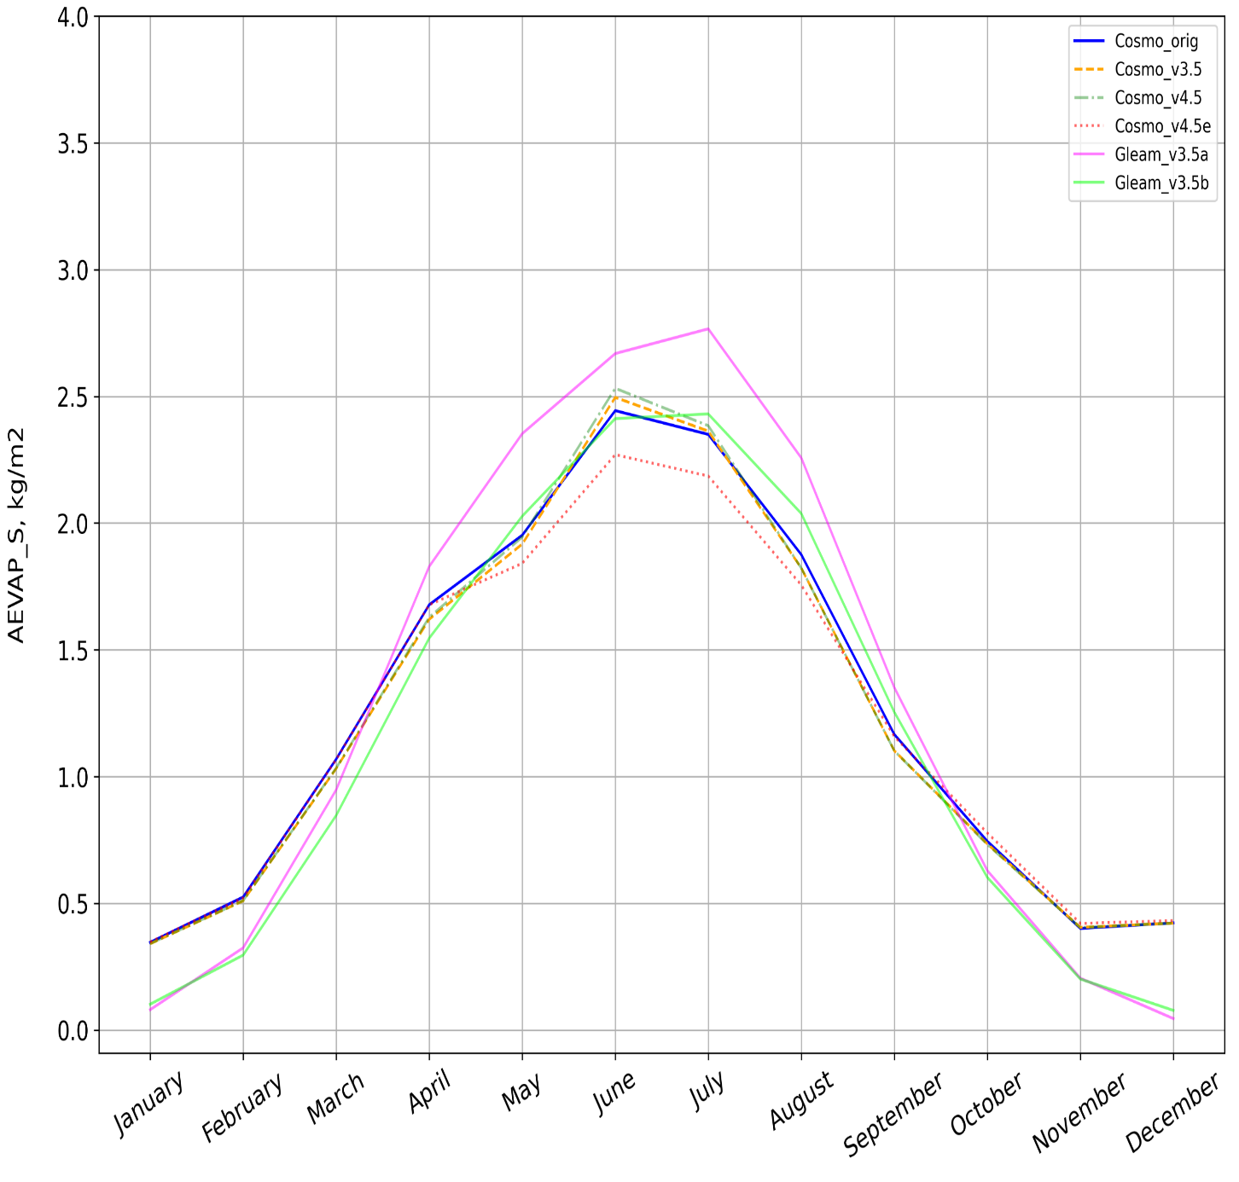
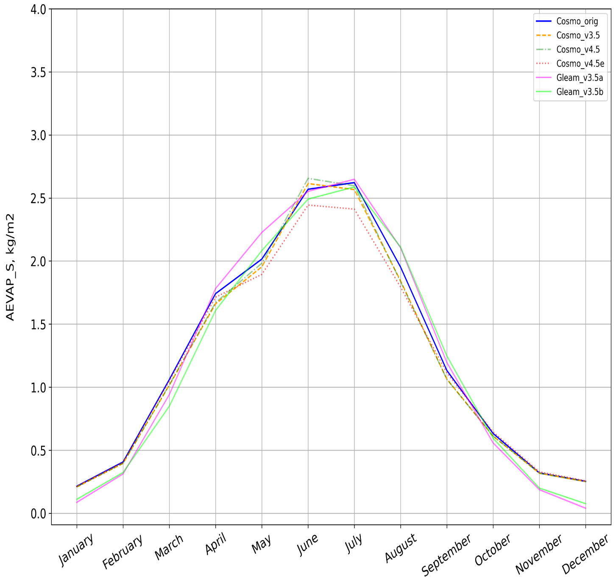
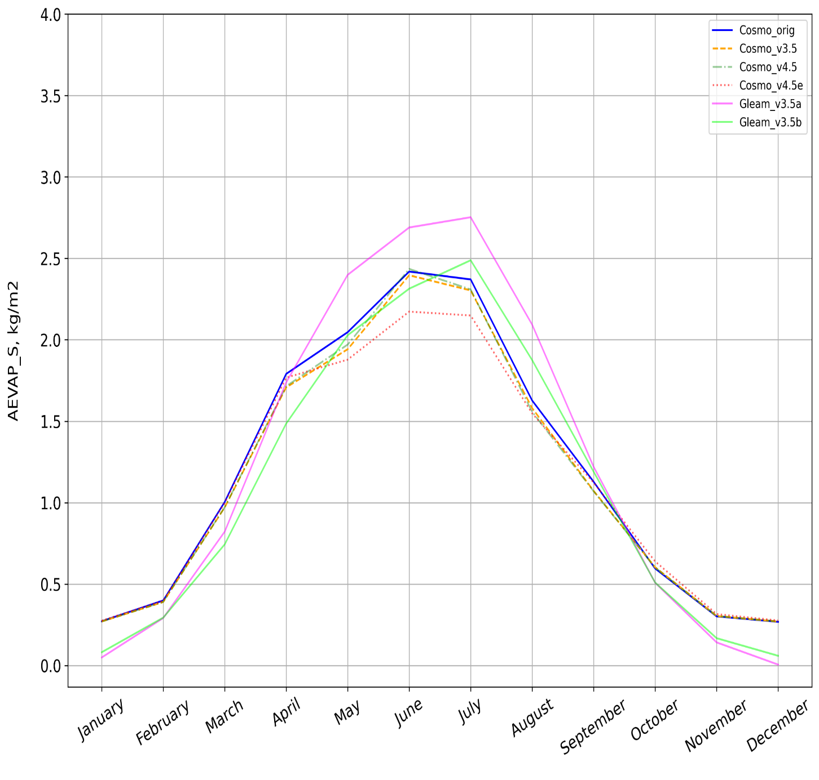
Amount of water evaporation - surface (AEVAP_S)
I
II
III
COSMO_orig
COSMO_v3.5
COSMO_v4.5
COSMO_v4.5e
Gleam_v3.5a
Gleam_v3.5b
I – Parc, II – Linden, III – Lindenberg

Slide 12
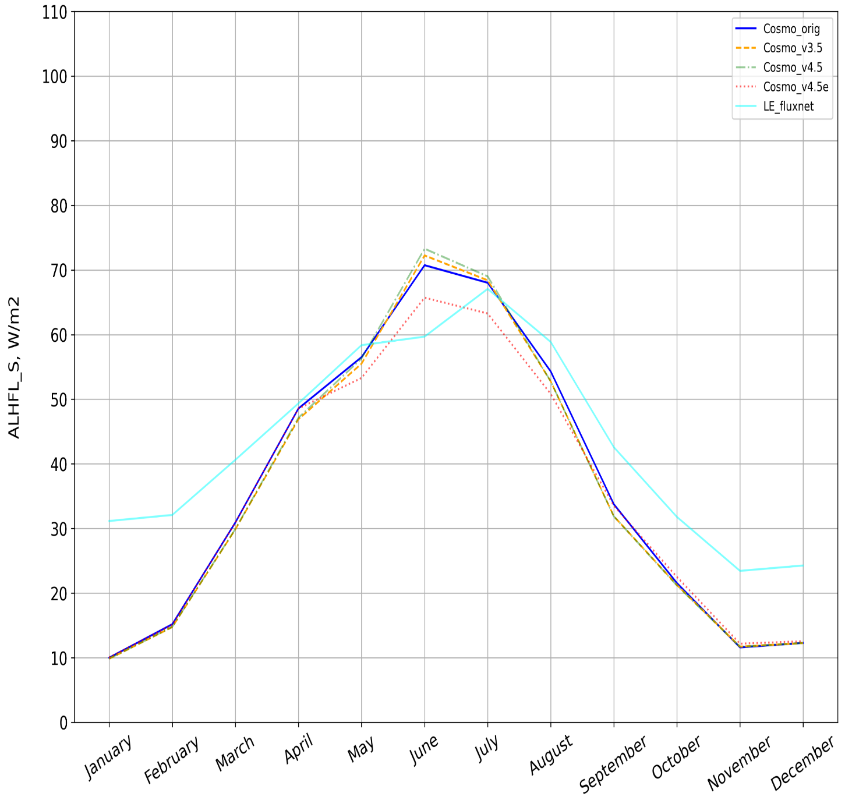
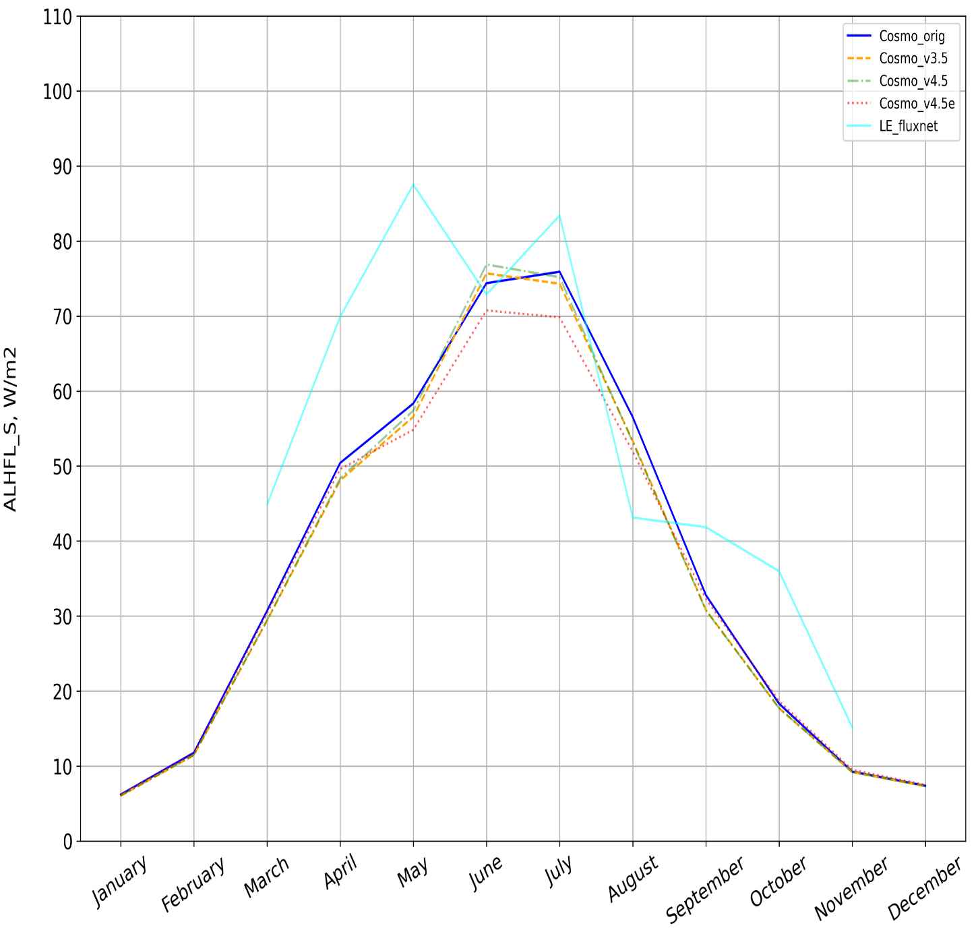
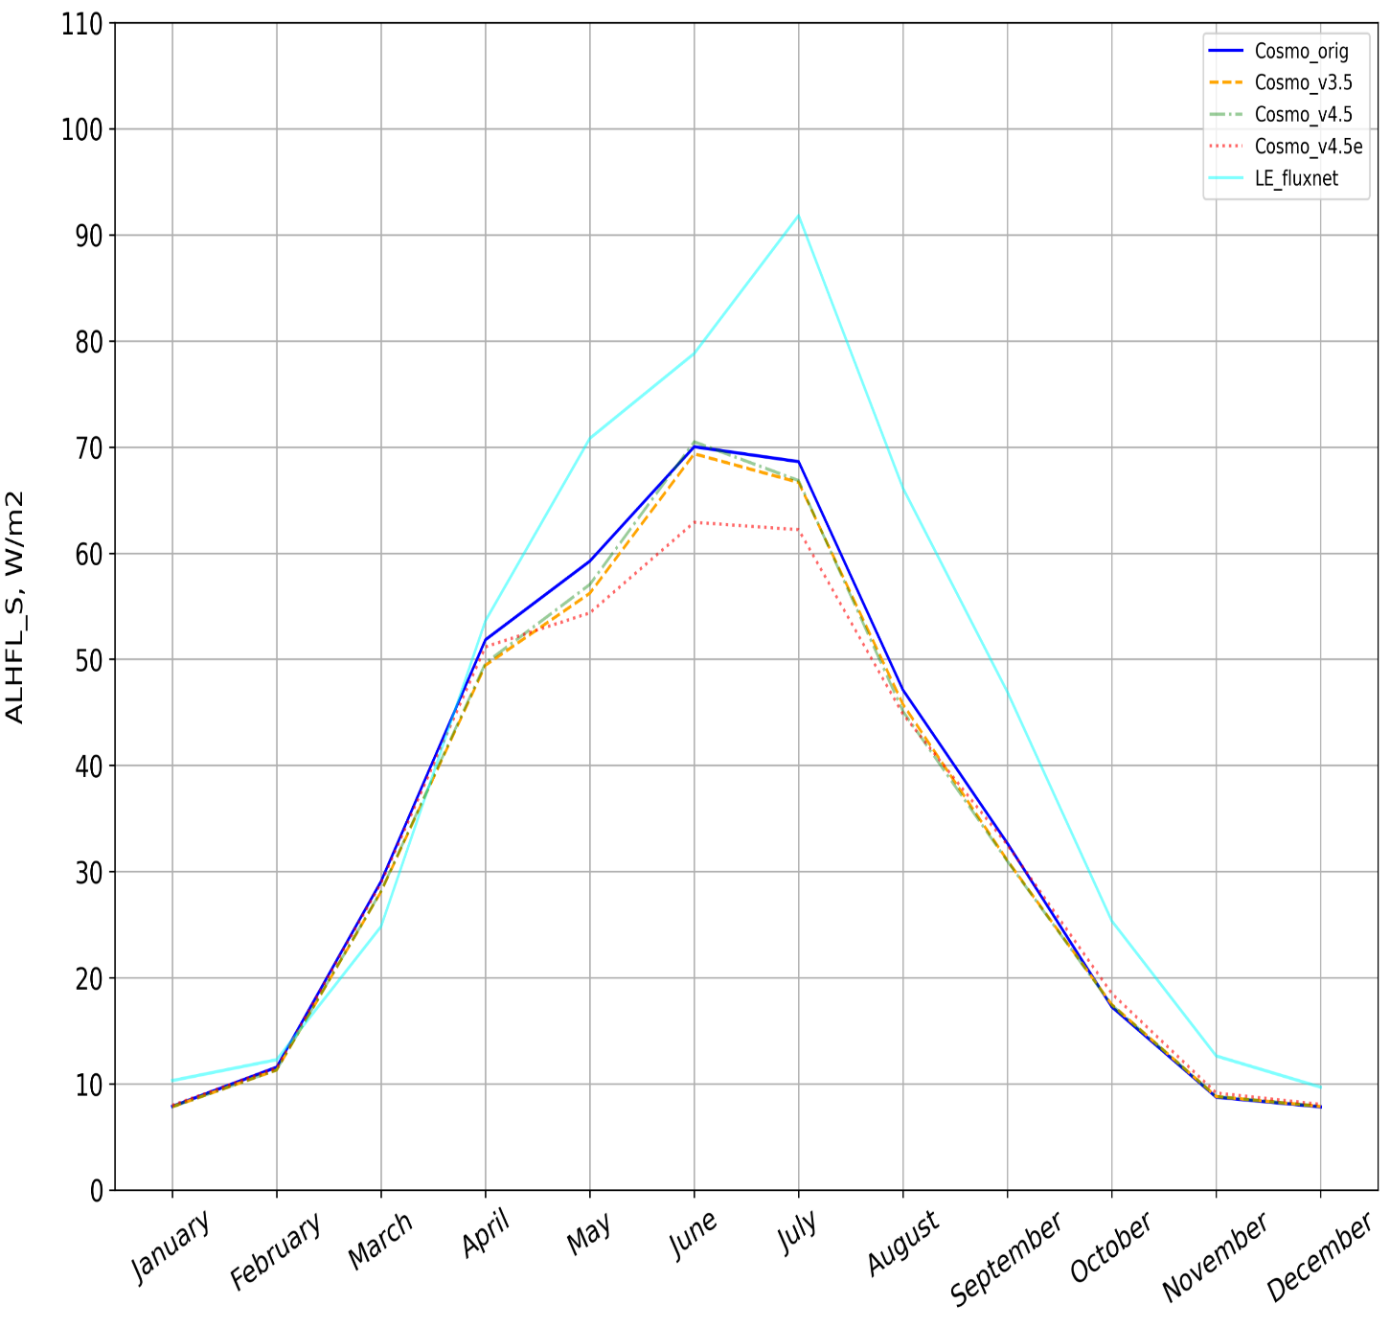
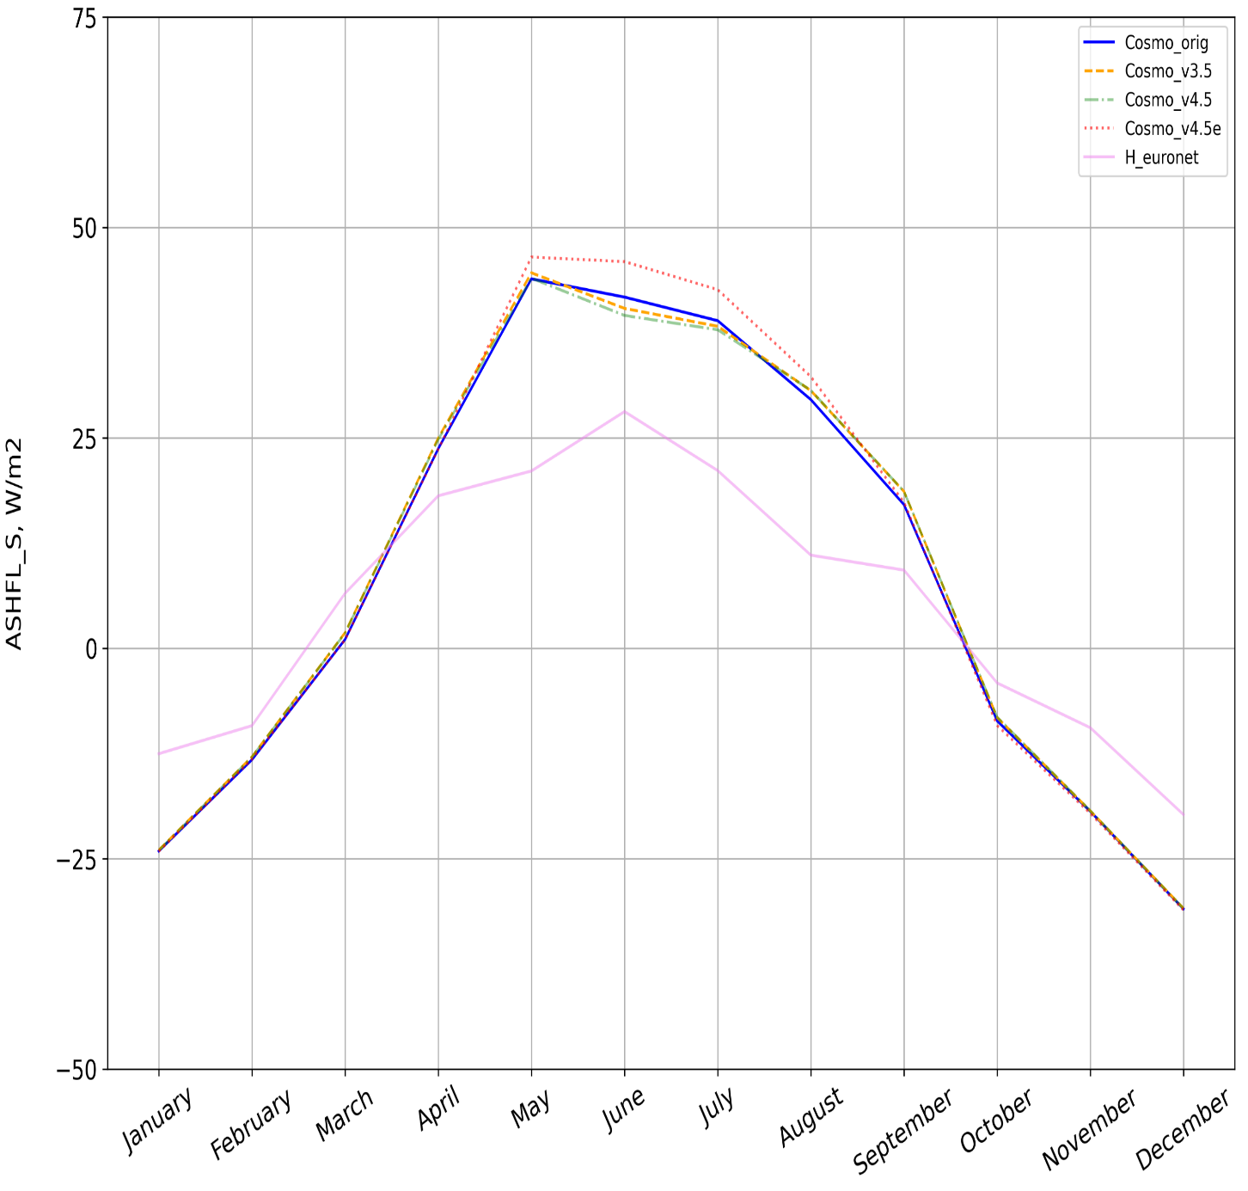
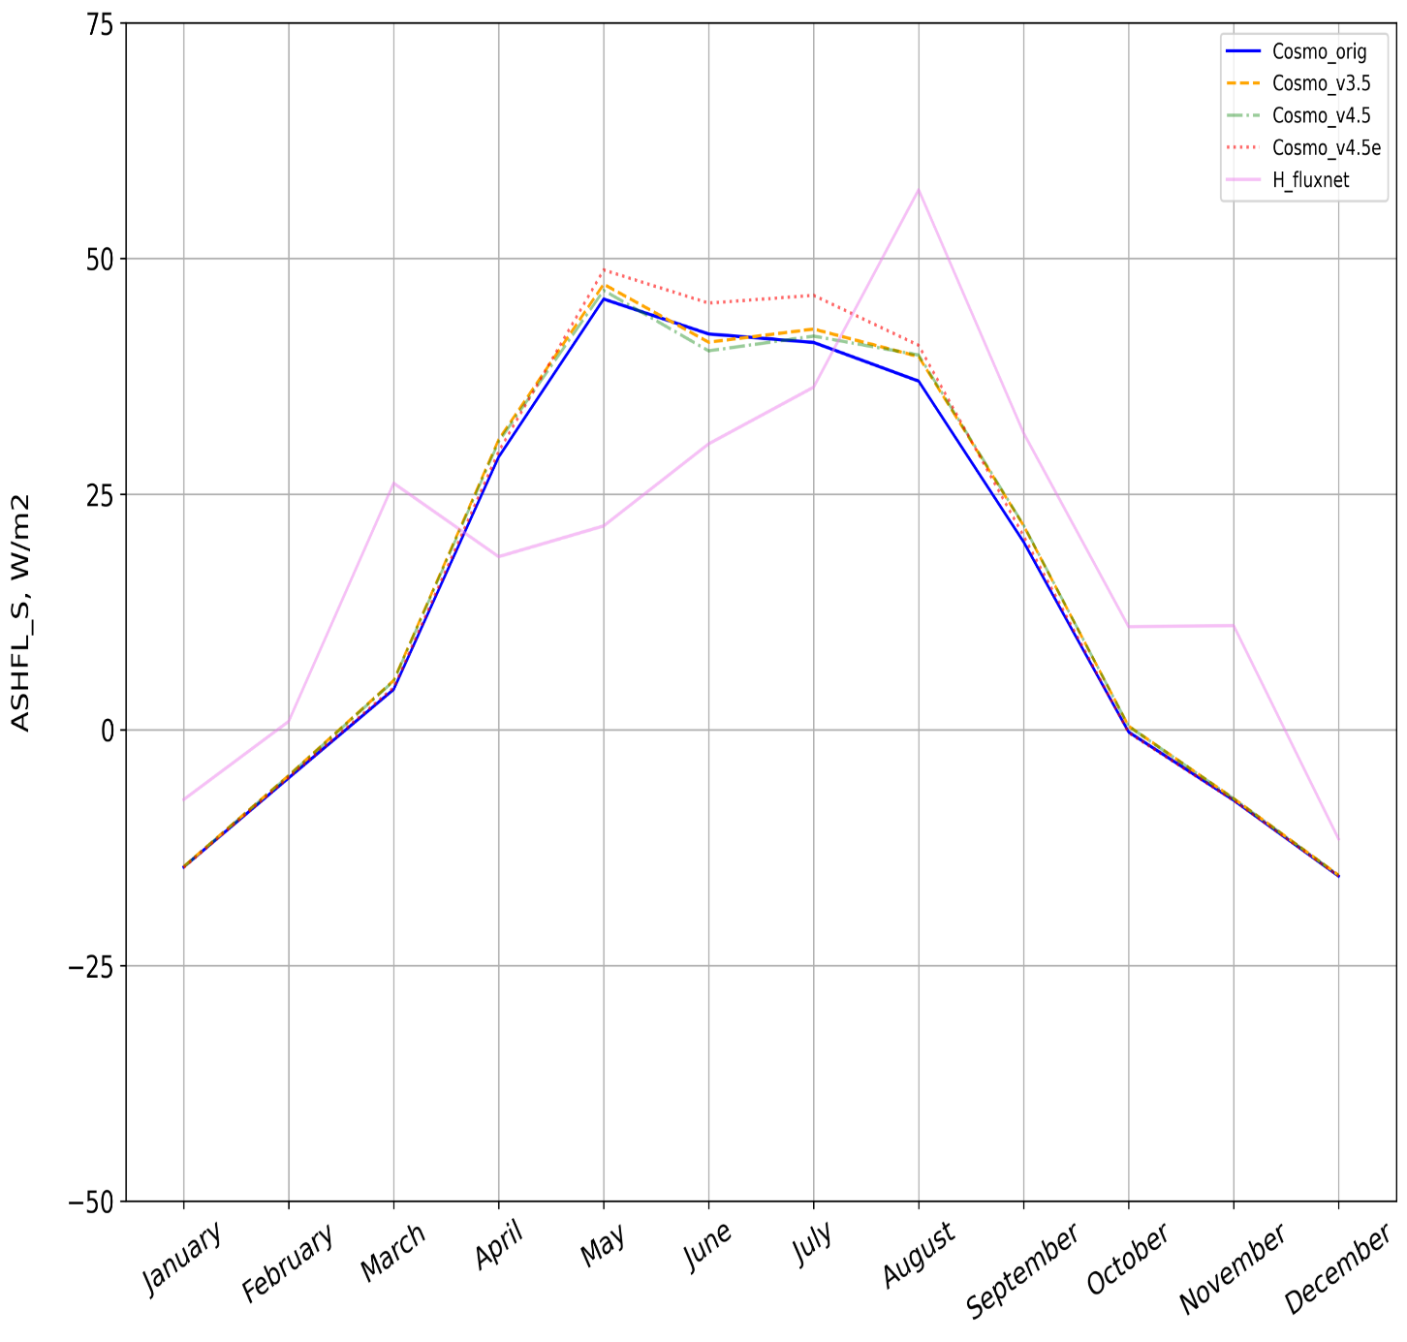
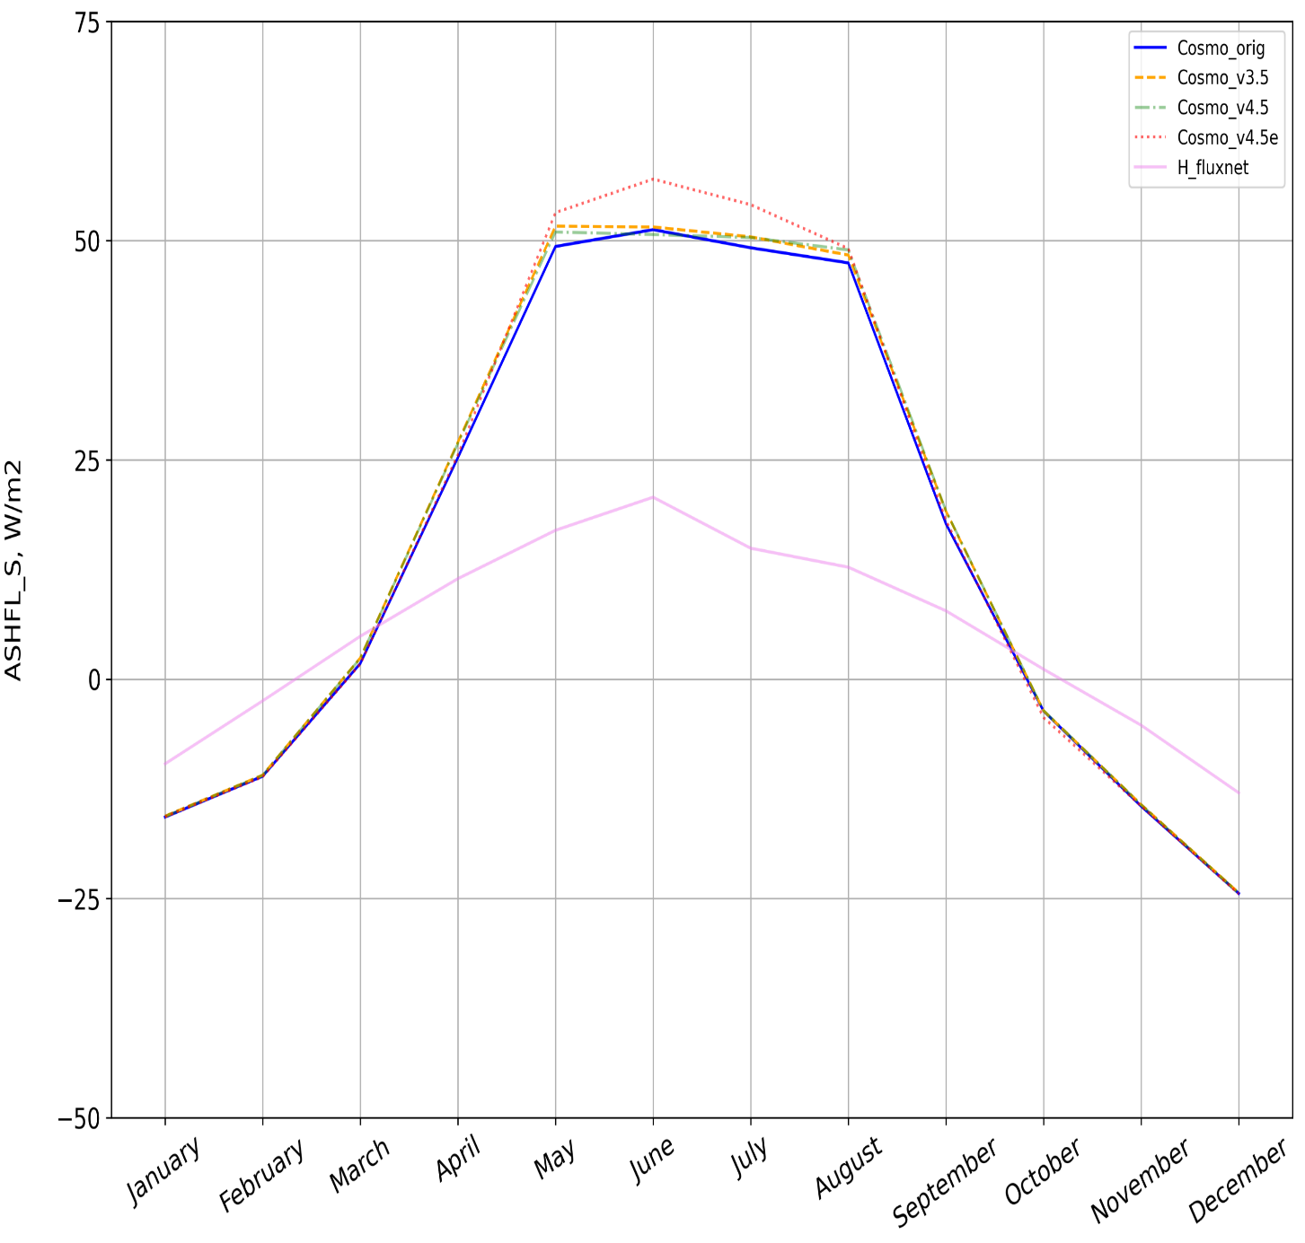
Average latent (a) and sensible (b) heat fluxes
a)
I
II
III
b)
I
II
III
COSMO_orig
COSMO_v3.5
COSMO_v4.5
COSMO_v4.5e
IN-SITU data
I – Parc, II – Linden, III – Lindenberg

Slide 13
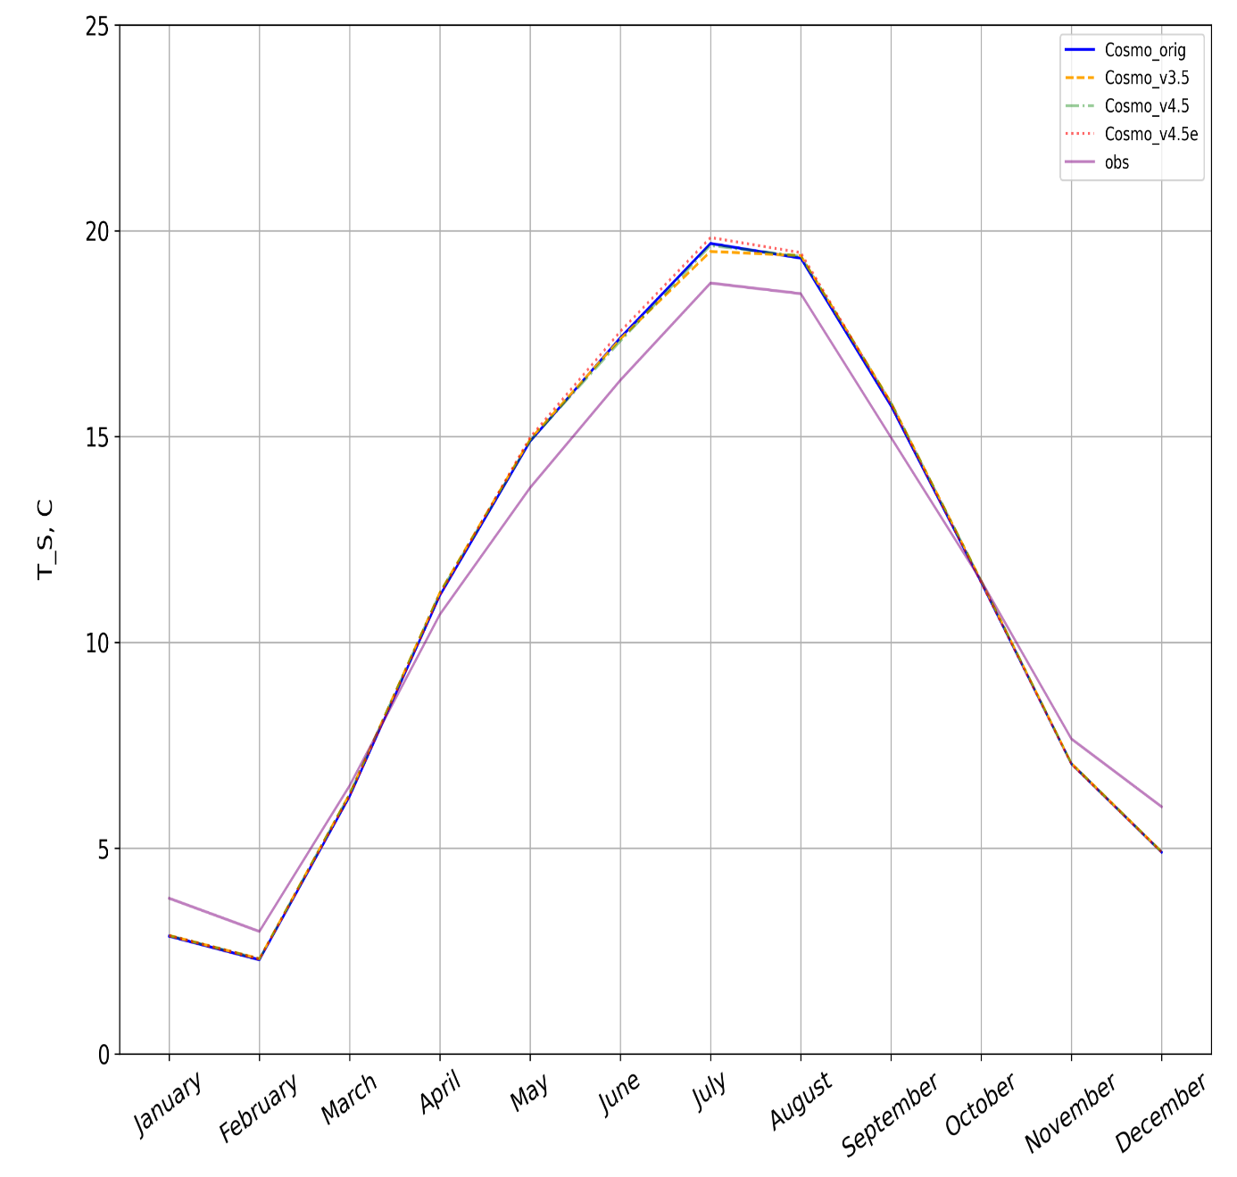
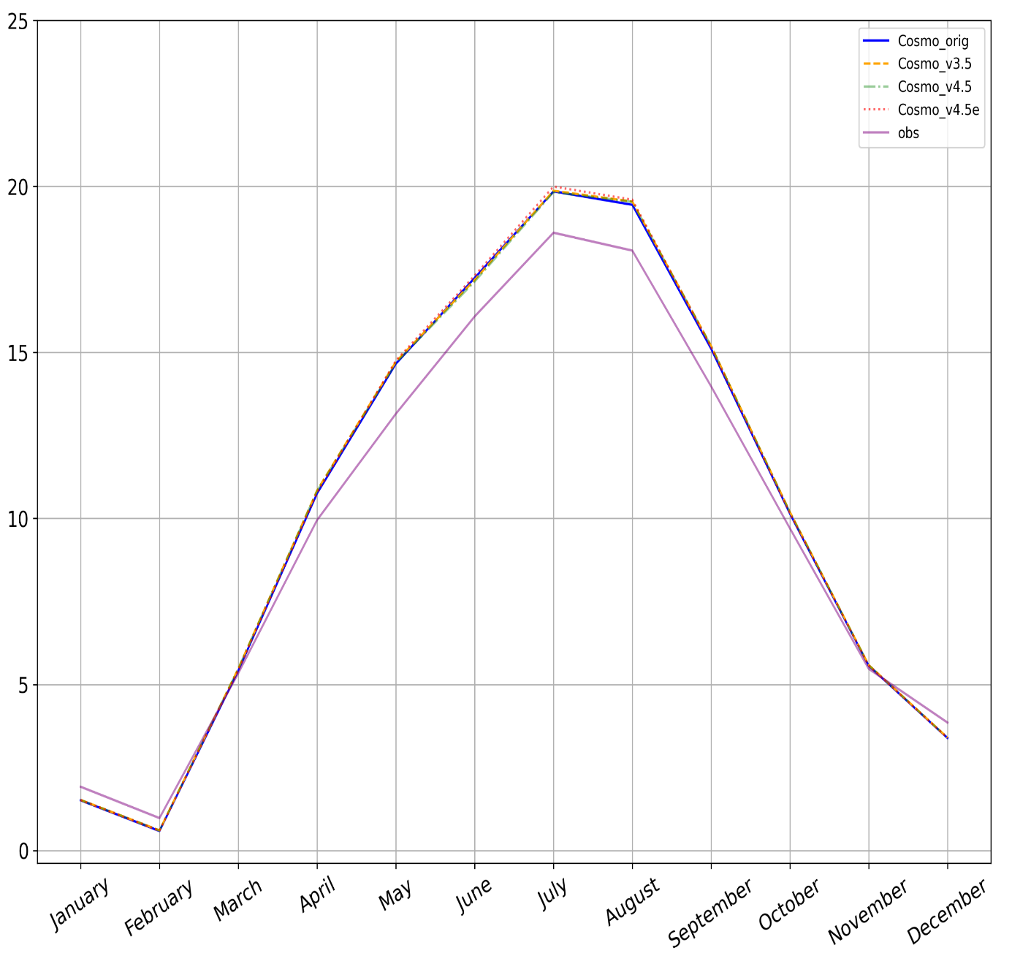
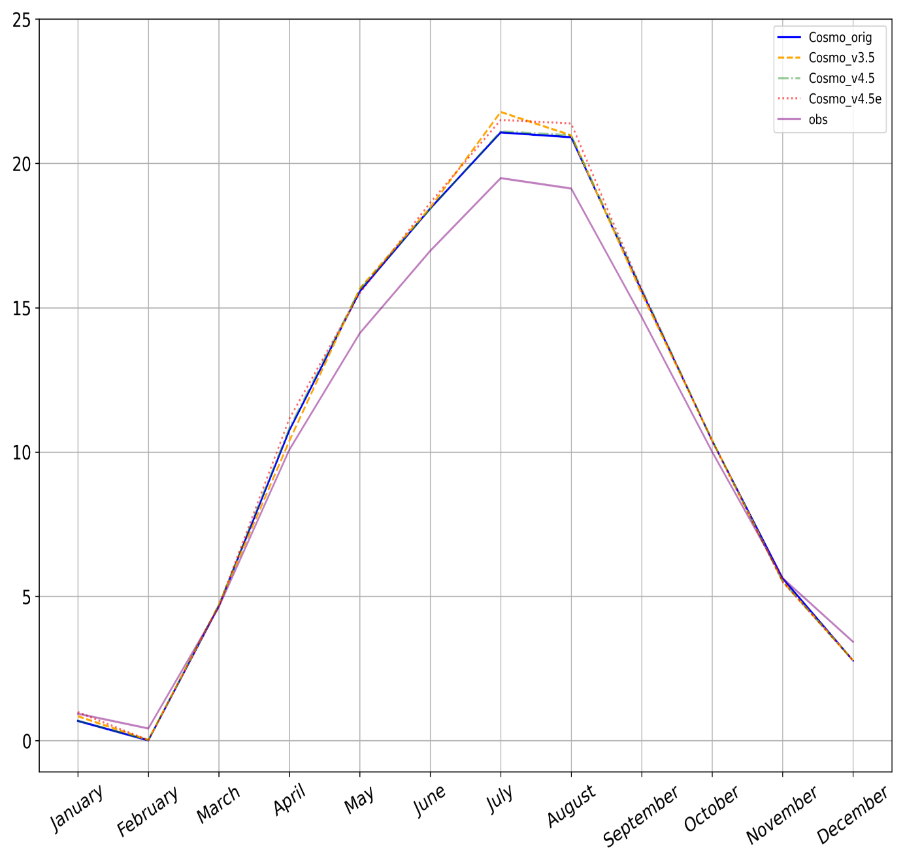
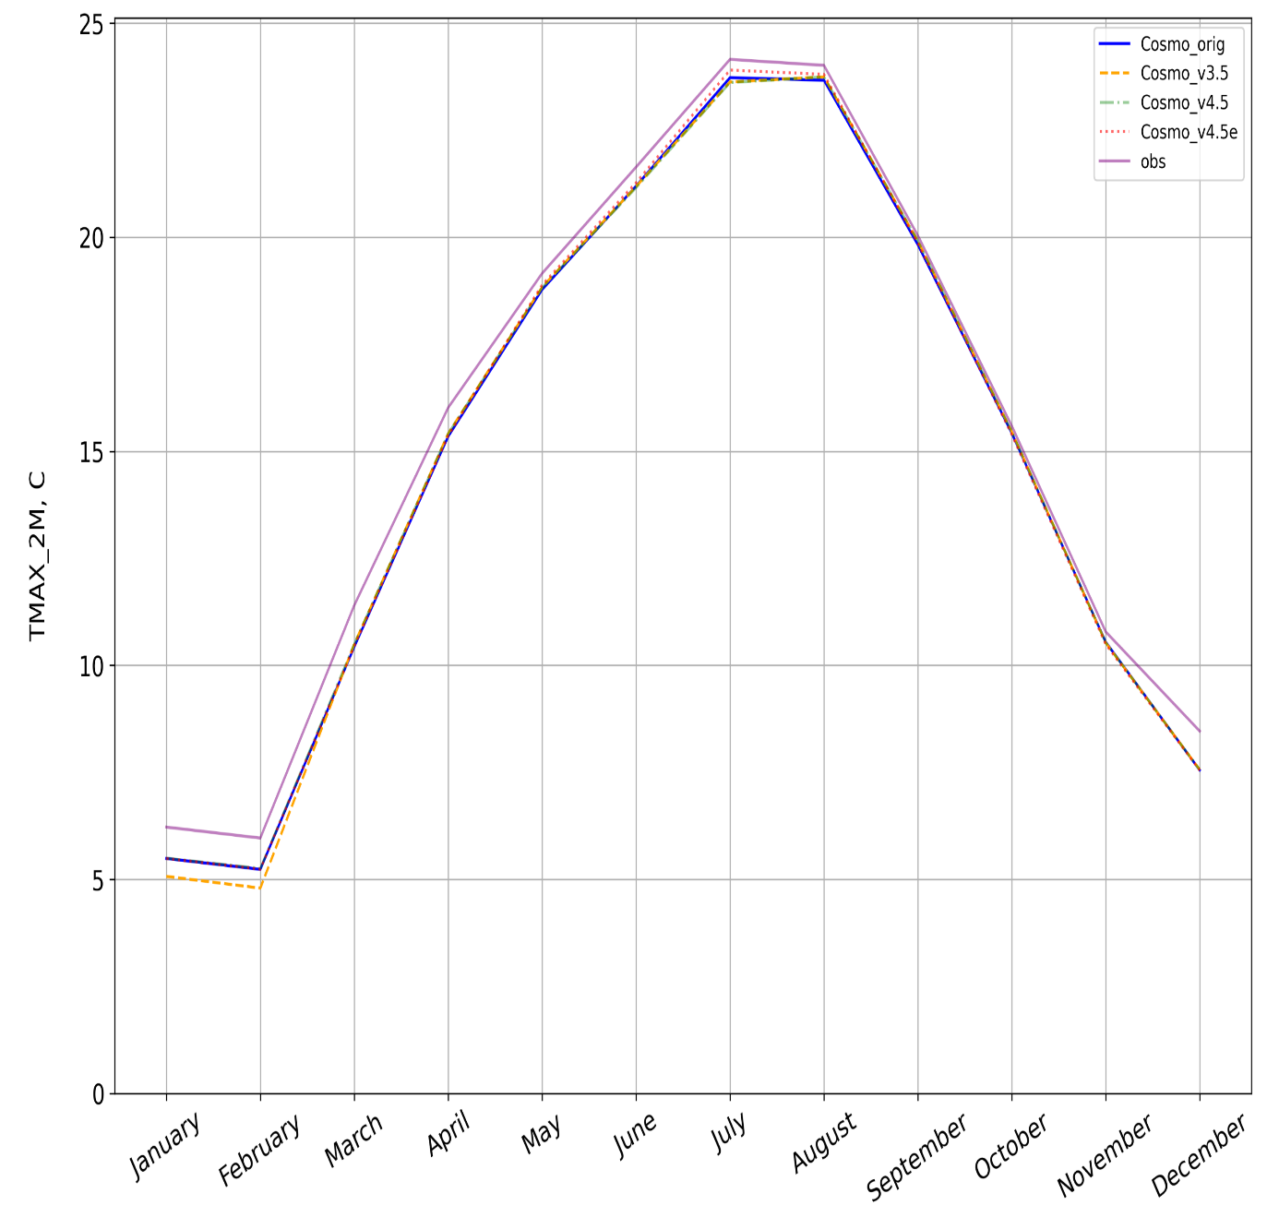
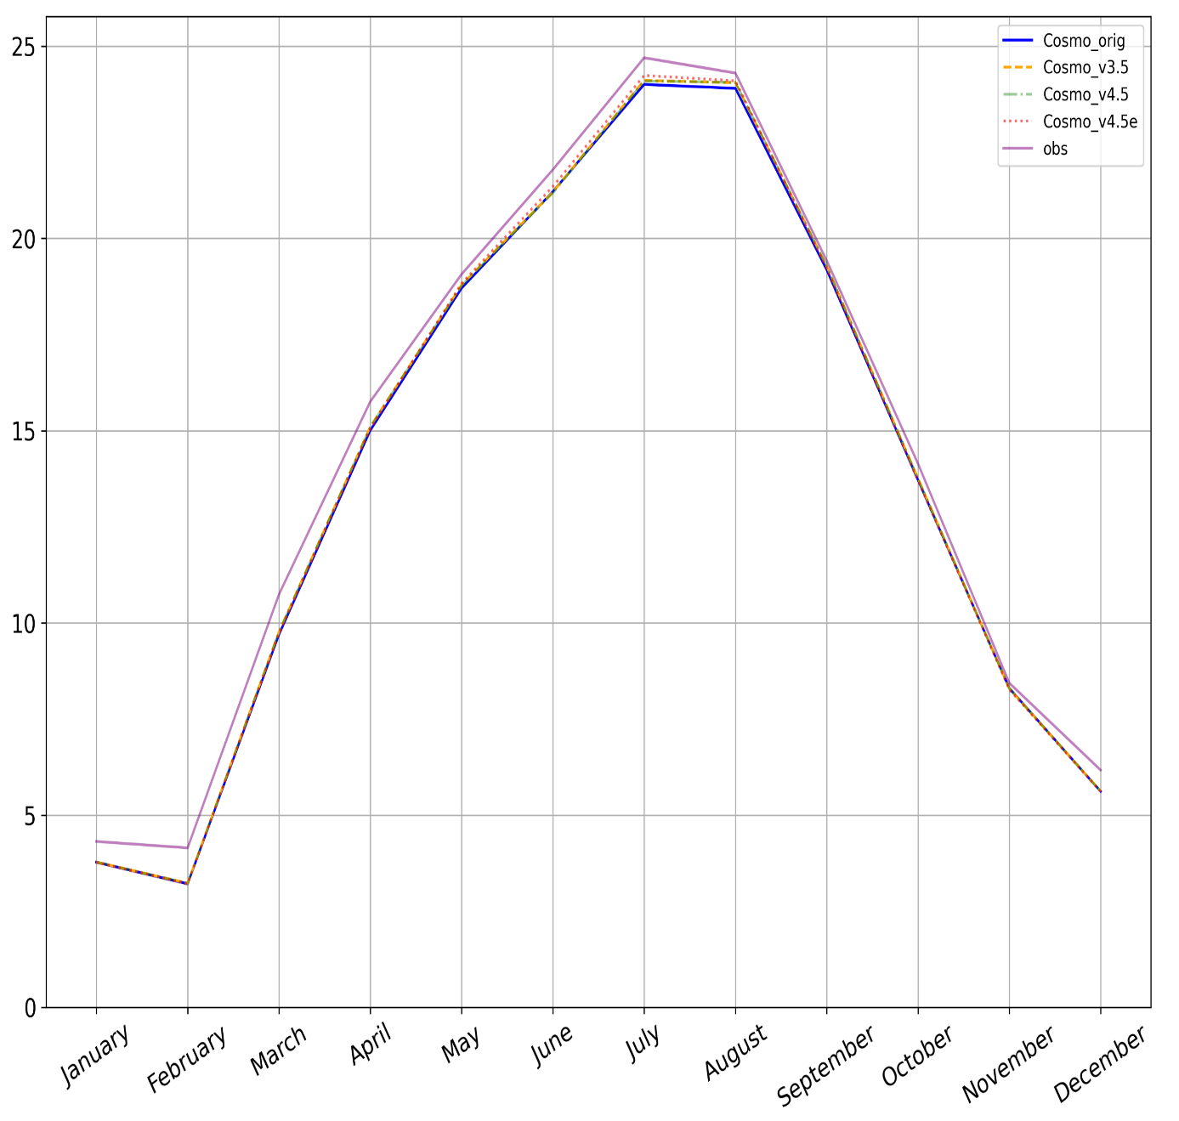
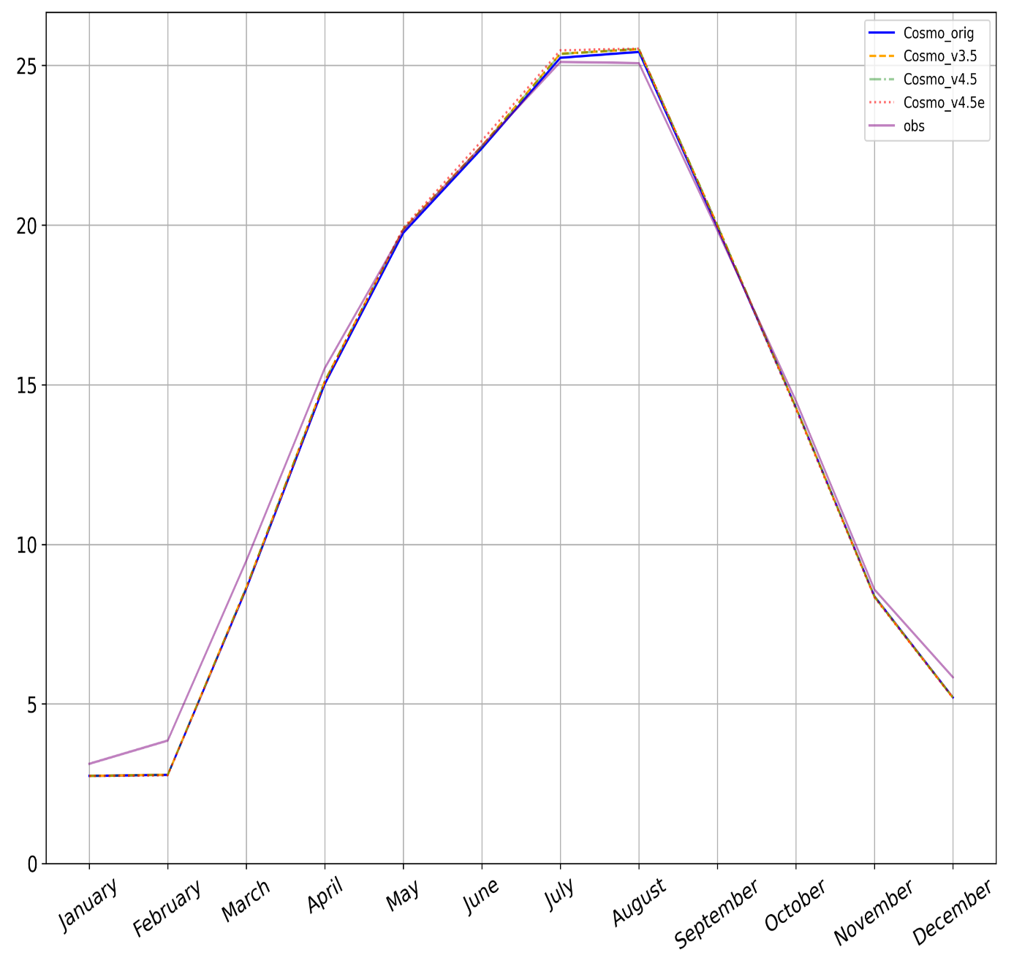
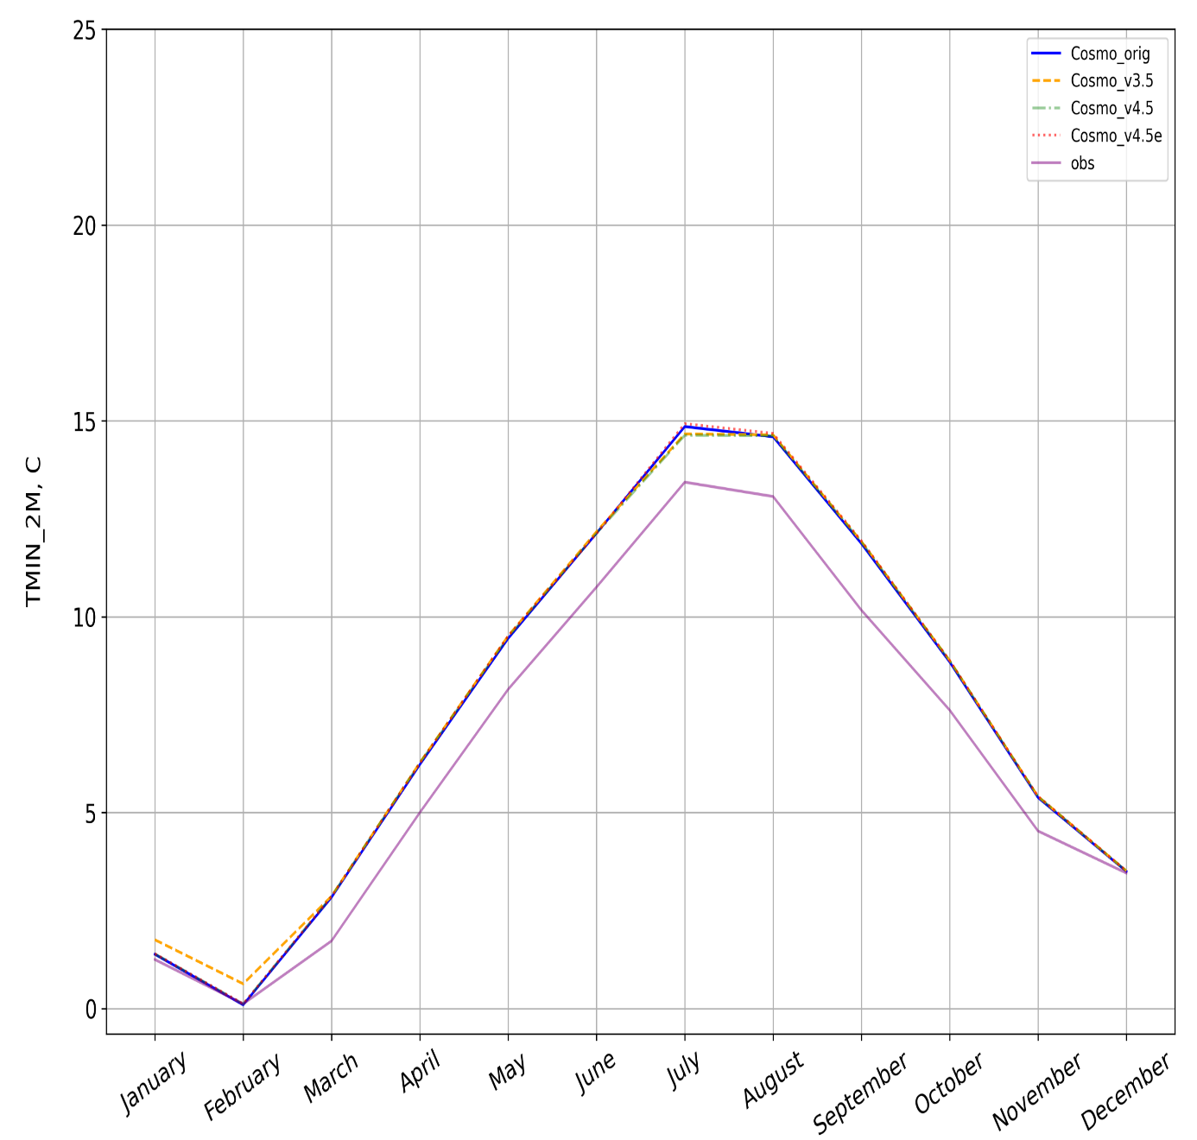
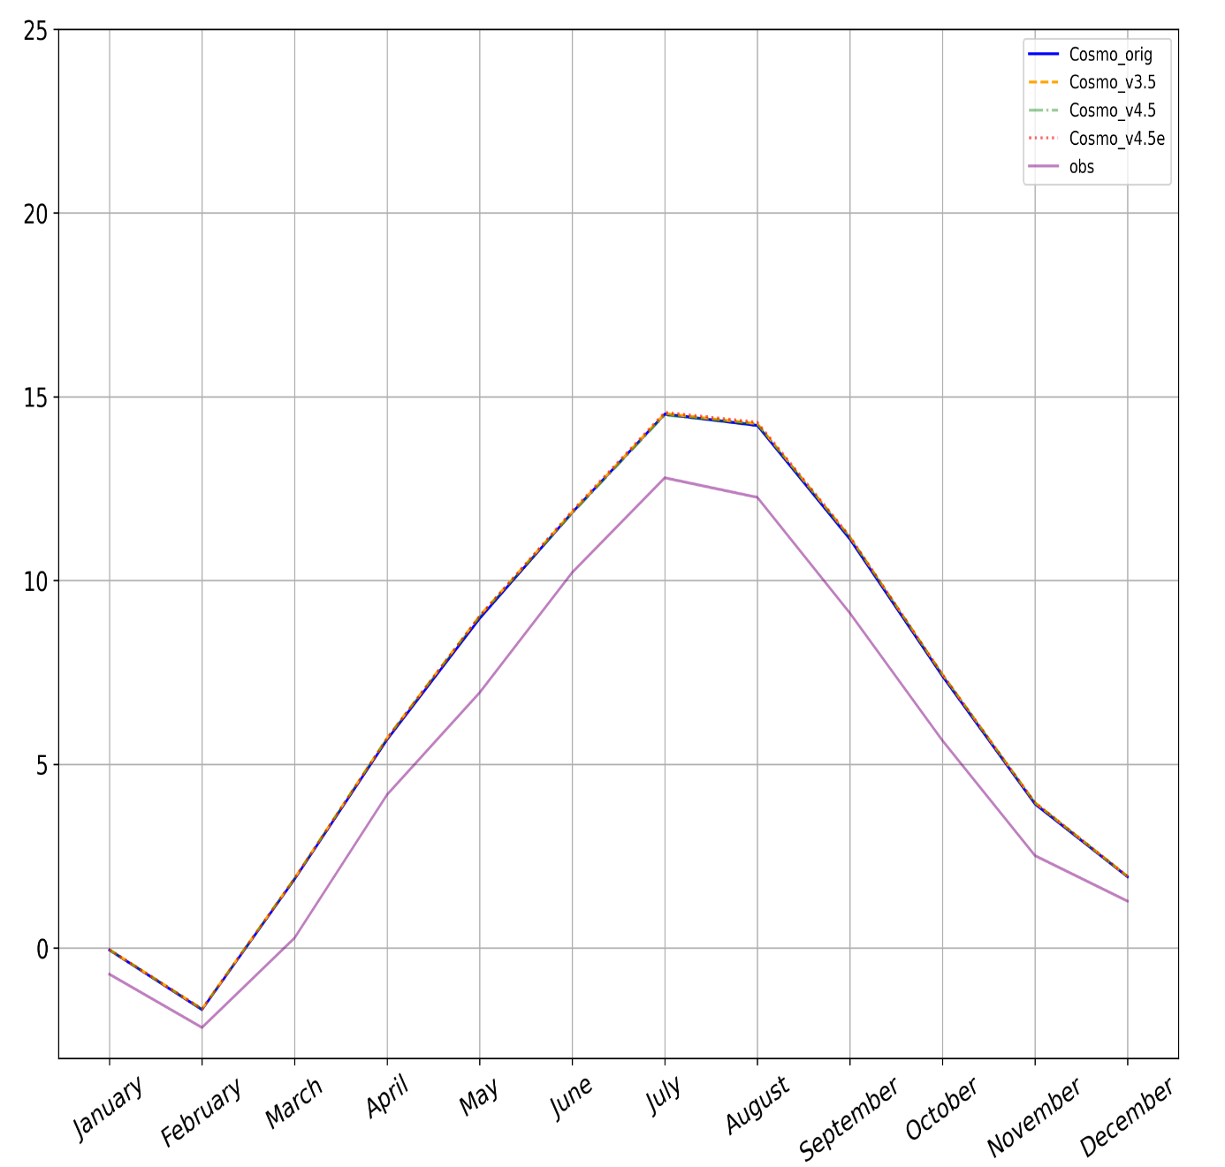
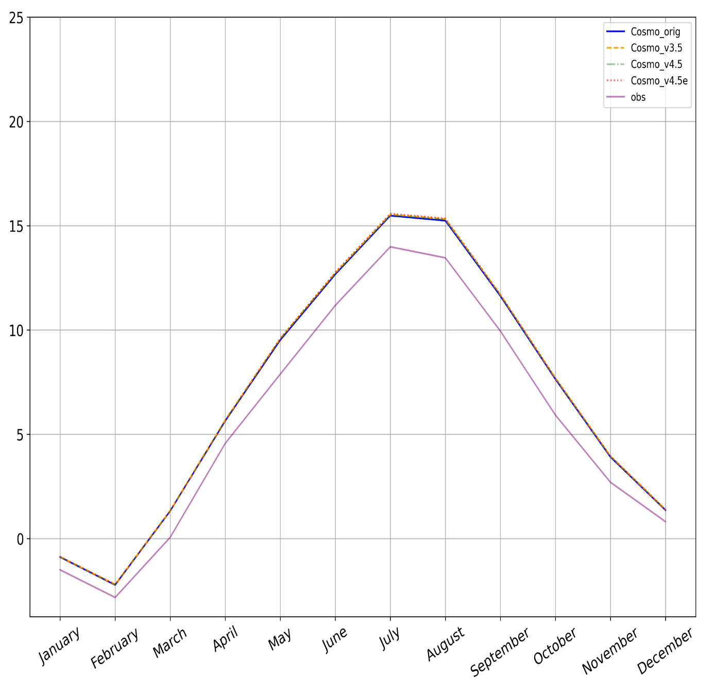
Surface (T_{S}), maximum (T_{max}) and minimum (T_{min}) temperatures
a)
I
II
III
b)
I
II
III
c)
I
II
III
COSMO_orig
COSMO_v3.5
COSMO_v4.5
COSMO_v4.5e
IN-SITU data
I – Parc, II – Linden, III – Lindenberg

Slide 14
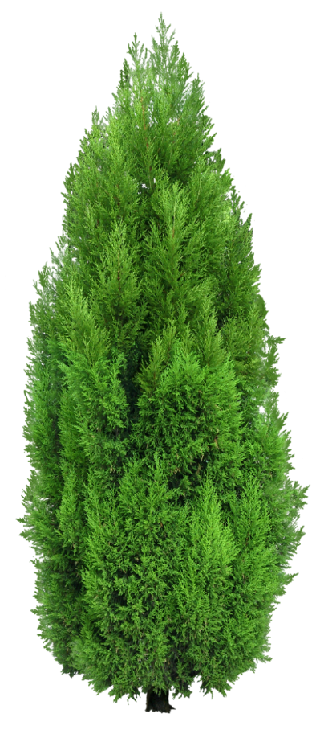
Conclusions
This study presents the first steps for updating the phenological cycle algorithms of COSMO based on Ball and Berry approach for stomatal conductance, instead of Jarvis approach
This research demonstrates upgrading results and comparison with original COSMO-CLM results, in-situ data and reanalysis data for the territory of Germany with the similar types of plants.
The research demonstrates the results of the implementation of a new module related to the photosynthesis algorithms based on Farquhar (for C₃ grass) and Collatz (for C₄) models.
The results are promising and suggest a positive tendency for increasing the accuracy of COSMO-CLM calculations.

Slide 15
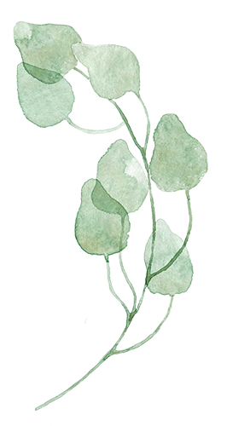
Our contacts:
GitHub page: https://github.com/users/merajtoelle/projects/1
Address: Universität Kassel - CESR
Wilhelmshöher Allee 47, 34117 Kassel
Email: evgenychur@uni-kassel.de

