Slide 1
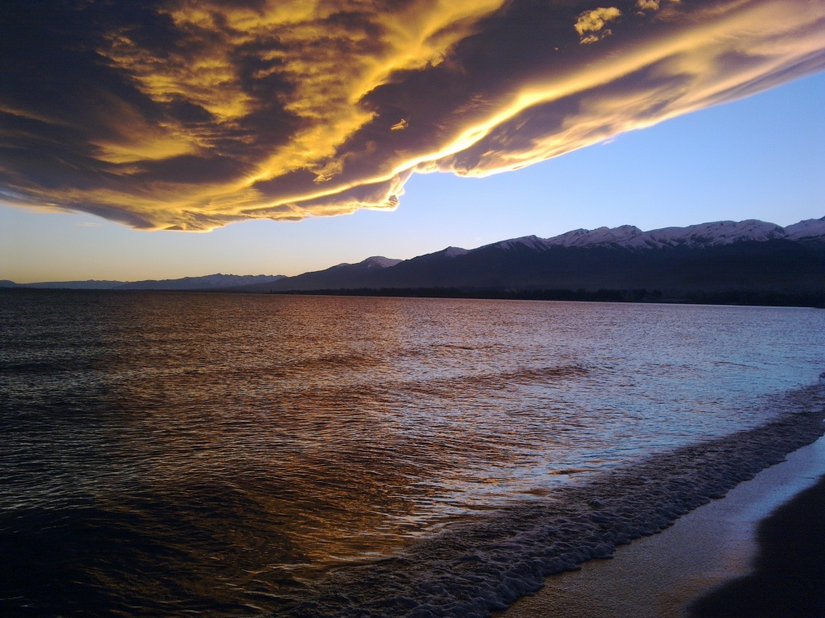
Regime of the strong paleo- and historical earthquakes in the Issyk-Kul Lake depression, Northern Tien Shan
Andrey M. Korzhenkov 1, Lyubov’ A. Korzhenkova 2, Jiao Liu 3, Jun Shen 4
1 Schmidt Institute of Physics of the Earth, Russian Academy of Sciences, Moscow
2 Sergeev Institute of Geoecology, Russian Academy of Sciences. Moscow
3 Institute of Geology, China Earthquake Administration, Beijing
4 Institute of Disaster Prevention, Sanhe City, Hebei Province

Slide 2
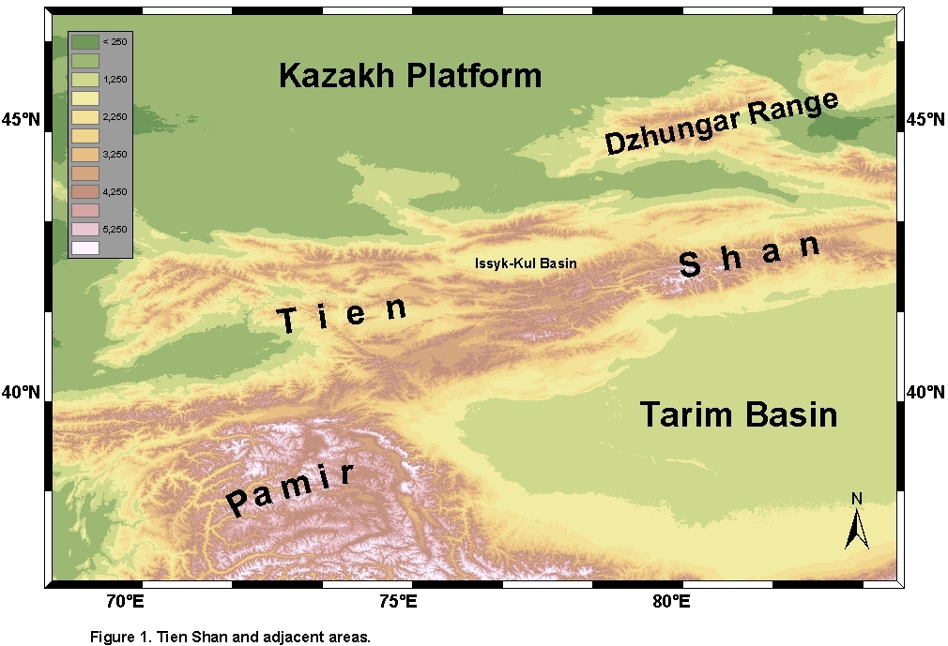

Slide 3
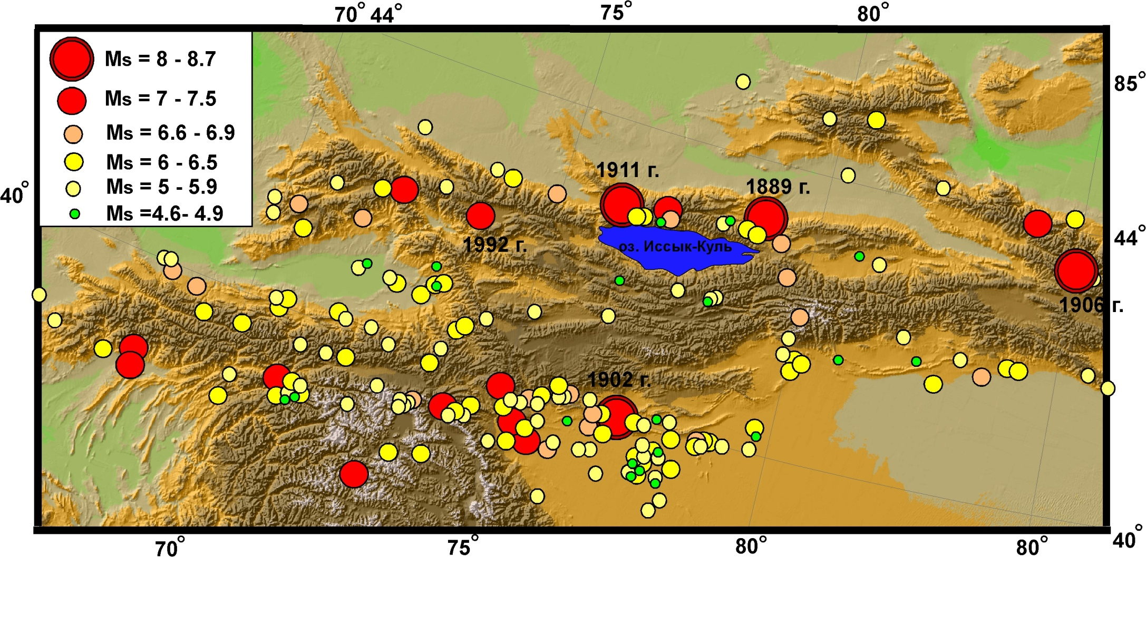
Digital map of western part of the Tien Shan mountains.
Circles show known seismicity

Slide 4
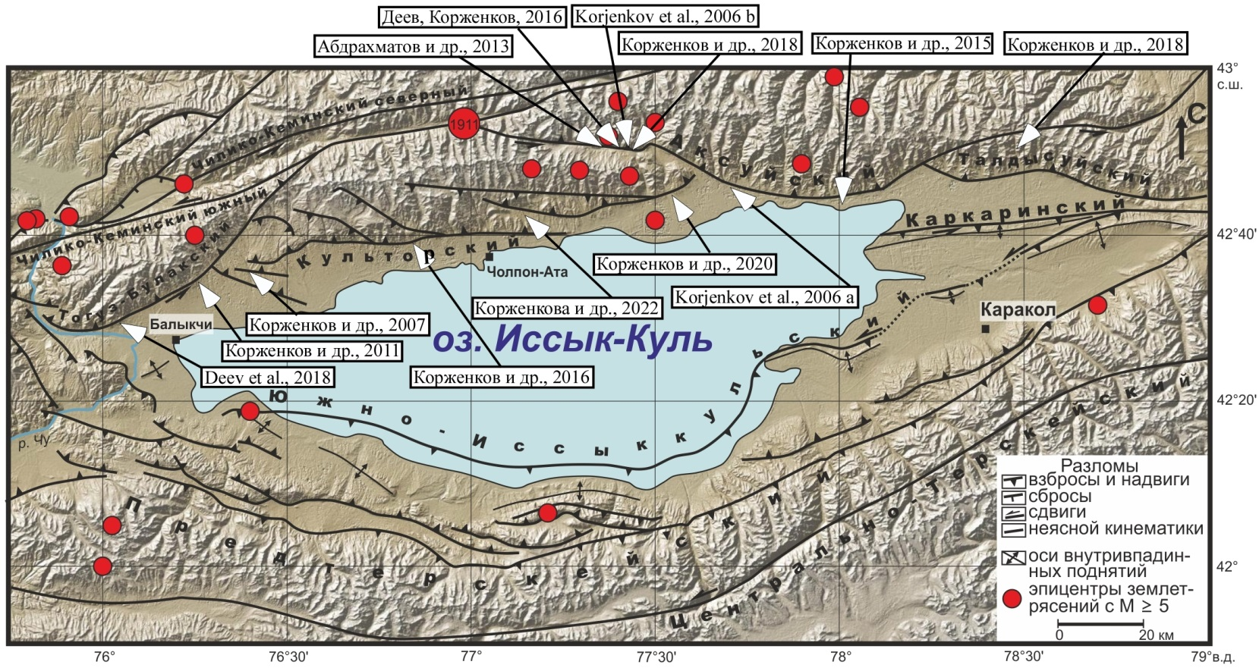
Main active structures of the Issyk-Kul Lake region.
Arrows show places of trenches and pits. In rectangles there are references where is a description of trenches and pits.

Slide 5
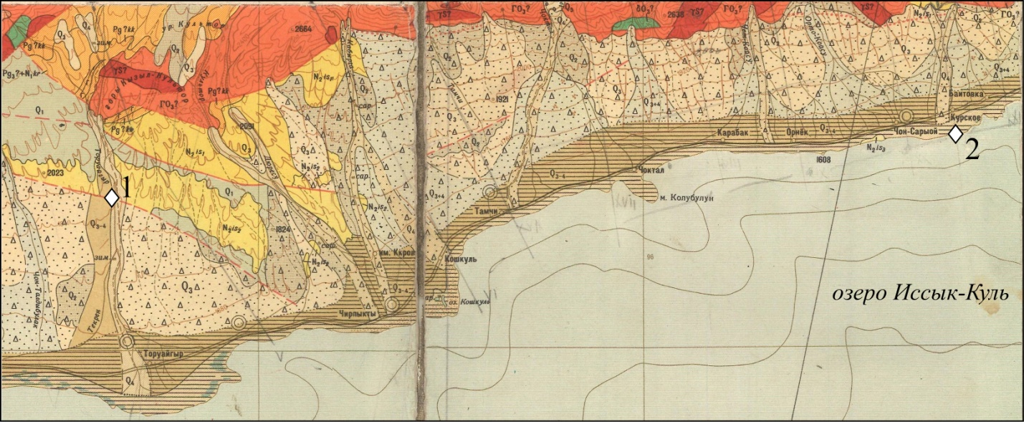
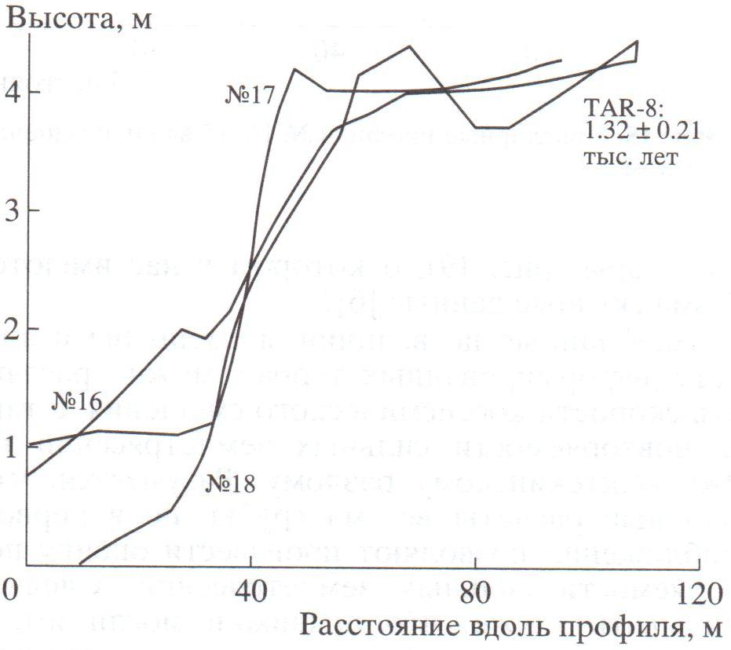
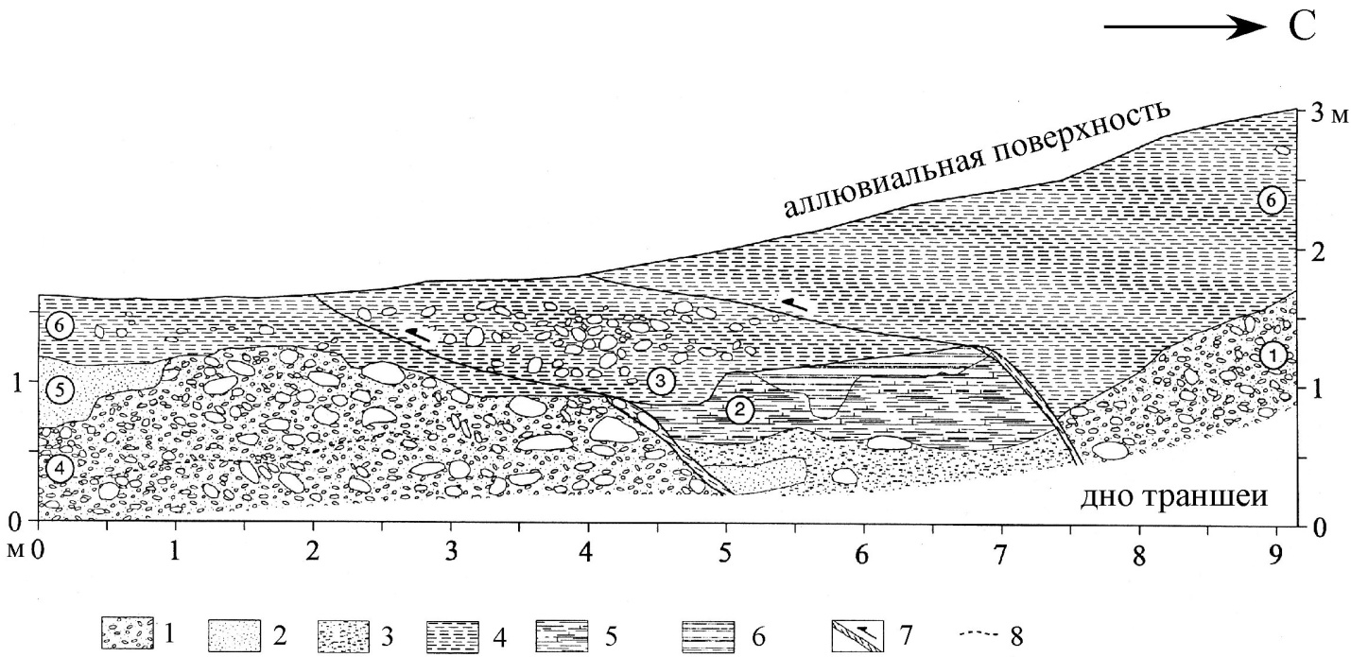
Fragment of geological map of 1:200 000 scale of NW of the Issyk-Kul Lake region
(modified after [Помазков, 1962]).
By shades of red and green colors there are shown Paleozoic rocks. Orange and yellow colors – Paleogene and Neogene deposits consequently. By shades of grey color are shown Quaternary deposits. Rhombs show places of our study: 1 – Southern Ak-Teke fault, 2 – submerged fortress of The Emyr Timur.
Detailed image of
the Southern Ak-Teke fault
(after [Korzhenkov et al., 2007]).
1 – pebbles; 2 – sand; 3 – loam; 4, 5 – clay: 4 – brown, 5 – white; 6 – organic material; 7 – rupture zone; 8 – hardened interlayers

Slide 6
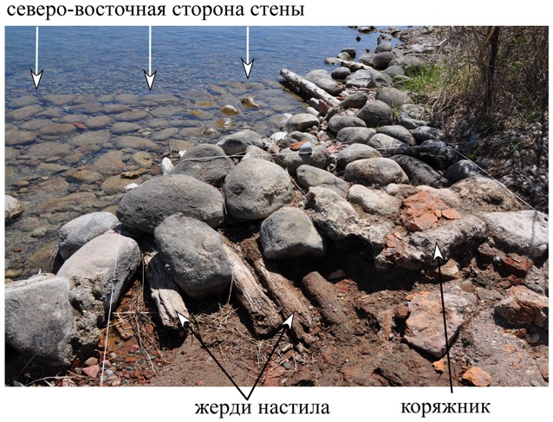
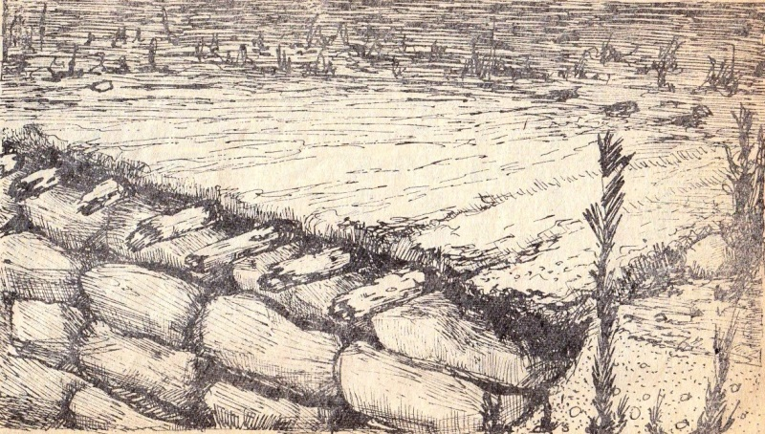
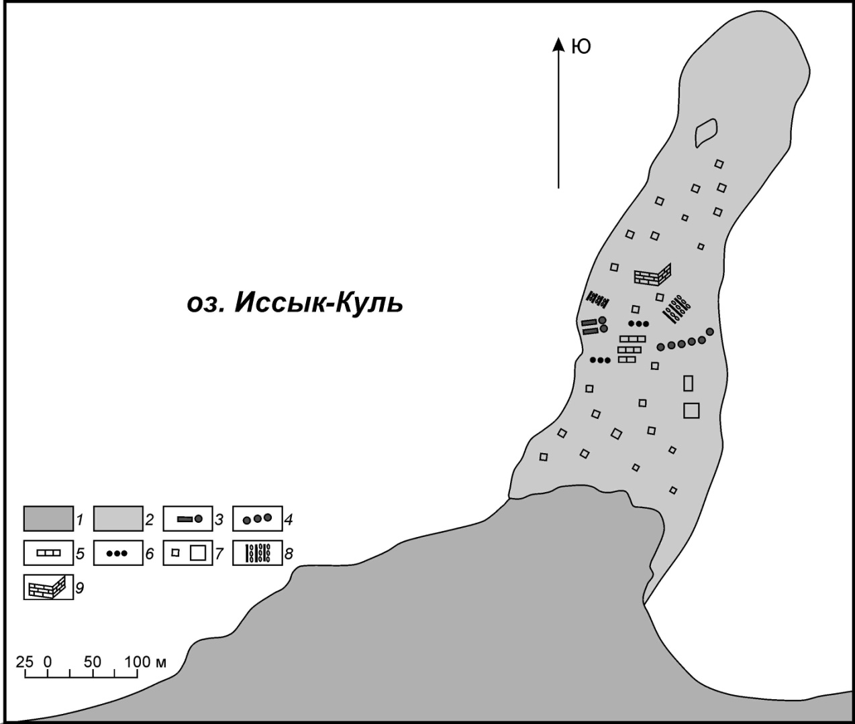
Study of underwater constructions near Kurskoe village.
Age of the logs – end of 14 century-beginning of 15 century
Our surface photograph of the eastern wall discovered by D.F. Vinnik group in 1959 [Винник, 1961]. View toward NE. One can observe 2-meters rope markup of recent archeological excavation
Plan of underwater shoal existed in 1959 г. (modified after [Винник, 1961] ).
1 – coast, 2 – underwater shoal , 3 – log decking, 4 – the hedge, 5 – walls remnants, 6 – walls basements, 7 – groups of scattered bricks, 8 – stone paving, 9 – building.

Slide 7
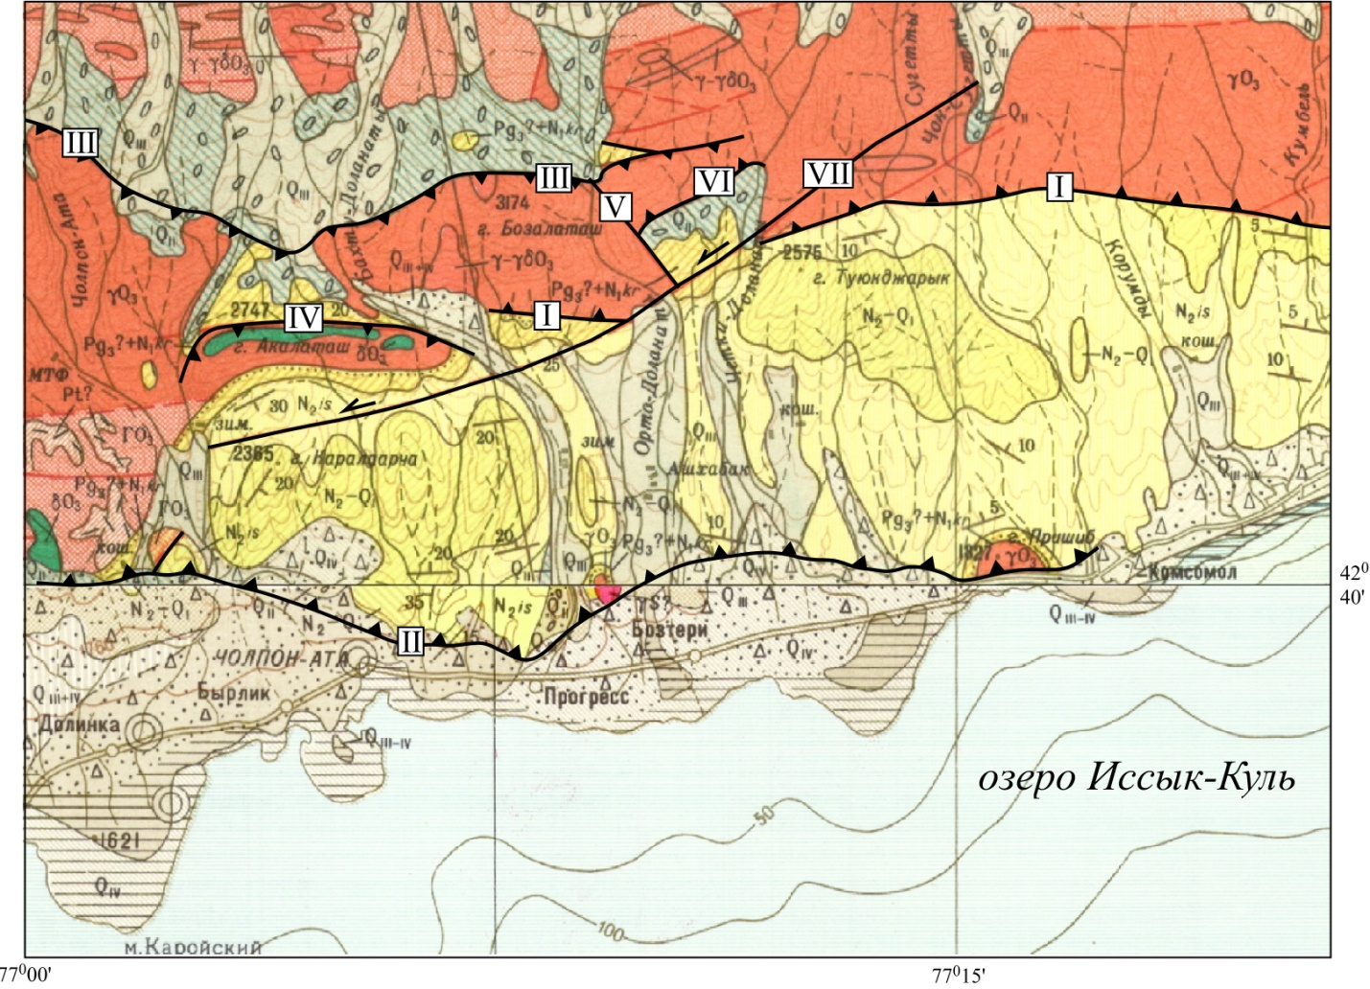
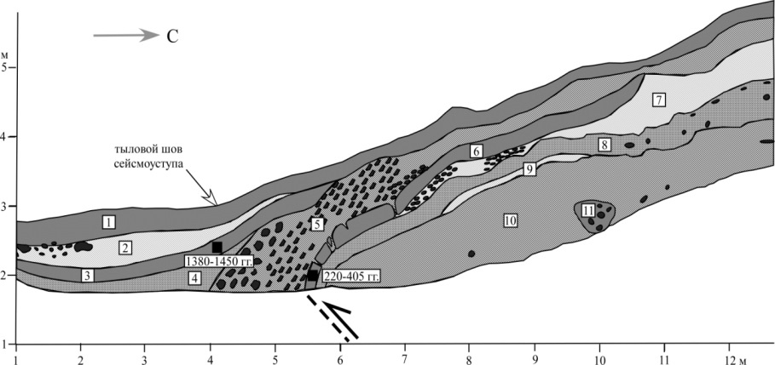
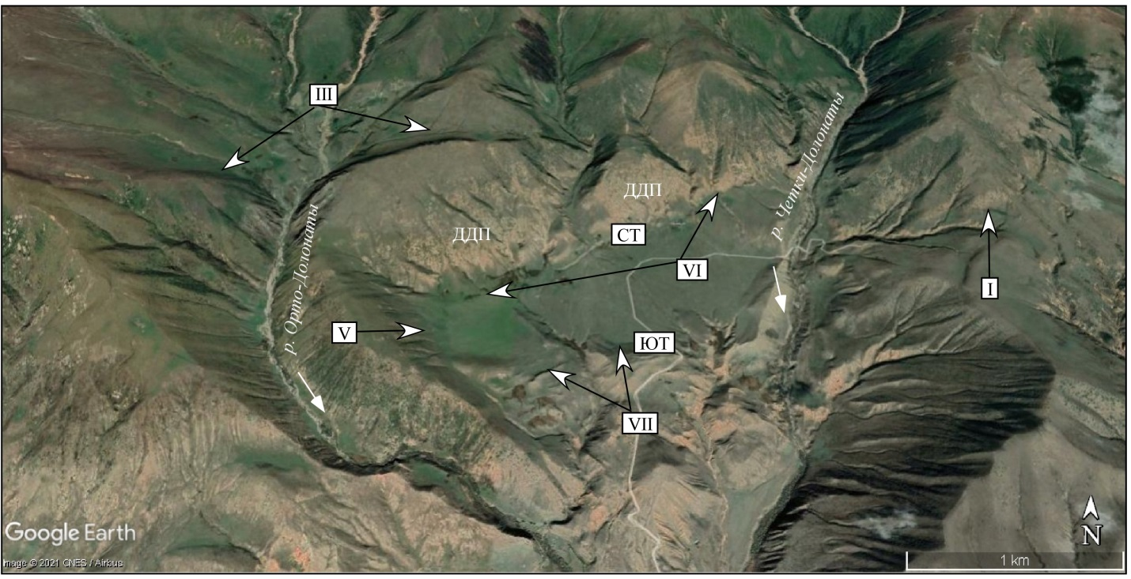
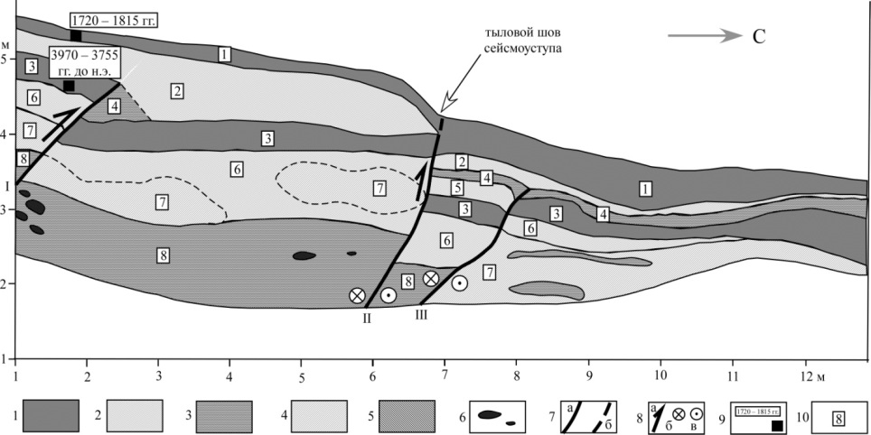
Paleoseismological study in the Cholpon-Ata – Korumdu interfluve
[Korzhenkova et al., 2022]
(upward – northern trench, downward – southern trench)

Slide 8
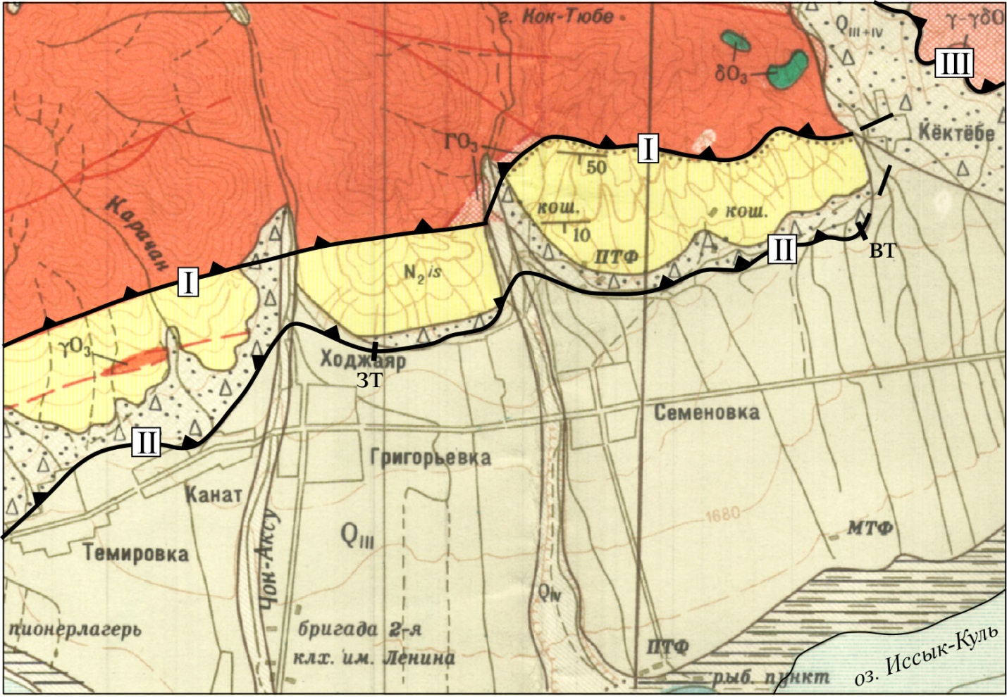
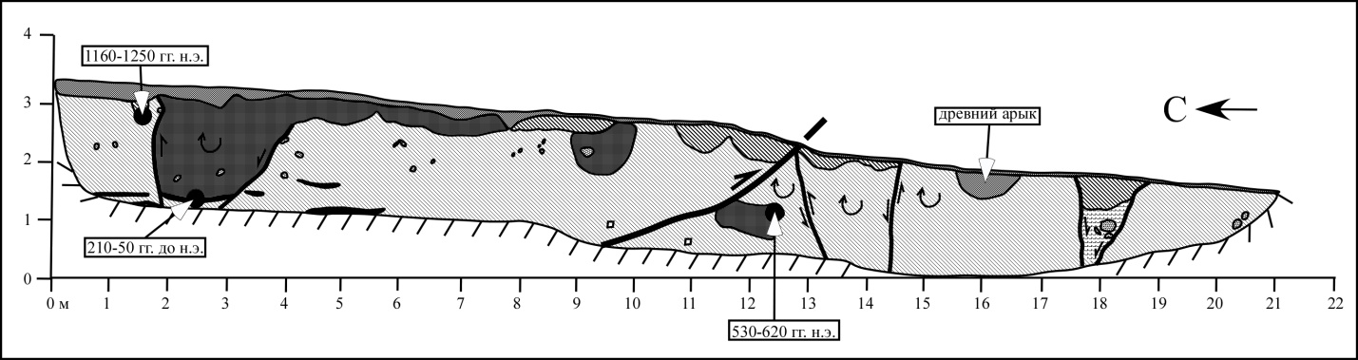
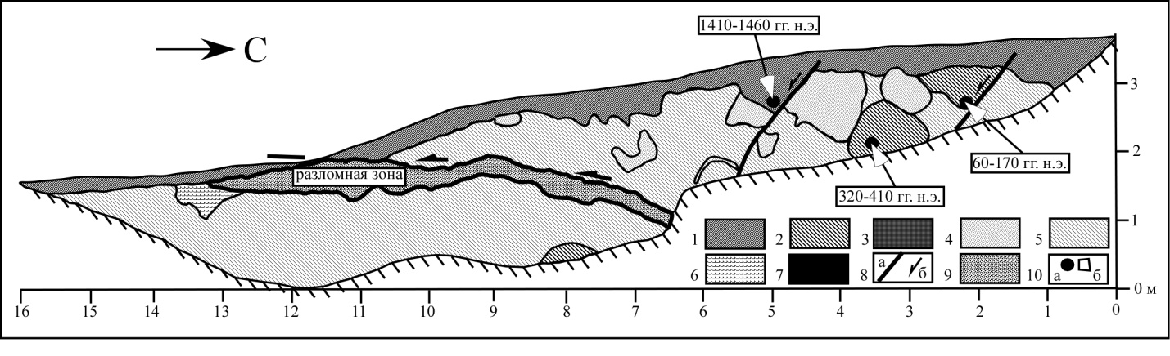
Dating of the ancient earthquakes along the eastern termination of the Kultor fault zone (I – Kultor border fault, II – Kultor adyr fault, III – Aksuu border fault)
Downward:
Paleoseismological trenches excavated across the fault scarps along the Kultor adyr fault [Korzhenkov et al., , 2020]).
1 – recent soil, 2 – red paleo-soil, 3 – brown paleo-soil, 4 – sandy loam, 5 – loess-like loam, 6 - rubble-gruss deposits, 7 – black paleosoil, 8 – seismogenic ruptures(а - planes, б – direction of shifting), 9 – loose deposits (granules, gruss), filled the fault zone, 10 – places of the samples collection (а – for C14 analysis, б - ceramics).

Slide 9
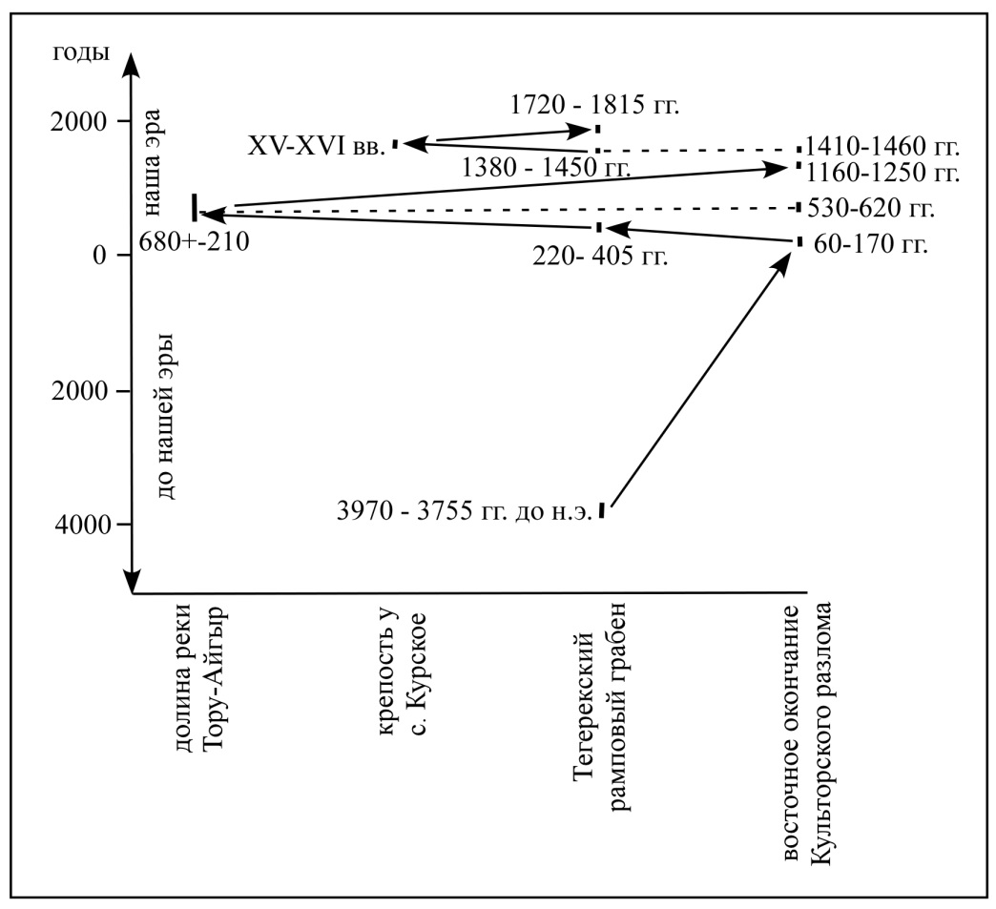
Regime of the strong Late Holocene earthquakes along the Kultor fault zone.
Schematic correlation [Korzhenkov et al., 2007; 2016; 2020; Korzhenkova et al., 2022]

Slide 10
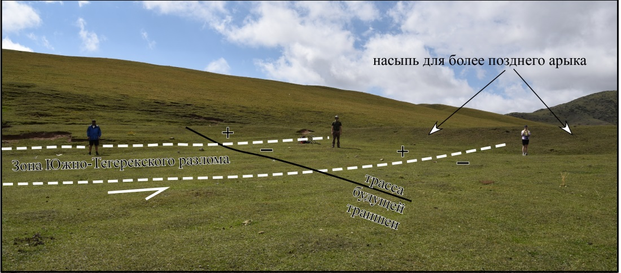
Last movement along the Southern Tegerek fault [Korzhenkova et al., 2022] occurred along the I rupture: its plane penetrates into recent soil and its thick layer is a colluvial wedge of the last - 7th seismic event. Besides, Ist rupture is marked by the rear seam of recent fault scarp of 60 cm height. We suppose that minimum age of this event is the age of our sample Vs-3102 (1720 – 1815 years AD), when after fault scarp formation it took place the stabilization of the slope in the hanging wall of the rupture and it has been started a formation or recent mountain soil.

Slide 11
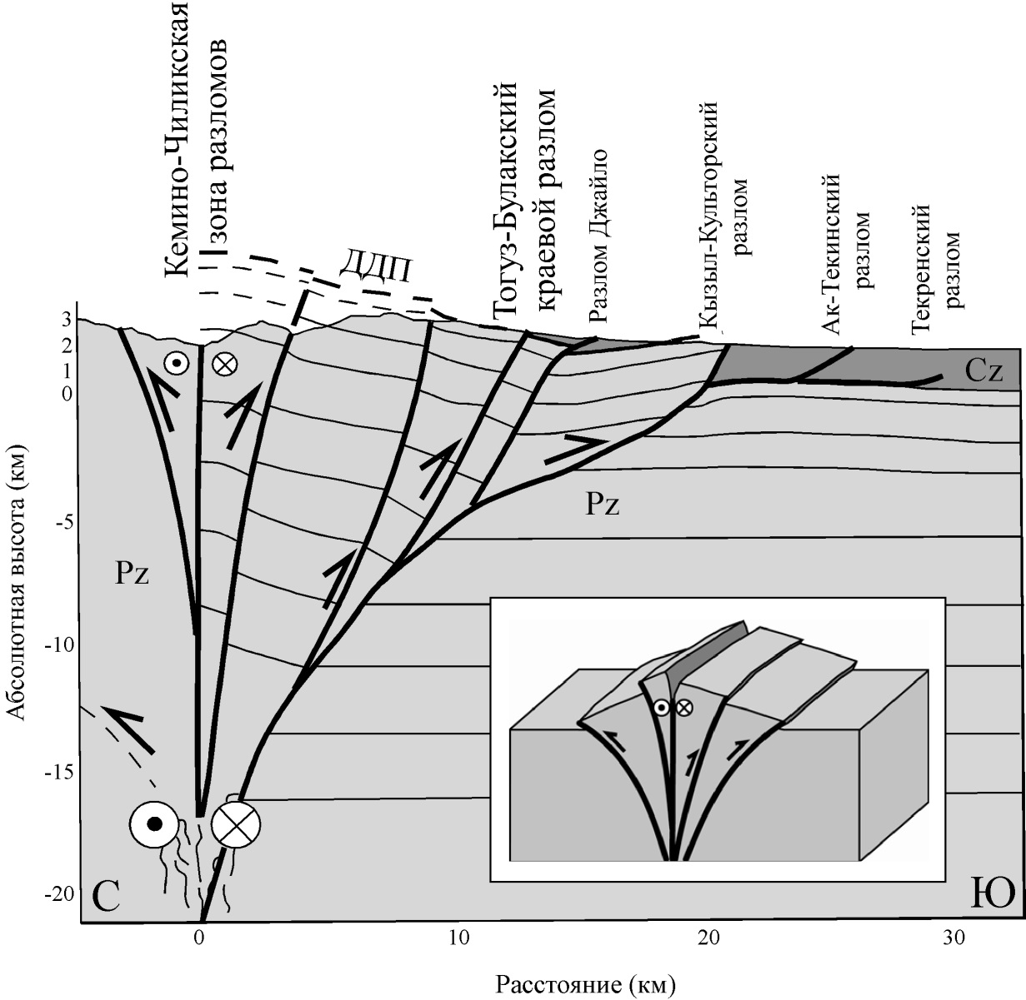
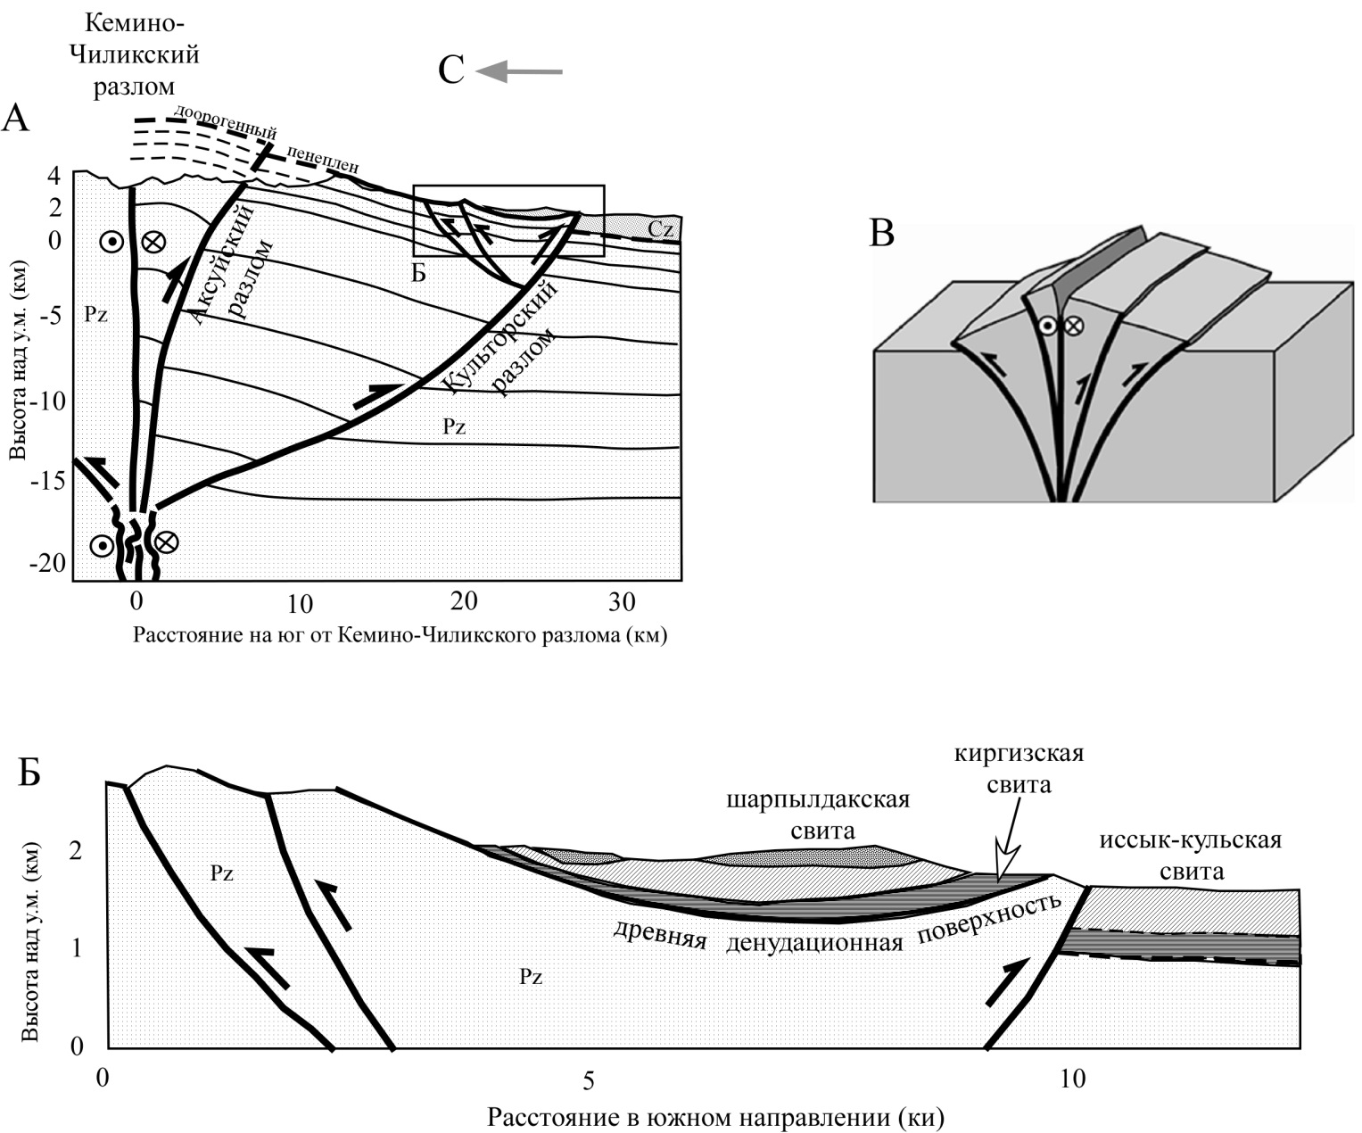
Balanced sections (А, Б) along the Bakhtu-Dolonaty (left) and Toru-Aygyr (right) rivers.
Modified after [Selander et al., 2012] in [Korzhenkov et al., 2011; Korzhenkova et al., 2022].
There are shown the only main structures. In inset – a schematic block-diagram of the “flower” structure with the listric thrusts which joint each other in the depth – in the zone of main strike-slip fault

Slide 12
Thus:
Morpho-structures along the southern slope of the Kungey Ala-Too range and its southern foothills (adyrs) have been studied with use of tectonic geomorphology and paleoseismology methods.
Analysis of C14 and infra-red luminescence data in excavated pits and trenches shows lateral migration of the strong seismic activity along the zome of the Kultor fault.
Recent strong seismic activity is concentrated to its adyr (foothill) zone and located along the adyr faults.
At least SEVEN morphogenetic earthquakes occurred along the fault zone in Late Holocene.
During common era the occurrence of the morphogenic earthquakes was once in 200-300 years. At this, in VII and XV centuries along the fault apparently there are occurred strong seismic catastrophes with М ~ 7.5 (Io = Х), during which the seismic sources reached the surface and form the fault scarps of 70-80 km length.
Age of the last seismic event along the Kultor fault zone (age of our sample Vs-3102) 1720 – 1815 AD, thus we are in a period of expectation o a new strong earthquake.

Slide 13
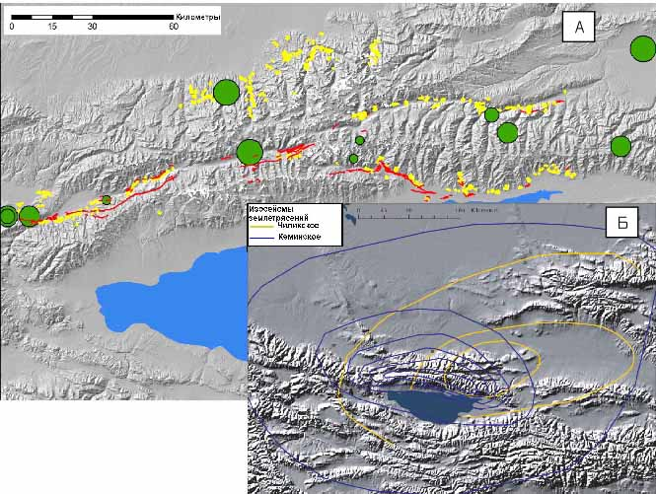
Overview map of central part of the northern Tien Shan:
А – map of epicenters of the strong earthquakes occurred in XIX-XX centuries: seismic deformations of the Kebin 1911 earthquake are shown by yellow color [Богданович и др. 1914]; our data have shown by red color;
Б – isoseismal lines of the Chilik 1889 earthquake (yellow) and Kebon 1911 earthquake (blue) (modified after [Arrowsmith et al., 2004])

Slide 14
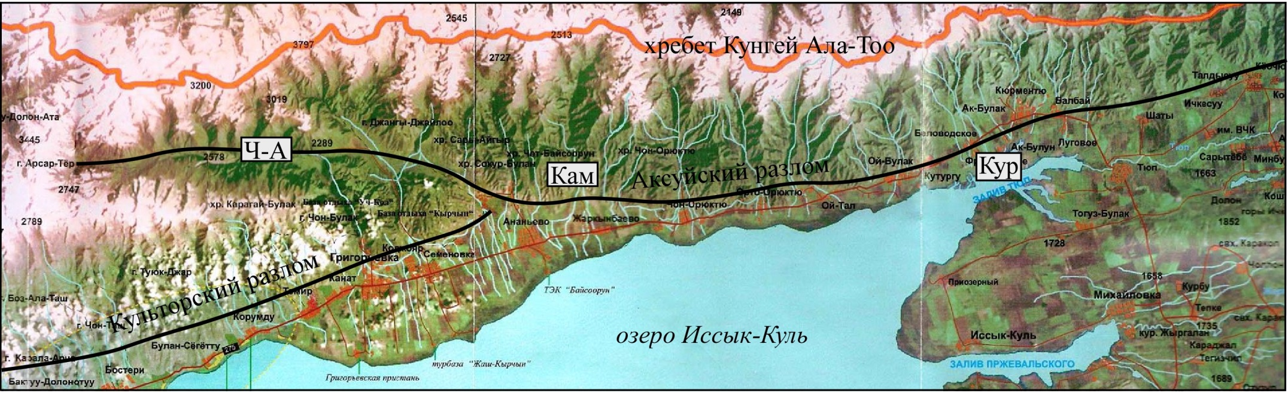
Satellite image. There are shown places of study along the Aksuu border fault with collection of sample for C14 analysis.
«Ч-А» – Chon-Aksuu river valley,
«Кам» – Kamenka medieval fortress,
«Кур» – Kurmenty medieval fortress

Slide 15
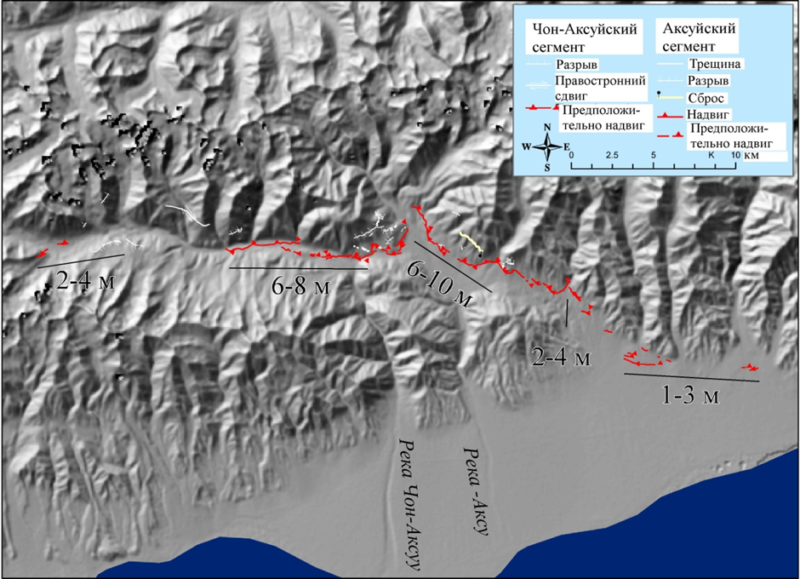
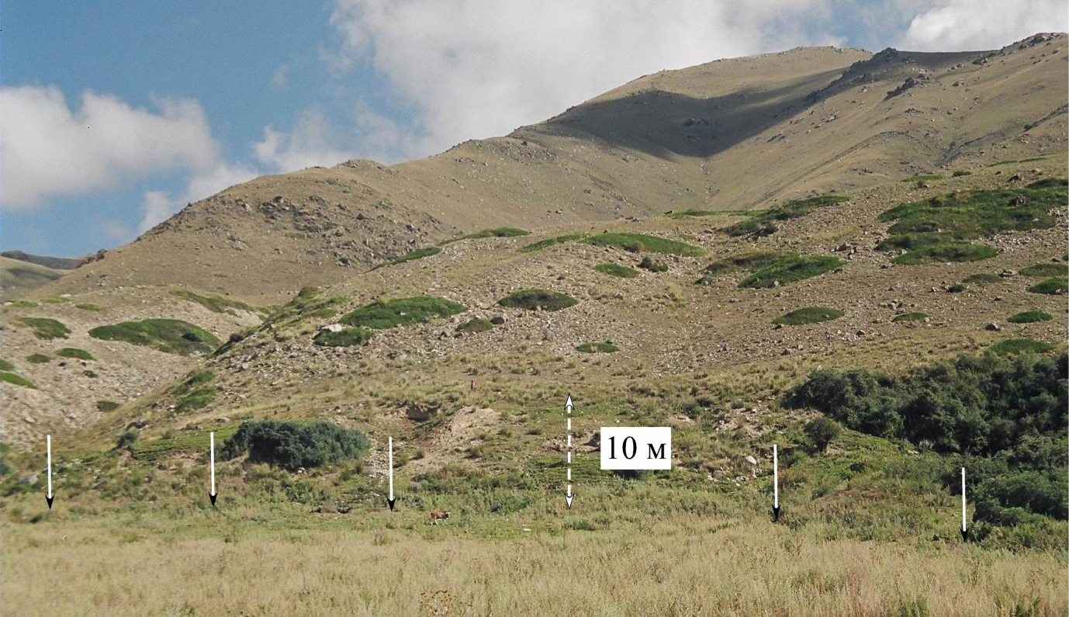
Summary of displacement values along the Chon-Aksuu and Kichi-Aksuu segments of Kebin earthquake rupture (modified after [Arrowsmith et al., 2004]).
Fault scarp (shown by arrows) formed doring Kebin 1911 earthquake in Tash-Bulak locality

Slide 16
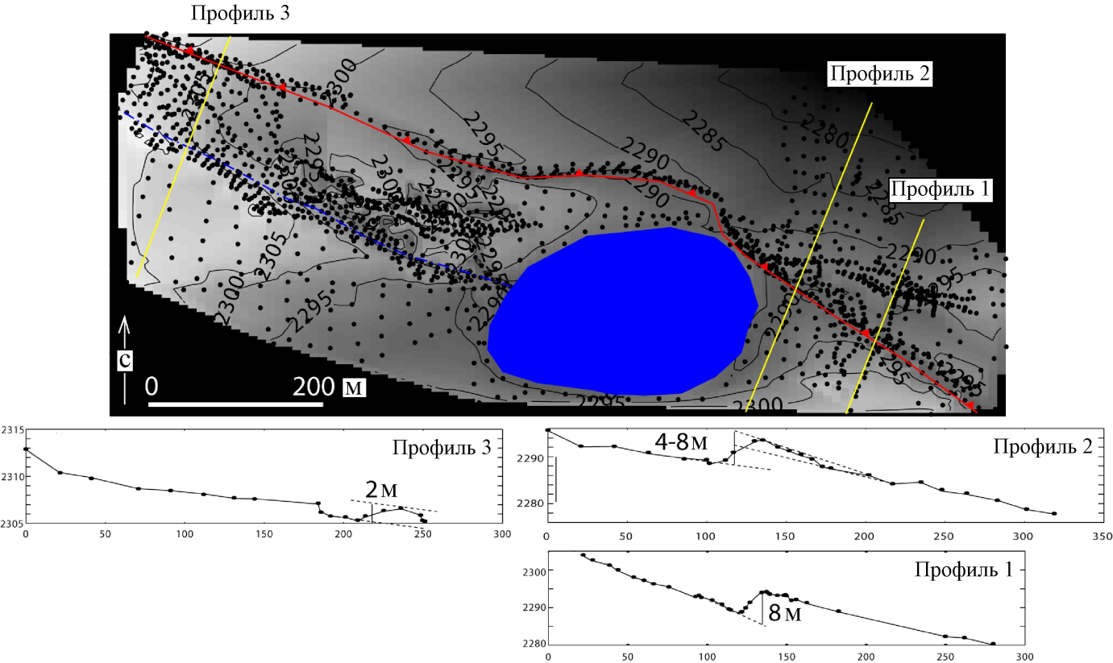
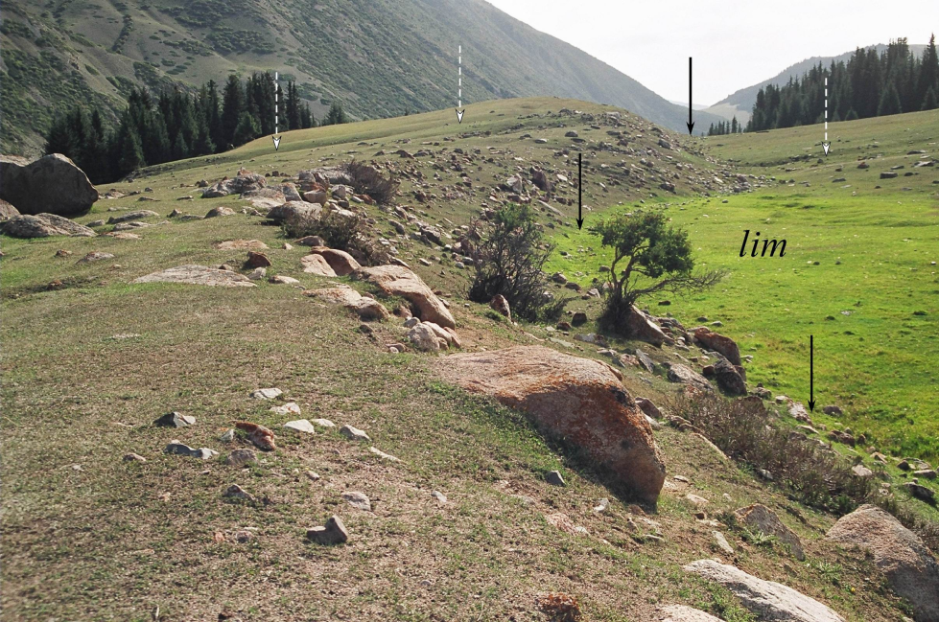
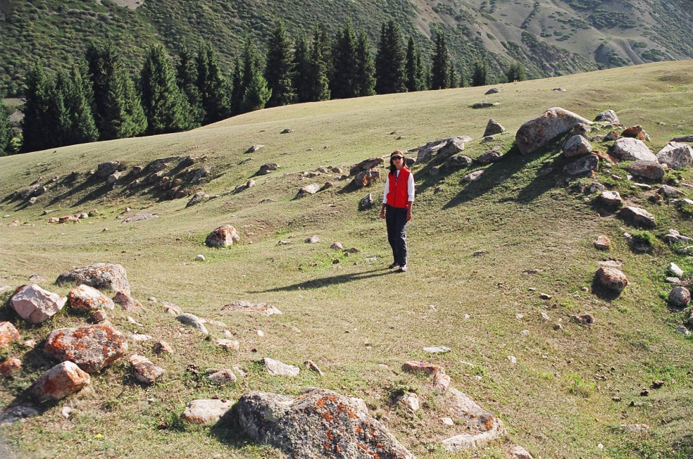
Lower lake formed after Kebin 1911 earthquake on the right slope of the Chon-Aksuu river valley (modified after [Arrowsmith et al., 2004])
(Upward) Thrusted limb of the rupture is located down the slope. Fault scarp dammed the lower lake in the Chon-Aksuu river valley
(Left). View to the east in a region of Profiles 1< 2 in the figure above. White arrows mark abandoned valley of the say (creak) joined to Chon-Aksuu before the earthquake of 1911. Swampy locality in front of the fault scarp (lim) – lacustrine-swampy deposits formed because of tectonic damming.
(Right). ”Wind gap” in thrusted limb of the fault scarp formed after the earthquake.

Slide 17
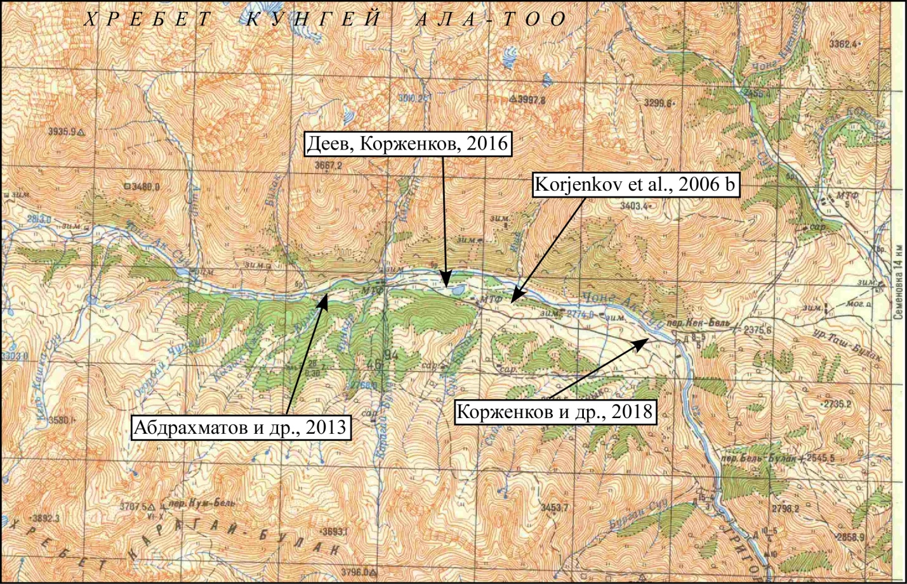
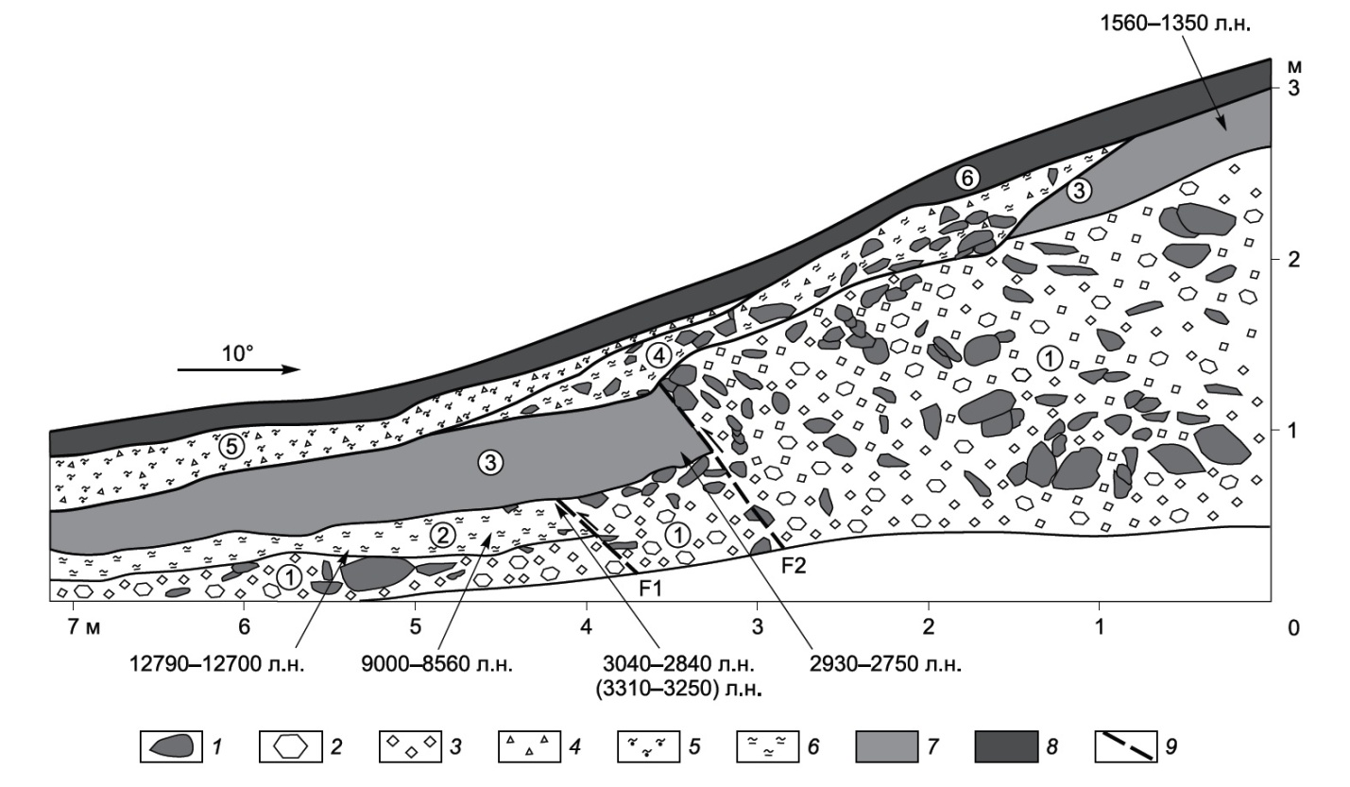
Study of paleoseismic deformations along the Aksuu fault
A fragment of the topographic map of central part of the Chon-Aksuu river valley. Arrows show places of trenches and pits. In rectangles – references on papers where is the description of those trenches and pits. Every square of the net is 2 x 2 km.
Western wall of paleoseismic trench in the Chon-Aksuu river valley near the lower lake [Deev and Korzhenkov, 2016].
1 — largest fragments and boulders, 2 — fragments, 3 — rubble, 4 — gruss, 5 — sandy loam, 6 — loam, 7 — brown humusized loam (paleo-soil), 8 — recent low-humus mountain soil, 9 — faults. Numbers in cirques – layers numbers.

Slide 18
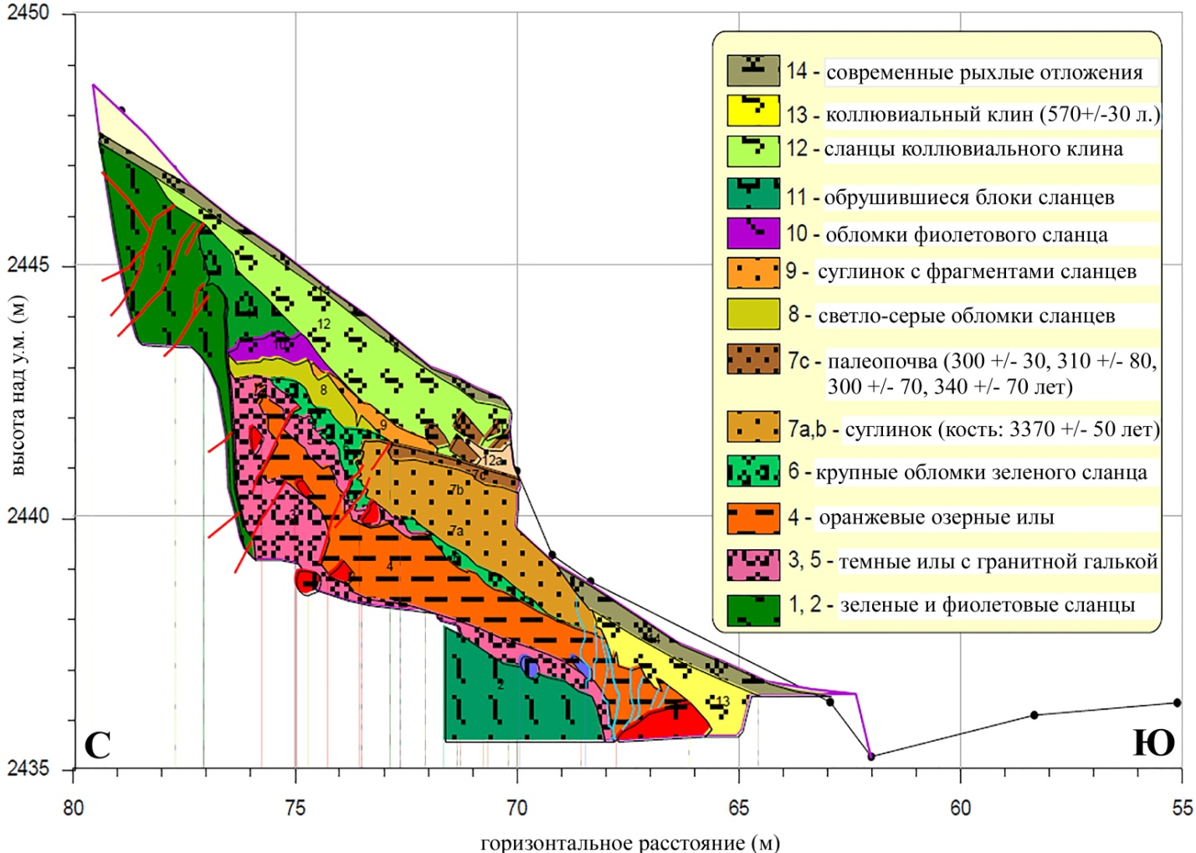
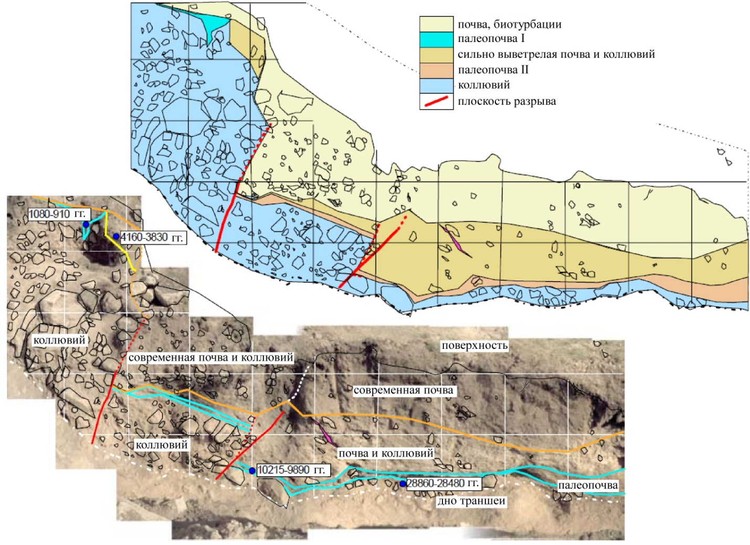
Layers in a trench near the second lake
(modified after [Абдрахматов и др. 2013])
A trench in the Chon-Aksuu river valley below the first lake
(modified after [Korjenkov et al., 2006])

Slide 19
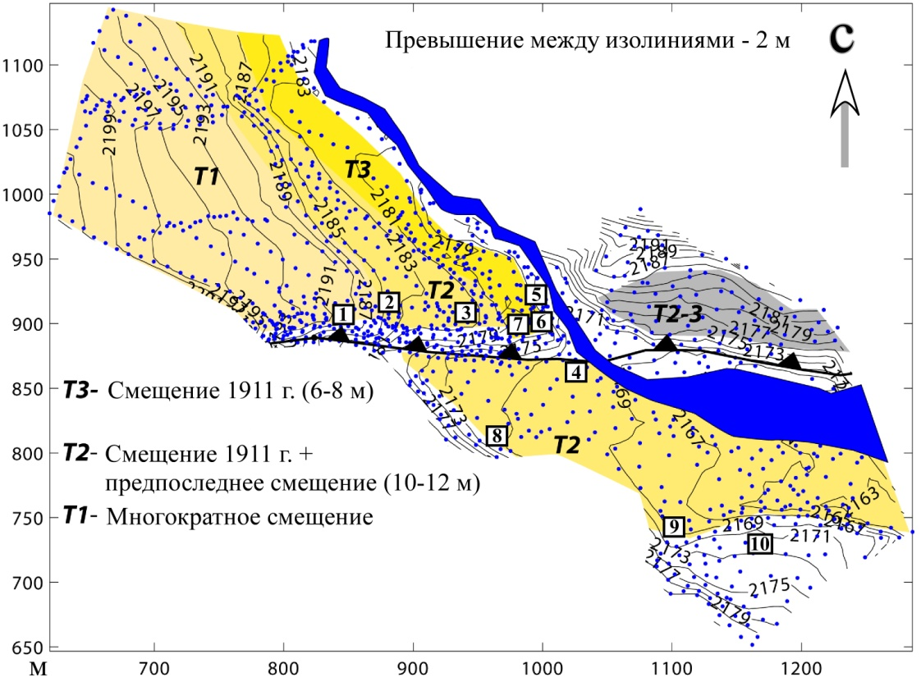
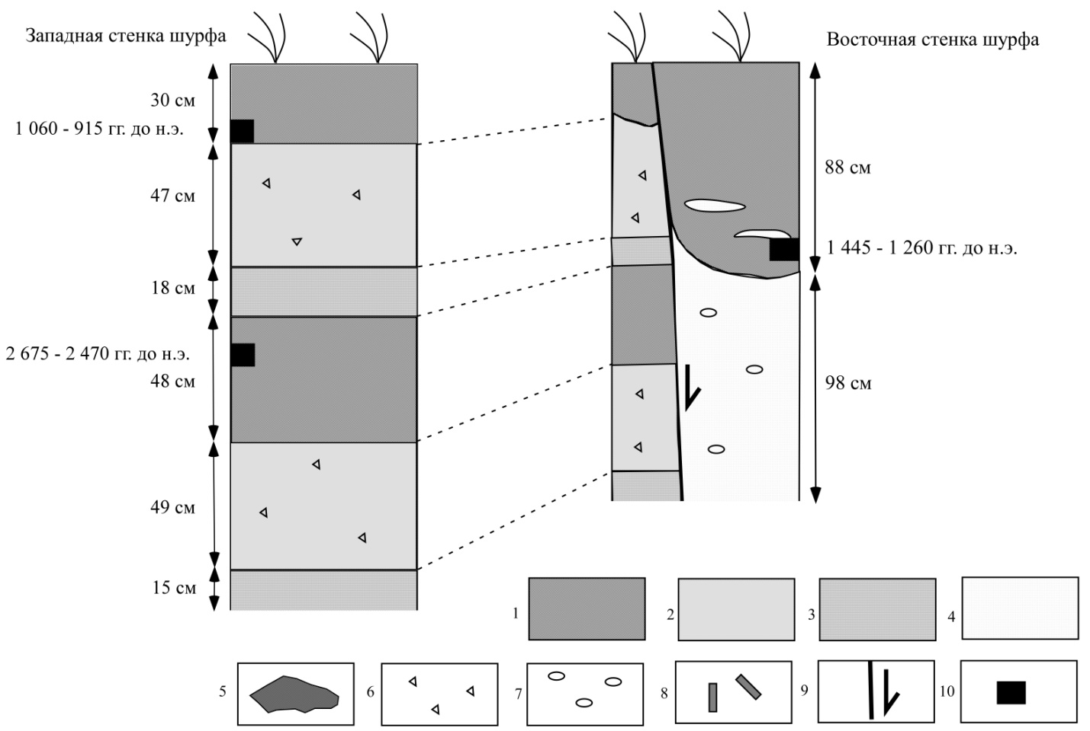
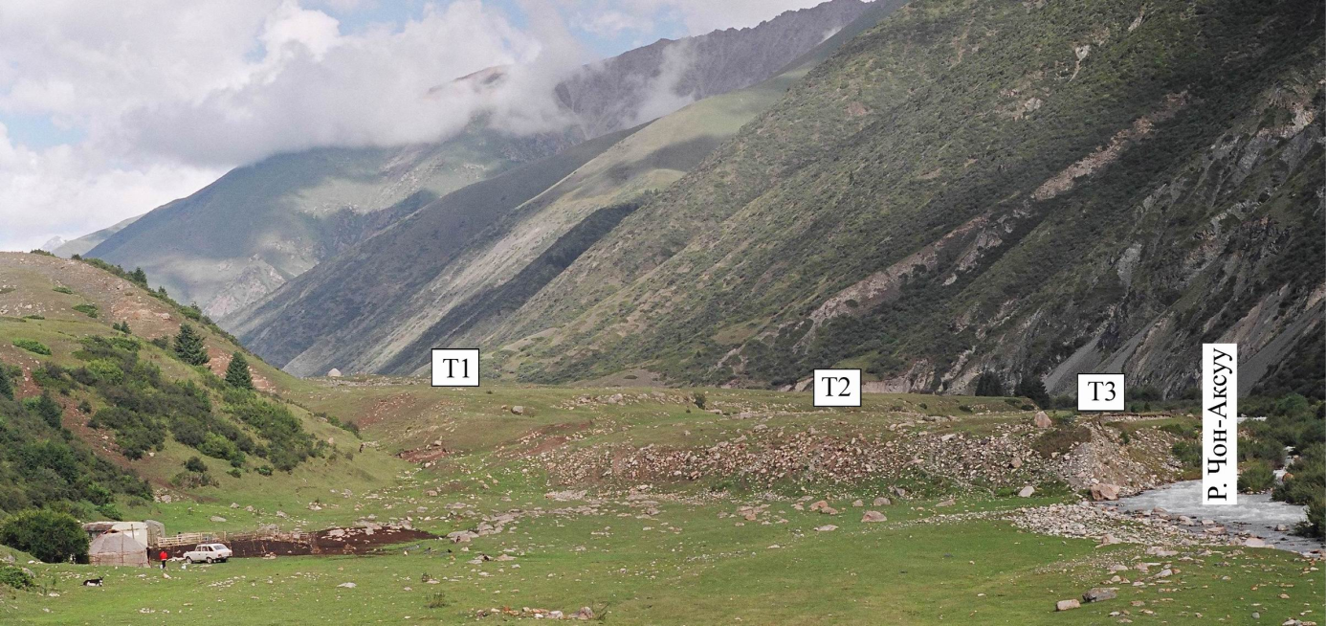
(Up, left) Topographic map of the fault scarp crossed the Chon-Aksuu river (modified after [Arrowsmith et al., 2004])
(Down) A view toward WNW on the fault scarp crossed Chon-Aksuu river valley
(Right) Western and eastern walls of pit # 1 in the hanging wall of the Chon-Aksuu fault scarp [Korzhenkov et al., 2018]. 1 – soil, 2 – clay, loam, 3 – crushed non-rounded granite fragments, 4 – sands, sandy loam, 5 – separated boulders and block, 6 – non-rounded fragments (gruss, gravel), 7 – rounded pebbles, 8 – wood fragments, 9 – plane of secondary rupture (an arrow shows direction of displacement), 10 – places for collection of sample for C14 analysis

Slide 20
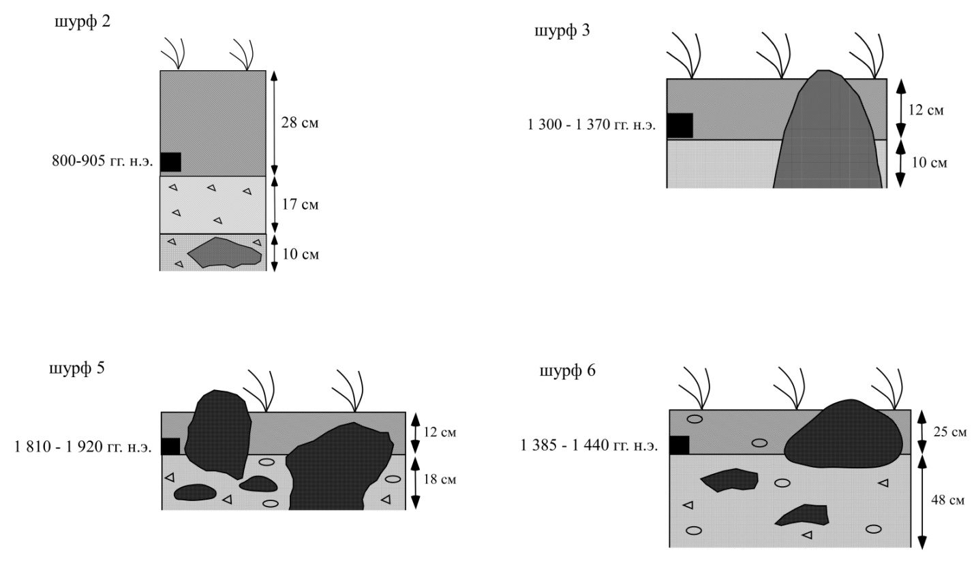
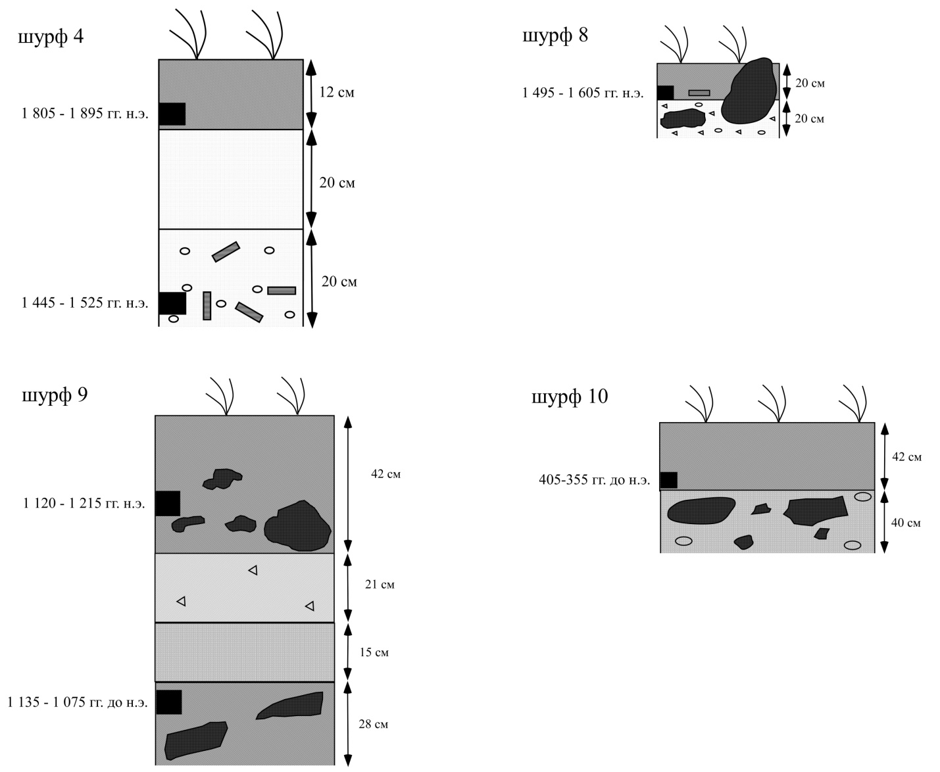
Pits logging in the hanging (thrusted) wall of the fault scarp [Korzhenkov et al., 2018]. Symbols are the same as in previous picture.
Pits logging in the foot wall of the Chon-Aksuu fault scarp [Korzhenkov et al., 2018]

Slide 21

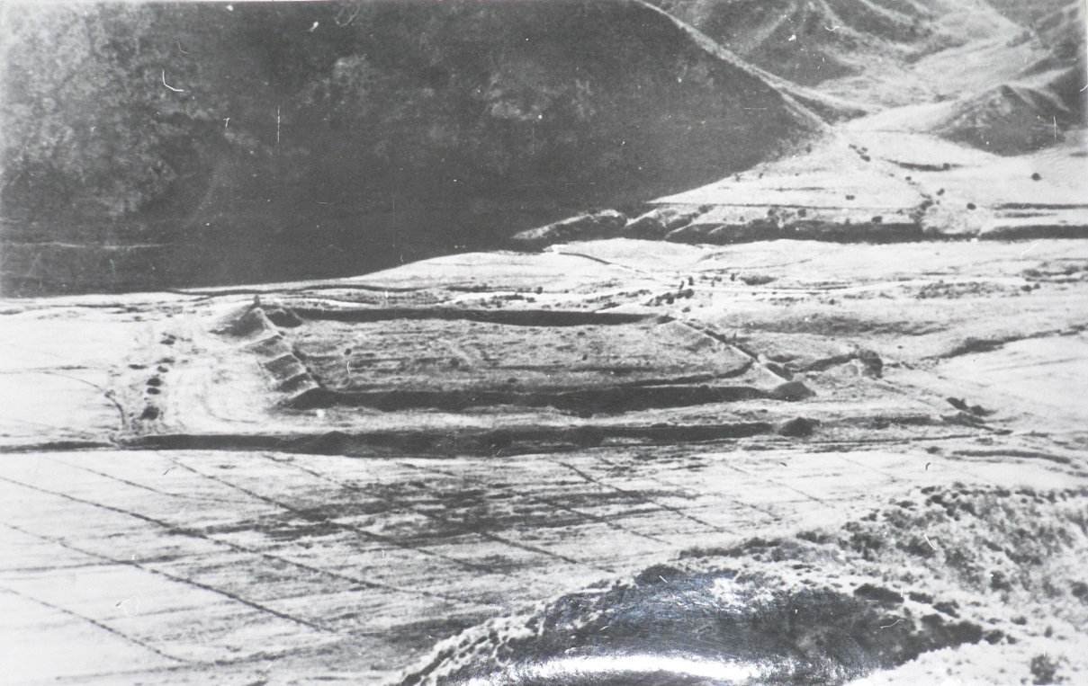
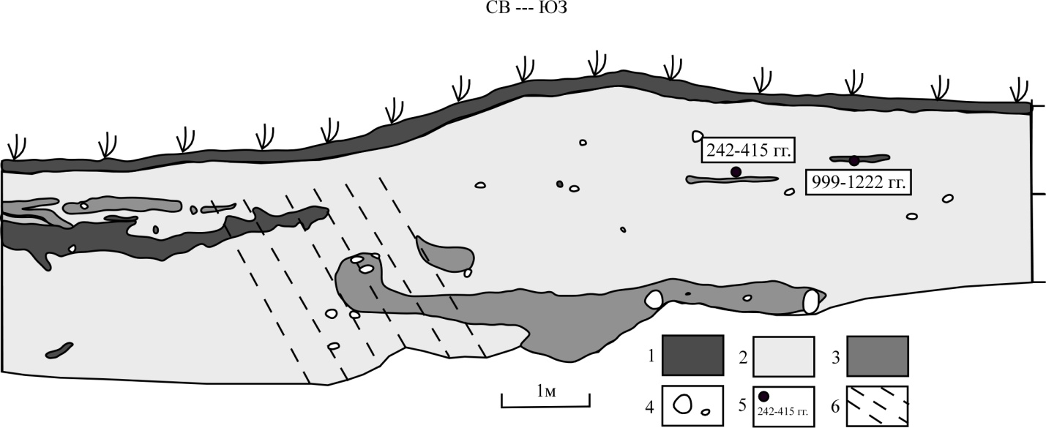
(Left, up) Schematic map of Kamenka medieval fortress and a rupture which cuts it [Korjenkov et al., 2006]:
1 – fault scarp, 2 – fortress walls, 3 – rivers and canals, 4 – isolines in 50 m, 5 – altitudes in meters.
(Left, down) A log of the trench across the fault scarp [Корженков, 2006]:
1 - soil, 2 – loam, 3 – coarse sand with gruss , 4 – separated boulders, 5 – samples collection locations, 6 – a zone of supposed seismotectonic deformation.
(Right, down) A photograph from local history museum in Karakol town

Slide 22
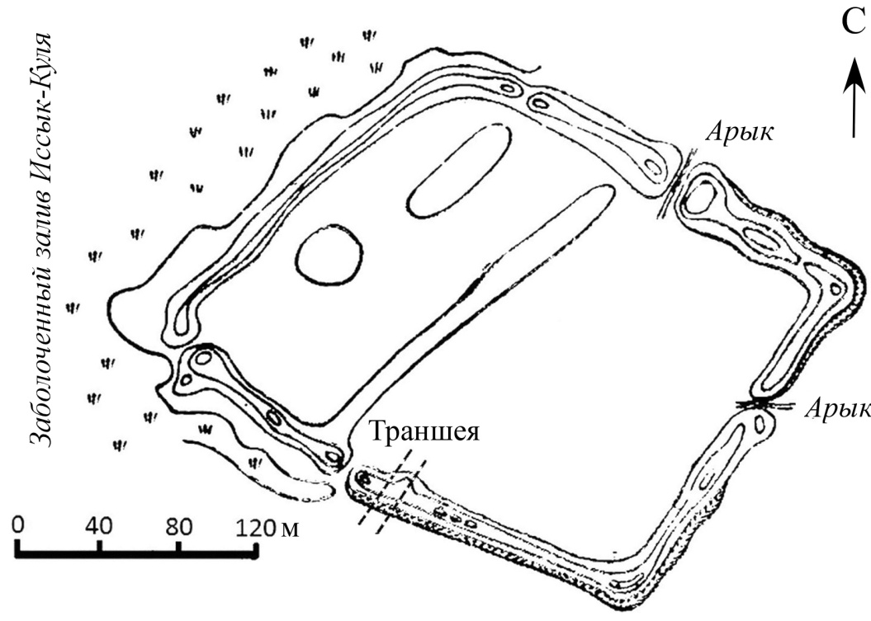

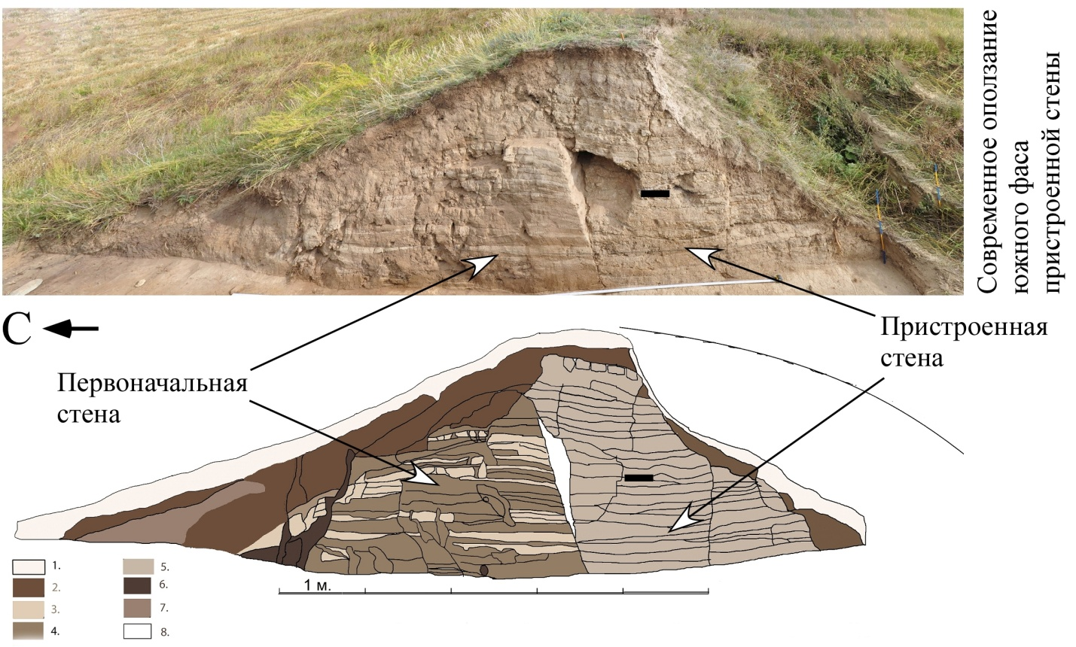
(Upward) A scheme of Kurmenty settlement
(modified after [Ак-Булун, 2006]).
(Downward) SE wall of the archeological trench across SW wall of Kurmenty settlement [Korzhenkov et al., 2015].
Black rectangle – sample collection place for C14 analysis (Vs-2543: 1530–1170 BP).
1. – Turf layer. 2. Dripped layers. 3. Grey “pakhsa” belts (in wall № 1). 4. Pakhsa belts (wall 1). 5. Pakhsa belts (wall 2). 6. Animal holes. 7. Paleo-soil (Loose clayey layers). 8. Open space between walls 1 and 2

Slide 23
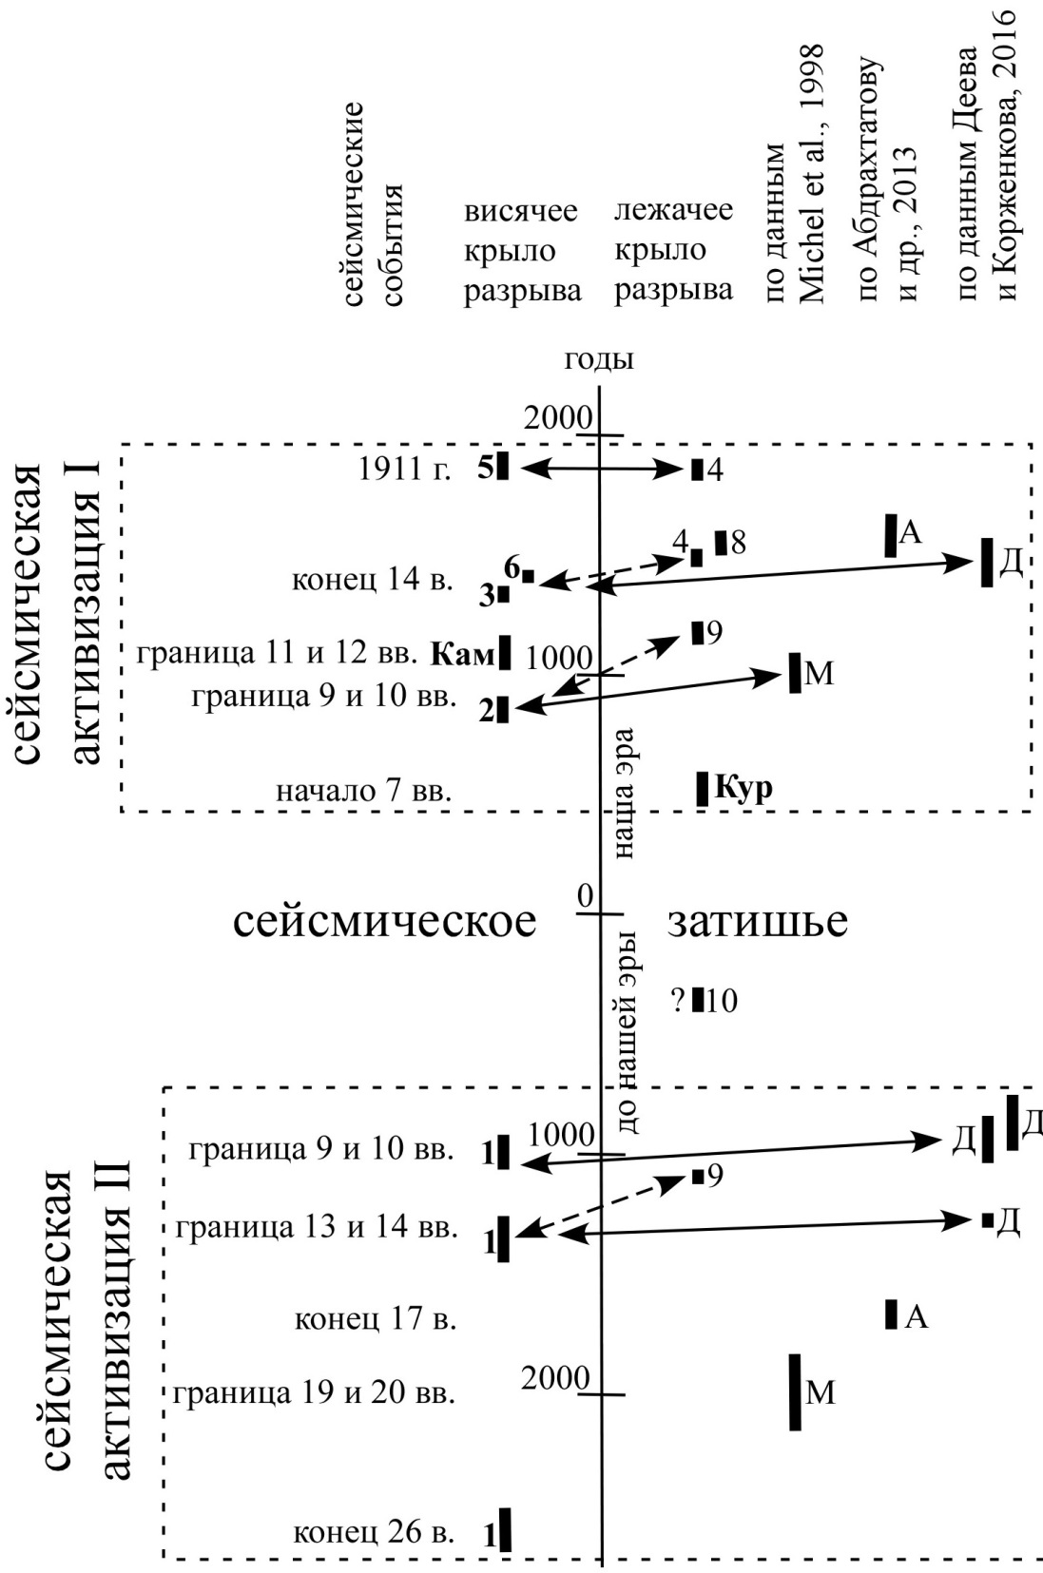
Schematic correlation of C14 dating [Korzhenkova et al., 2024]
Data collected from
[Korzhenkov et al., 2018] in a zone of Chon-Aksuu fault scarp (numbers 1-10)
- Obtained by G. Mikhel and V. Mikhaylyov (Symbol M from book of [Korjenkov et al., 2006]),
- [К.Е. Абдрахматова и др., 2013] (symbol А)
- [Deev and Korzhenkov, 2016] (symbol Д ).
C14 dating in Kamenka (Кам) and Kurmenty (Кур) medieval fortress [Korjenkov et al., 2006; Korzhenkov et al., 2015].

Slide 24
So
Aksuu border fault is characterized by the high seismic potential.
Reoccurrence of the strong earthquakes along the fault – first hundreds years.
Aksuu fault is characterized by М ≥ 8 and by epicentral seismic intensity up to Io = Х-XI.
During first half of Holocene the fault has cluster release of the seismic energy: 1 500 years periods of the seismic activity are changing by 1 500 years period of the seismic calm.

Slide 25
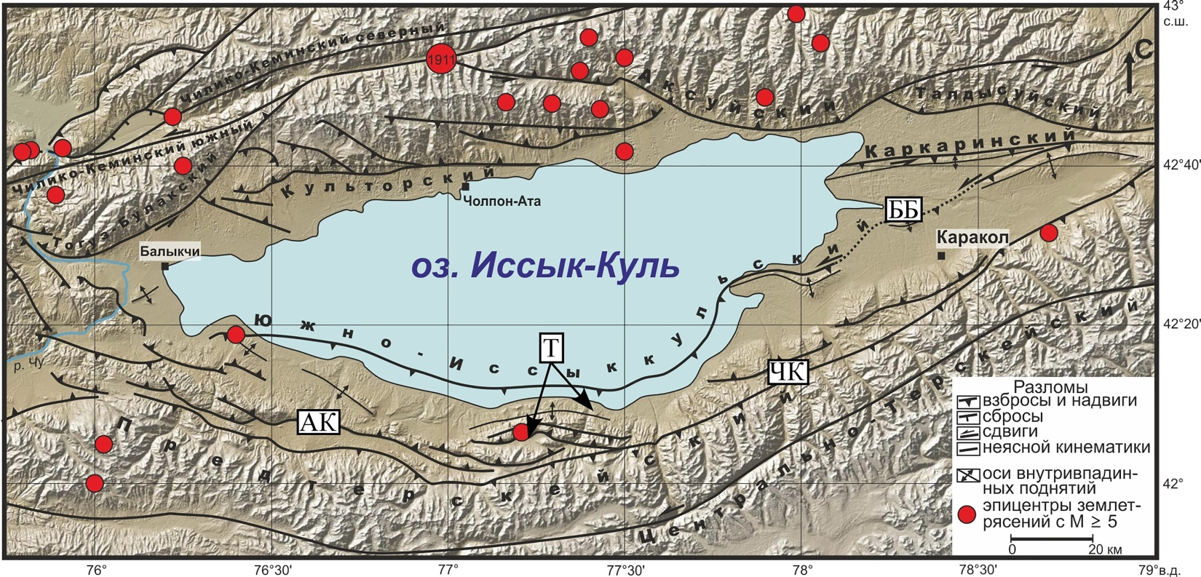
Main active structures of the Issyk-Kul Lake region.
Epicenters of historical in instrumental earthquakes with M ≥ 5 during period from 250 AD until present [Кальметьева и др., 2009] and seismic catalogs NEIC and IRIS. Shaded relief is created with use of GeoMapApp (http://www.geomapapp.org). Abbreviations in rectangles: АК – Alabash-Konuroleng depression, Т – Tossor river basin, ЧК – Chon-Kyzyksuu river valley, ББ – Bir-Bash anticline

Slide 26
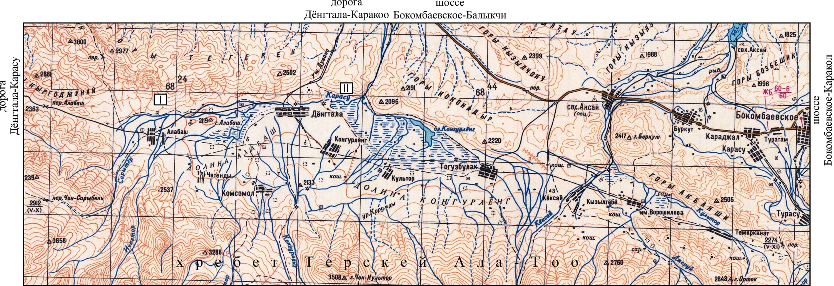
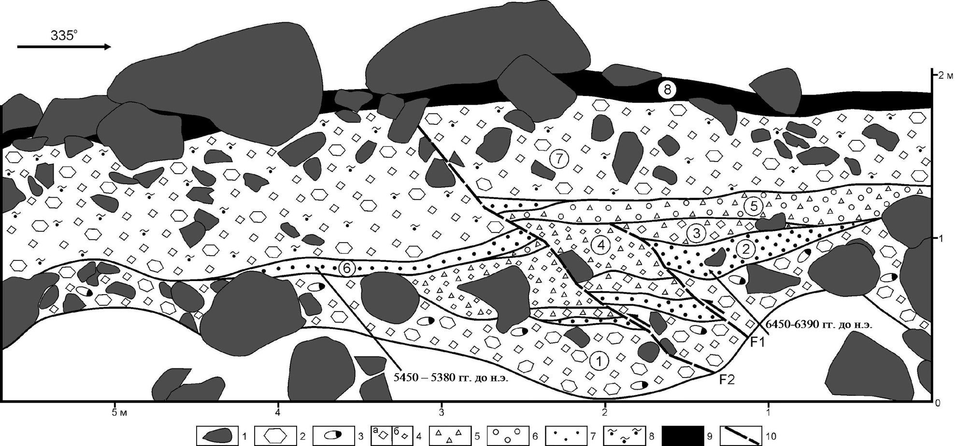
Topographic map of the Alabash-Konuroleng depression.
Size of every net is 4 x 4 km.
In rectangles are studied localities of the fault scarps: I - natural outcrop north from Ala-Bash village, II – seismic deformations locality by the foot of the Duvana mountain
An outcrop of western wall of the dry valley which cuts the fault scarp in the northern flank of the Alabash-Konuroleng depression
(modified after [Деев и др., 2016] ).
1 — largest boulders, fragments and blocks; 2 — fragments; 3 — boulders; 4 — rubble: а — large, б — small; 5 — gruss; 6 — gravel; 7 — sand, 8 — sandy loam, 9 — recent low-humus mountain soil, 10 — faults. 1—7 — alluvium layers

Slide 27
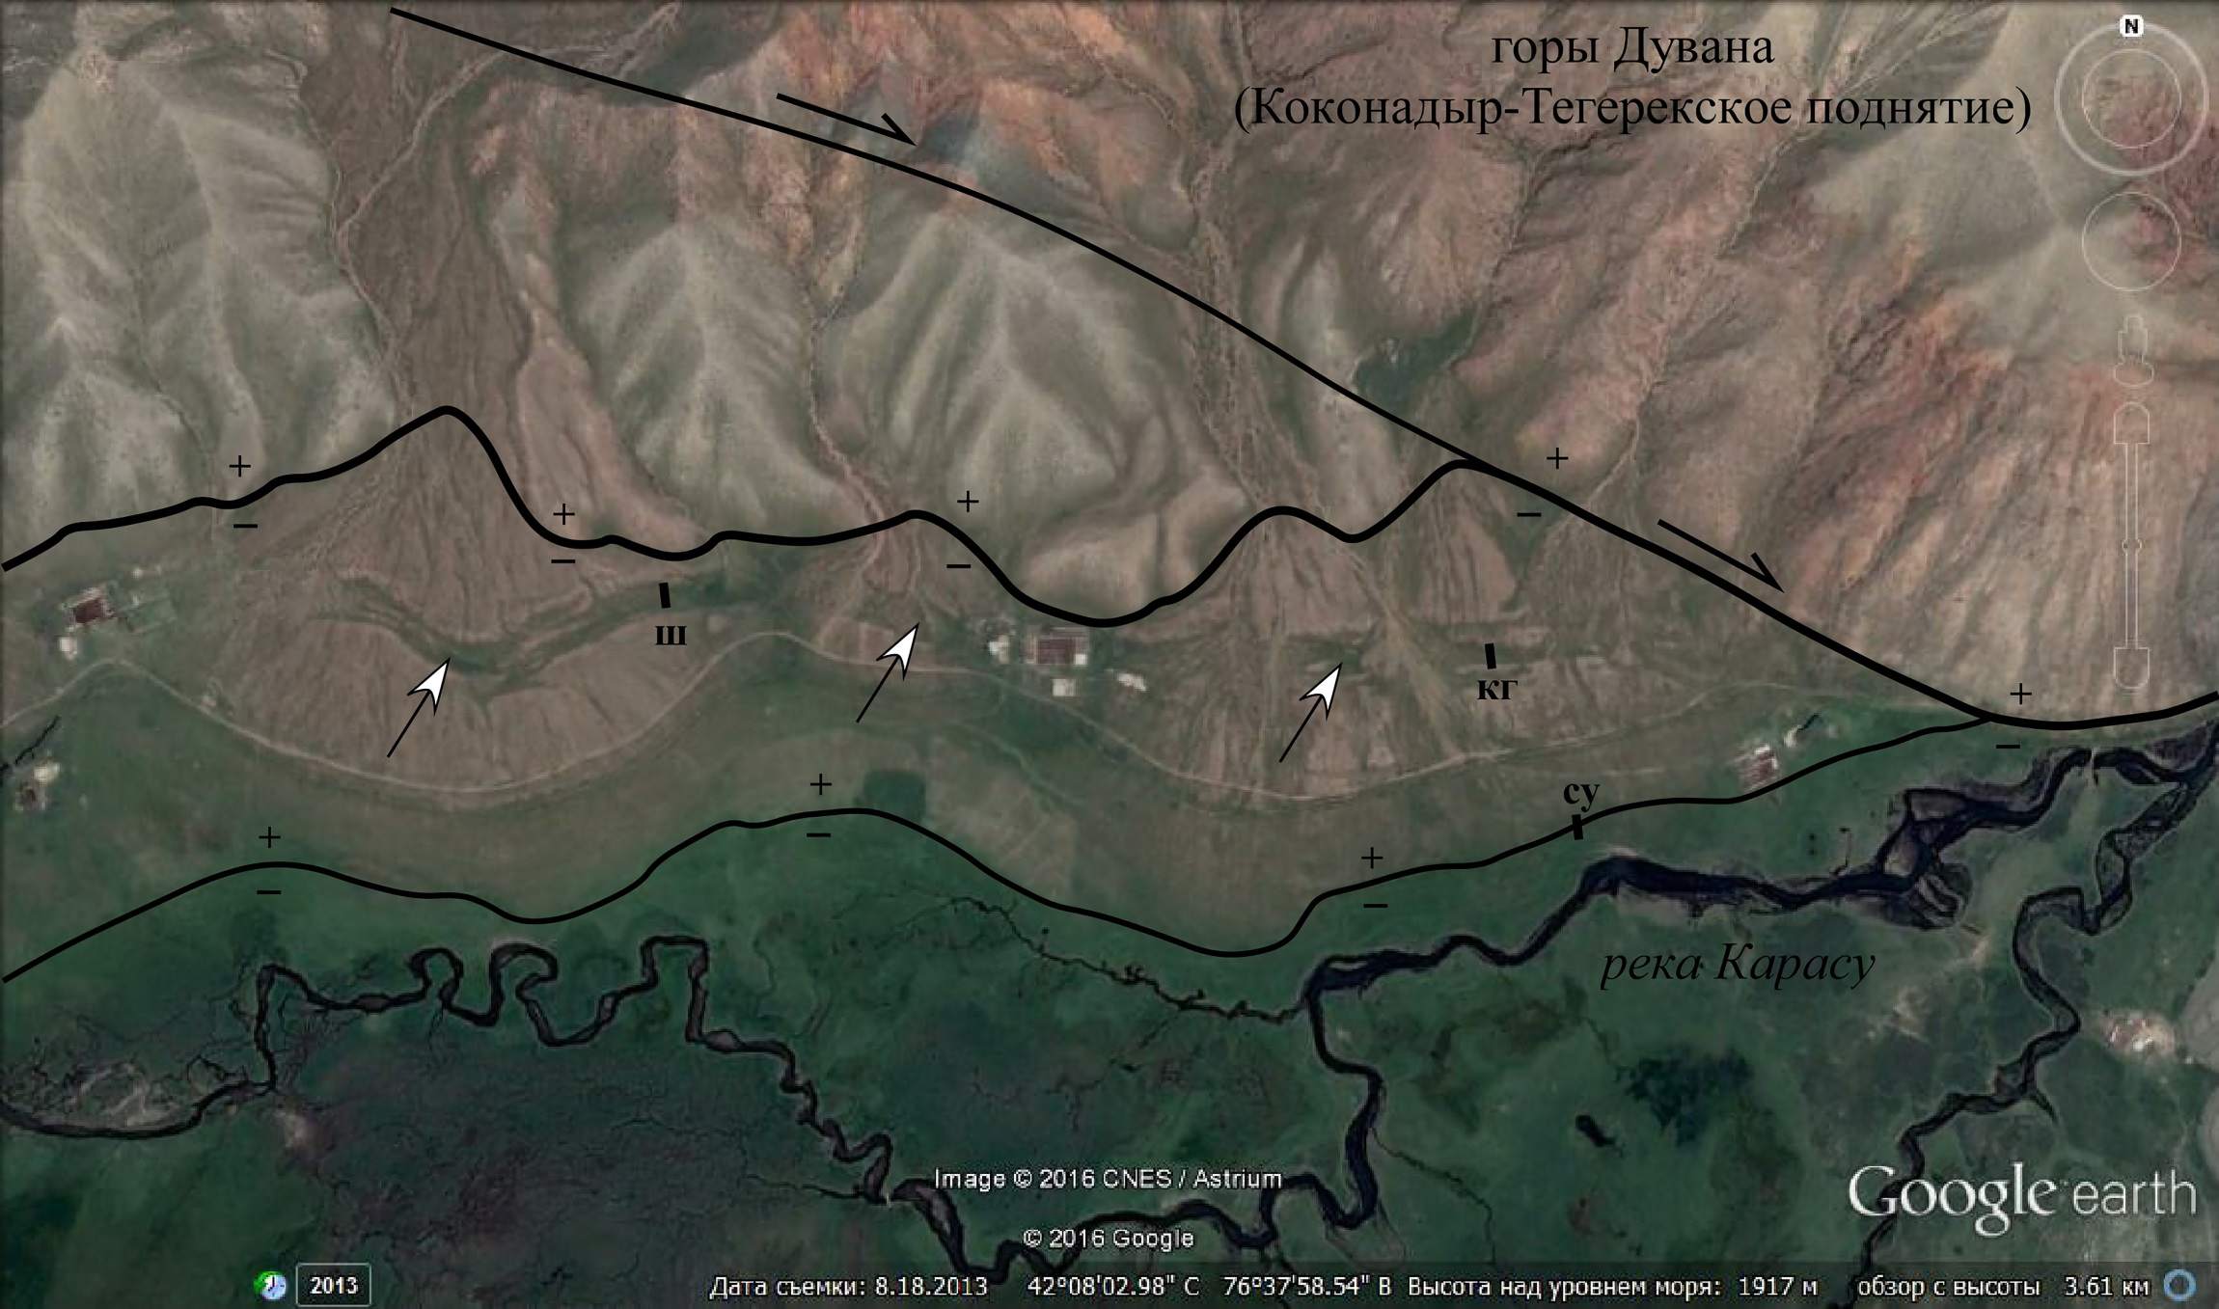
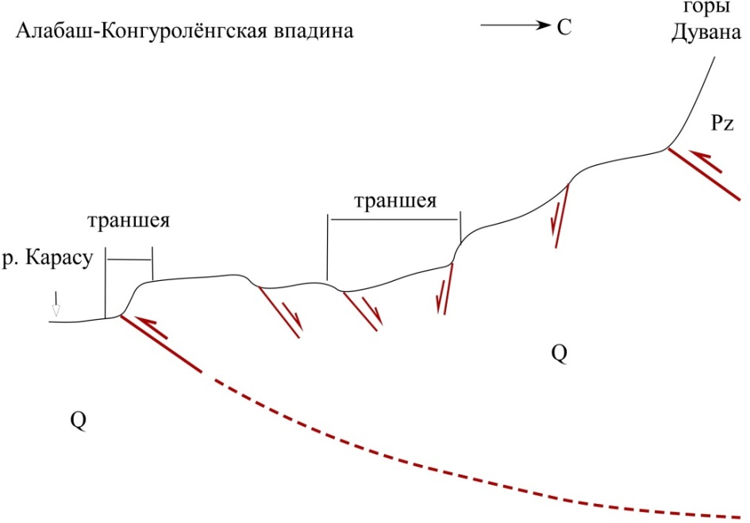
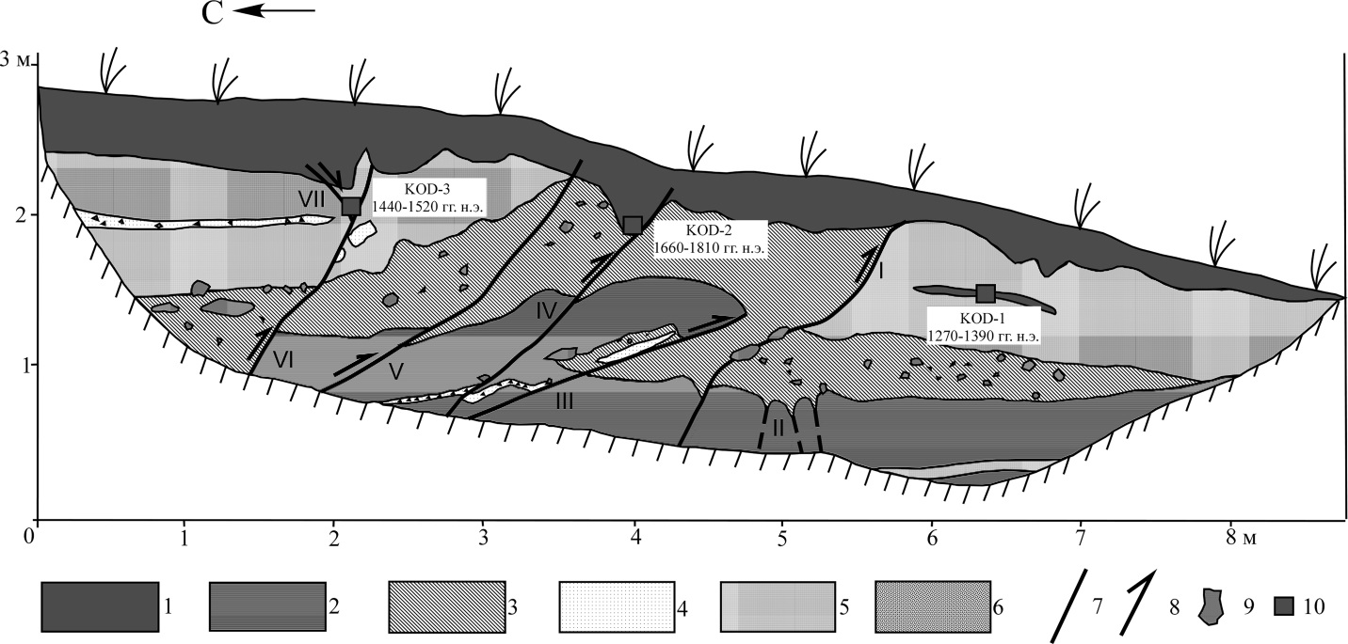
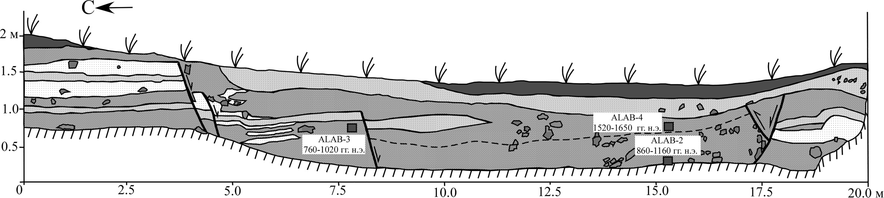
Compensation graben in back of reverse fault scarp south of the Duvana mountain. Satellite image where a tail of large dragon is visible. Its length about 1 km. Upward (in the north) – Duvana mountains. Downward (in the south) – Karasu river meanders. Thick black line – Kokonadyr-Tegerek adyr fault. Black line south of it – right-lateral strike slip. Other black line to the south – fault scarp. + – hanging wall, - – foot wall, су – a trench across the fault scarp, кг – a trench across the central part of the compensation graben, ш – a pit in the compensation graben

Slide 28
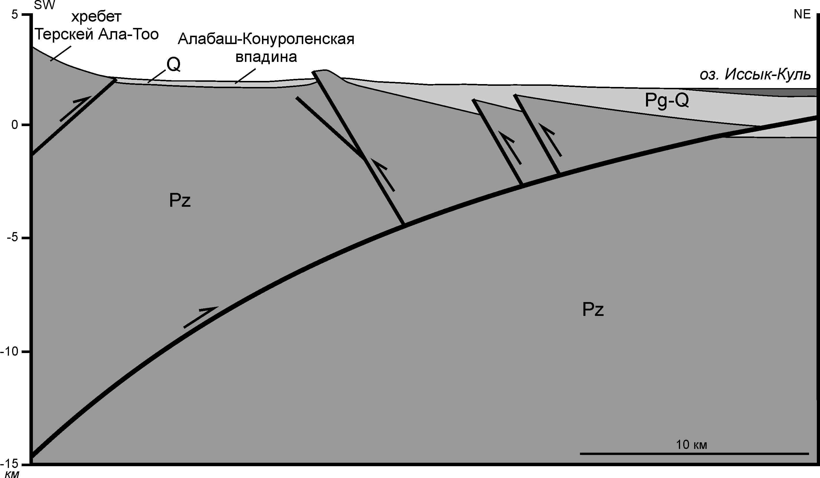
A model of Neotectonic structure of the southern Issyk-Kul Lake region
Modified after [Burgette, 2008]

Slide 29



Tossor rockslide, aerial view
Schematic field logging of the pits in lower part of the fault scarp (upward) and in lowering of rockslide in Tegerek-Say dry river basin
Longitudinal cross-section I-I along the Tossor river valley
(modified after Chediya et al., 1988)
Rockslides masses are thrown down from the southern limb of the Lower-Tossor horst-anticline

Slide 30


Topographic map of lower parts of the Kadzhi-Say and Tossor river basins.
1 net in the map is 2 х 2 km. Solid red lines – main faults. Dashed lines – fault scarps
A section of southern wall of the trench excavated in eastern wall of Tossor medieval fortress.
There are deformations occurred during two seismic events. During 1st seismic event it took place a destruction of the wall with throwing away its fragments eastward onto significant distance (down). During 2nd strong earthquake the wall was broken by cracks, which formed “flower” structure in western part of the wall and wedge in eastern part of the wall (upward)

Slide 31



Mobilized Late Pleistocene morains in Cho-Kyzylsuu river valley.
Aerial view

Slide 32

Stratigraphic column of deposits accumulated behind a natural dam in middle part of Chon-Kyzylsuu river valley.
1 — soil, 2 — loam and sandy loam, 3 — sand, 4 — gruss, 5 — pebble, 6 — boulders, 7 — pattum and alluvial deposits, 8 — horizons with seismites.

Slide 33


Satellite image of the Bir-Bash uplift.
The structure is broken along South-Issykkul adyr fault (it is marked by white lines, bergstrichs show a direction of fault plane tilting). «T» - a trench excavated across one from the fault scarps in the northern slope of the Bir-Bash mount
A section of the eastern wall of the trench
[Korzhenkov et al., 2021].
Numbers in cirques – numbers of layers. 1 – thrust, 2 – places of C14 sample collection

Slide 34

Sub-longtitudinal section across SE part of the Issyk-Kul depression

Slide 35

Schematic correlation of the strong earthquakes in southern part of the Issyl-Kul depression [Korzhenkov et al., 2014 – 2021; and Deev et al., 2016]

Slide 36
Нами были изучены палеосейсмодислокации в южной части Иссык-Кульской котловины - на территории адыров (предгорий) хребта Терскей Ала-Тоо: 1) вдоль южного подножия гор Коконадыр-Тегерек в Ала-Баш-Конур-Олёнгской межгорной впадине; 2) в бассейне реки Тоссор; 3) в долине р. Чон-Кызыл-Суу и 4) на северном склоне внутривпадинного адырного поднятия Бир-Баш. Использовались 21 результат радиоуглеродных определений проб, отобранных в стенках палеосейсмологических траншей или расчищенных природных обнажений. В результате этих исследований в пределах голоцена было выявлено 10 сильных сейсмических событий. Отмечена их миграция от Ала-Баш-Конур-Олёнгской впадины в начале голоцена на восток к горе Бир-Баш (к началу новой эры), а затем назад - в западном направлении к подножию гор Коконадыр Тегерек (к концу позднего средневековья). Полученные данные могут быть использованы при построении Новой карты сейсмического районирования Иссык-Кульской области Кыргызской Республики.

Slide 37


Slide 38


Slide 39
The study has been conducted at financial support of the state research program of Schmidt Institute of Physics of the Earth RAS.

