Slide 1
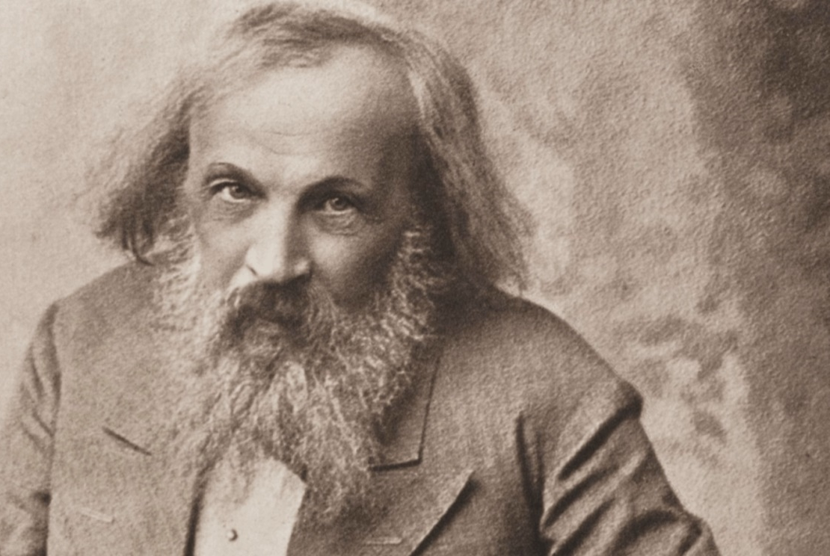
Mendeleev 2024
XIII International Conference on
Chemistry for Young Scientists
THEORETICAL CHEMISTRY
Estimating Electron Transfer Rates of DNA Repair by means of Multiconfiguration Quantum Chemistry Calculations
Odintsov K.V., Domratcheva T.M.

Slide 2
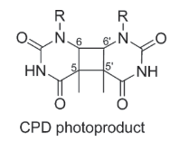
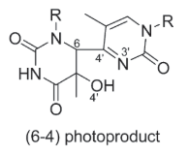
Photodamaging and Photorepair of DNA
Mendeleev 2024
XIII International Conference on Chemistry for Young Scientists
5’thymine
3’thymine
damaging
repair
$$265−290 nm$$
$$350−500 nm$$
CPD (cyclobutene pyrimidine dimer) photoproduct
5’thymine
3’thymine
(6-4) photolyase (64 PL)
CPD photolyase (CPD PL)
(6-4) photoproduct

Slide 3
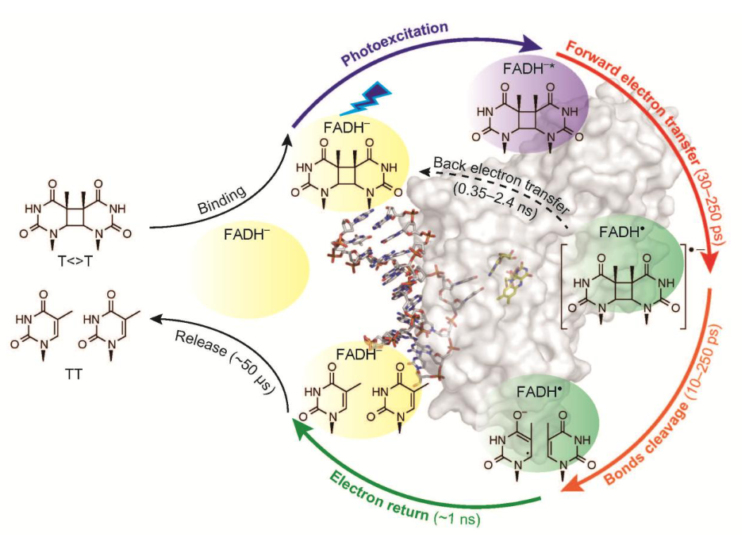
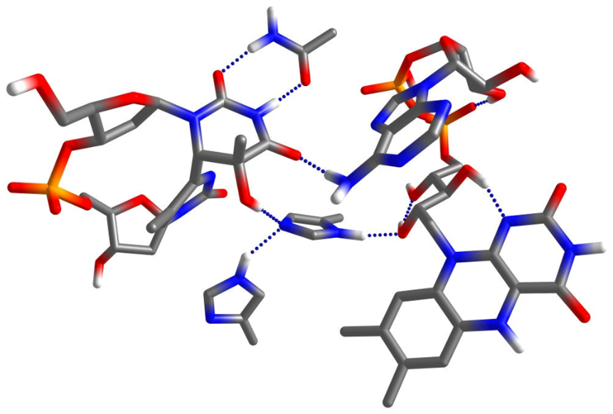
The Quantum Yield of Repair in CPD and 64 PLs
Mendeleev 2024
XIII International Conference on Chemistry for Young Scientists
Adenine of FADH⁻
*
QY of repair:
CPD PL: 70-100%
64 PL: 1-20%
64 PP
FADH⁻
The active site of 64 PL
The reaction cycle of photorepair in CPD PL
* Yamamoto, Plaza, Brettel, Photochem. Photobiol., 2017

Slide 4
64 PL: Excitation Energies and Electronic Couplings
Mendeleev 2024
XIII International Conference on Chemistry for Young Scientists
ET 5’base
State | Excit. energy, eV
HQ | 0.0
ET 3’base | 1.96
HQ* | 2.48
ET Ade | 2.85
HQ** | 3.30
ET 5’base | 3.42
Electron coupling matrix elements V_{ij}, cm⁻¹
HQ*/ET 3’base | 1
HQ*/ET Ade | 17
HQ*/ET 5’base | 12
ET 3’base/HQ | 4
ET Ade/HQ | 181
ET 5’base/HQ | 76
ET Ade/ET 5’base | 518
HQ**
ET Ade
HQ*
ET 3’base
HQ
Couplings (GMH Scheme):
ET Rates (Marcus theory):
*
$$V_{ij}=\frac{μ_{ij}E_{ij}}{\sqrt{{\left(μ_{i}−μ_{j}\right)}^{2}+4μ_{ij}^{2}}}$$
**
$$k_{ET}=\frac{2π}{ℏ}\left|V_{ij}^{2}\right|\frac{1}{\sqrt{4πλk_{B}T}}exp\left(−\frac{E_{ij}^{2}}{4λk_{B}T}\right)$$
Geometry optimization (S₀): B3LYP-D3/cc-pVDZ
Excitation energies: SA-CASSCF/XMCQDPT2/cc-pVDZ/PCM
E_{ij} – energy gap, µ_{ij} – transition dipole moment, µ_{i} – dipole moment, λ –reorganization energy
* Cave R.G., Newton M.D., Chem. Phys. Lett., 1996
** Marcus, Sutin, Amos, Biochimica et Biophysica Acta, 1985

Slide 5
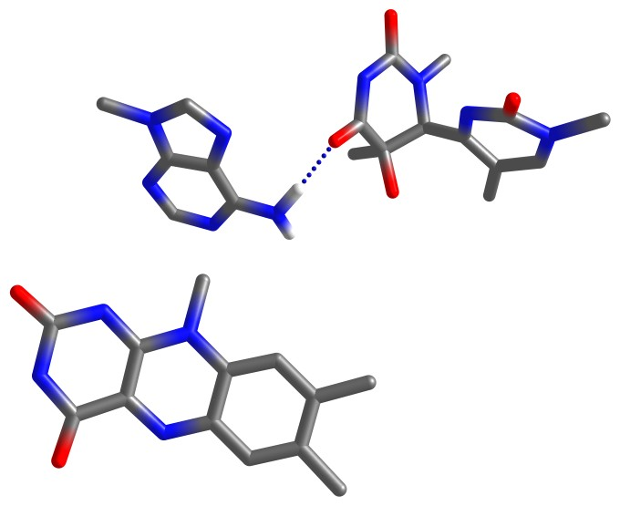
64 PL: Comparing ET Channels
Mendeleev 2024
XIII International Conference on Chemistry for Young Scientists
Experimental timescales:
FET 225 ps
BET 50 ps
5’base
$E$,eV
3.4
3.4
FET
BET
ET 5’base
2.83
Ade
*λ=0.59
3’base
2.77
10²³ s
HQ*
2.5
*λ=0.3
2.2
2 s
Excitation
0.9
0.0
0.3
HQ
HQ*/HQ
HQ
min
HQ*
min
ET 5’base
min
V_{HQ*/ET 5’base} = 12 cm⁻¹
* Osswald M., Fingerhut B.P., J. Phys. Chem. B, 2021

Slide 6
Mendeleev 2024
XIII International Conference on Chemistry for Young Scientists
64 PL: Comparing ET Channels
Experimental timescales:
FET 225 ps
BET 50 ps
5’base
$E$,eV
FET
BET
Ade
3’base
2.5
HQ*
2.2
BET
FET
2.0
ET 3’base
2.0
HQ*/HQ
V_{HQ*/ET 3’base} = 1 cm⁻¹
0.3
0.0
FET |  |  |  | BET
λ, eV | 0.4 | 1.0 | 1.6 | 0.4 | 1.0 | 1.6
Time scale | 8 ns | 6 ns | 6 ns | 0.01 s | 90 ns | 700 µs
HQ
HQ
min
HQ*
min
ET 3’base
min

Slide 7
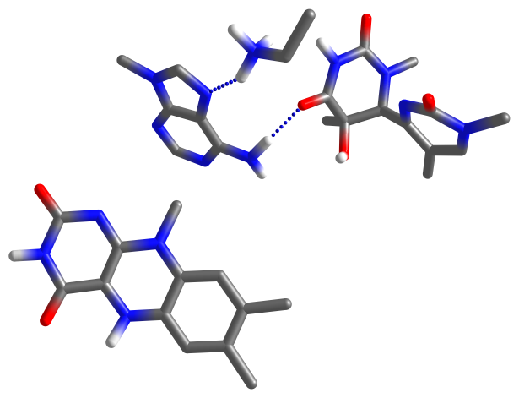
64 PL: Comparing ET Channels
Mendeleev 2024
XIII International Conference on Chemistry for Young Scientists
Experimental timescales:
FET 225 ps
BET 50 ps
Lys
$E$,eV
5’base
3.4
3’base
ET Ade
2.9
2.9
3.0
Ade
0.1 ps
(2 ns)
2.5
*λ=0.82
HQ*
2.2
2.0
*λ=1.25
480 ps
(2.4 ns)
1.60
1.55
1.1
0.3
HQ
0.0
HQ*/HQ
ET Ade
min
HQ
min
HQ*
min
V_{HQ*/ET Ade} = 17 cm⁻¹
* Osswald M., Fingerhut B.P., J. Phys. Chem. B, 2021

Slide 8
64 PL: Comparing ET Channels
Mendeleev 2024
XIII International Conference on Chemistry for Young Scientists
Experimental timescales:
FET 225 ps
BET 50 ps
Lys
5’base
$E$,eV
BET
3’base
Ade
3.4
3.4
3.4
ET 5’base
FET
λ₂
ET Ade
2.9
2.9
λ₁=0.82
λ₁=1.25
2.0
1.6
V_{ET Ade/ET 5’base} = 518 cm⁻¹
HQ
min
HQ*
min
ET Ade
min
ET 5’base
min
FET |  |  |  |  |  |  | BET
λ₁, eV | 1.25 |  |  | 0.82 |  |  | 1.25 |  |  | 0.82
λ₂, eV | 0.4 | 1.0 | 1.6 | 0.4 | 1.0 | 1.6 | 0.4 | 1.0 | 1.6 | 0.4 | 1.0 | 1.6
Time scale | 10²¹ s | 1.4 s | 10 µs | 10⁶ s | 2 µs | 2 ns | 800 µs | 0.02 ps | 2 ns | 40 ps | 0.5 ps | 9 µs

Slide 9
CPD PL: Excitation Energies and Electronic Couplings
Mendeleev 2024
XIII International Conference on Chemistry for Young Scientists
HQ**
ET CPD 2
State | Excit. energy, eV
HQ | 0.0
HQ* | 2.58
ET CPD 1 | 2.78
ET Ade | 3.21
ET CPD 2 | 3.29
HQ** | 3.34
Electron coupling matrix elements V_{ij}, cm⁻¹
HQ*/ET CPD 1 | 12
HQ*/ET Ade | 22
HQ*/ET CPD 2 | 14
ET CPD 1/HQ | 14
ET Ade/HQ | 201
ET CPD 2/HQ | 244
ET Ade/ET CPD 1 | 346
ET Ade
ET CPD 1
HQ*
HQ
Geometry optimization (S₀): B3LYP-D3/cc-pVDZ
Excitation energies: SA-CASSCF/XMCQDPT2/cc-pVDZ/PCM
Electron coupling matrix elements: GMH Scheme

Slide 10
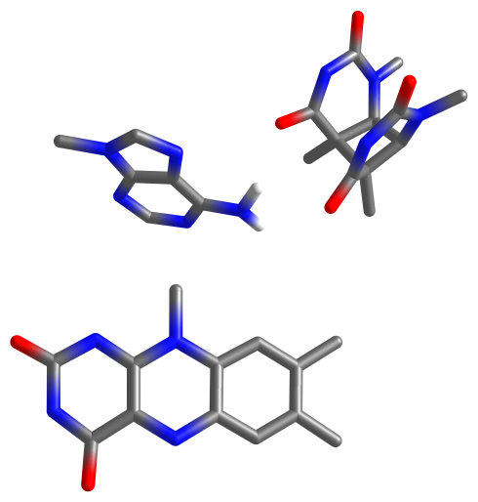
CPD PL: Comparing ET Channels
Mendeleev 2024
XIII International Conference on Chemistry for Young Scientists
Experimental timescales:
FET to CPD 209 ps
FET to adenine 1.34 ns
$E$,eV
CPD
3.6
Ade
3.2
3.2
3.4
2.8
2.8
ET Ade
24 ps
ET CPD 1
2.6
2.6
*λ=1.1
200 ps
HQ*
2.3
*λ=1.3
HQ*
2.3
1.6
2.2
20 ns
1.4
1.5
9 ps
0.3
0.3
HQ
0.0
HQ
0.0
HQ
min
HQ*
min
ET CPD 1
min
HQ
min
HQ*
min
ET Ade
min
V_{HQ*/ET CPD 1} = 12 cm⁻¹
HQ*/HQ
V_{HQ*/ET Ade} = 22 cm⁻¹
* Zhang, Wang, Zhong, Photochem. Photobiol., 2017

Slide 11
Conclusion
Mendeleev 2024
XIII International Conference on Chemistry for Young Scientists
In 64 PL, ET to adenine of FAD is the fastest channel for FET. This implies the essential role of adenine in hindering of repair.
Once the anion of the adenine is formed it can fastly decay into the ground state. Alternatively, further ET to 5’base of photoproduct may take place. But accurate estimating of the rate necessitates accounting for relaxation of ET 5’base state during electron transfer to adenine.
In CPD PL, ET to cyclobutane dimer is the fastest channel for FET.
BET from CPD is slower than the first step in repair reaction explaining high quantum yield of repair in CPD PL.

