Slide 1
Landscape Planning and Design
Valentina A. Toporina Lomonosov Moscow State University, Faculty of Geography,
Research Scientist of Environmental Management Department. Tel. 7 (495) 939 21 53 8 915 400 16 47
valya-geo@yndex.ru

Slide 2
What is Landscape planning?
What is “landscape”?
What does “planning” mean?
Is it basic science or interdisciplinary branch/ practical application?
The links between LP and other Sciences. What are the objects of landscape planning? (Priority, aims and tasks, theory, methods)
LP and SD: aspiration to link knowledge about sustainability with actions to achieve it.
Key examples.

Slide 3
What is Landscape planning?
Theory, concepts, glossary
methodology
Priority, aims and goals
Landscape planning (LP)
Instruments
Sustainability:
actions to achieve
Natural and human values

Slide 4
Key-topics
LP: history, names and examples.
Landscape plans for public goods. Planning models
Environmental impact questions, basic principles.

Slide 5
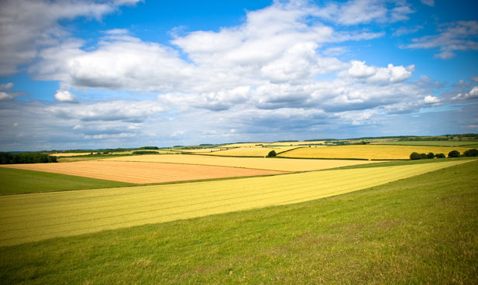
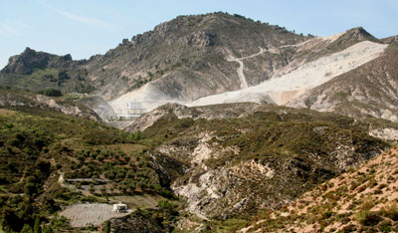
Key-topics
4.Agriculture, farming and countryside policy.
5. Mineral working, planning and design
Farm Diversification
Mineral working in the Sierra Nevada, outside Granada, Spain. This is part of a Landscape, and it can be planned

Slide 6
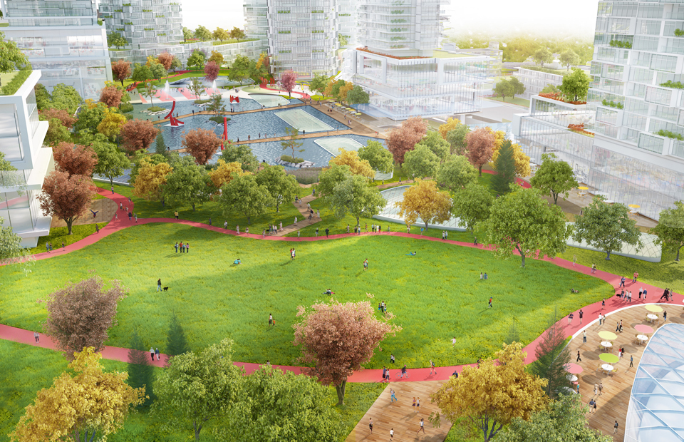
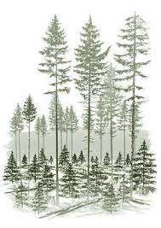
Key-topics
6. Public open space (POS)
7. Forest design, forestry and sylviculture
The expanded Oakridge Centre

Slide 7
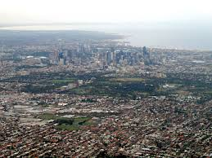
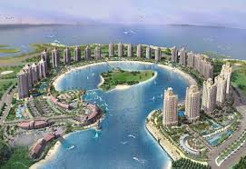
Key-topics
8. Urbanisation and growth management. The future of town and country planning
The urban sprawl of Melbourne
Qatar

Slide 8
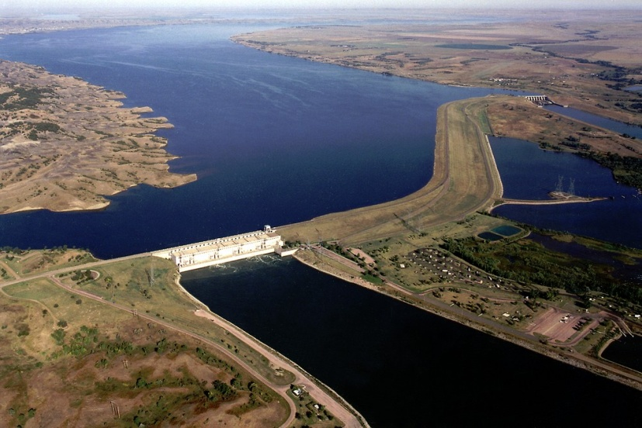
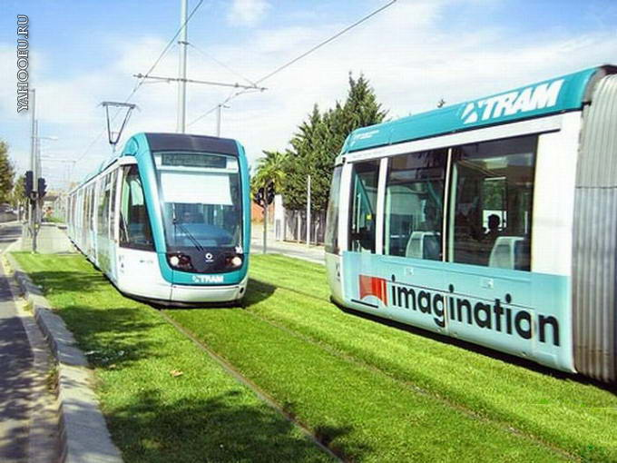
Key-topics
9. River engineering, channelization and floods.
10. Sustainable green transport. Context sensitive design theory.
11. Outdoor landscape design
The dam on the Missouri river
Green Zone

Slide 9
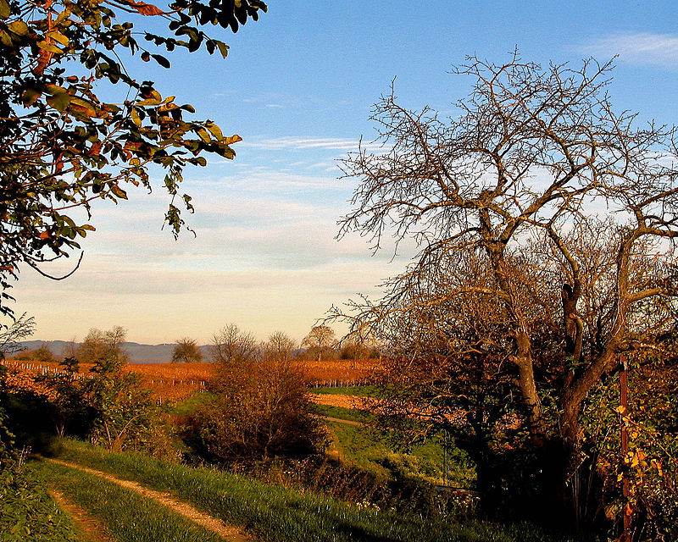
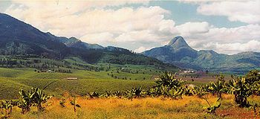
Lecture 1. Theories, Methods & Strategies for Landscape Planning
Landscape comprises the visible features of an area of land, including the physical elements of landforms such as (ice-capped) mountains, hills, water bodies such as rivers, lakes, ponds and the sea, living elements of land cover including indigenous vegetation, human elements including different forms of land use, buildings and structures, and transitory elements such as lighting and weather conditions.
Diversified and partly man-shaped landscape in northern Mozambique.

Slide 10
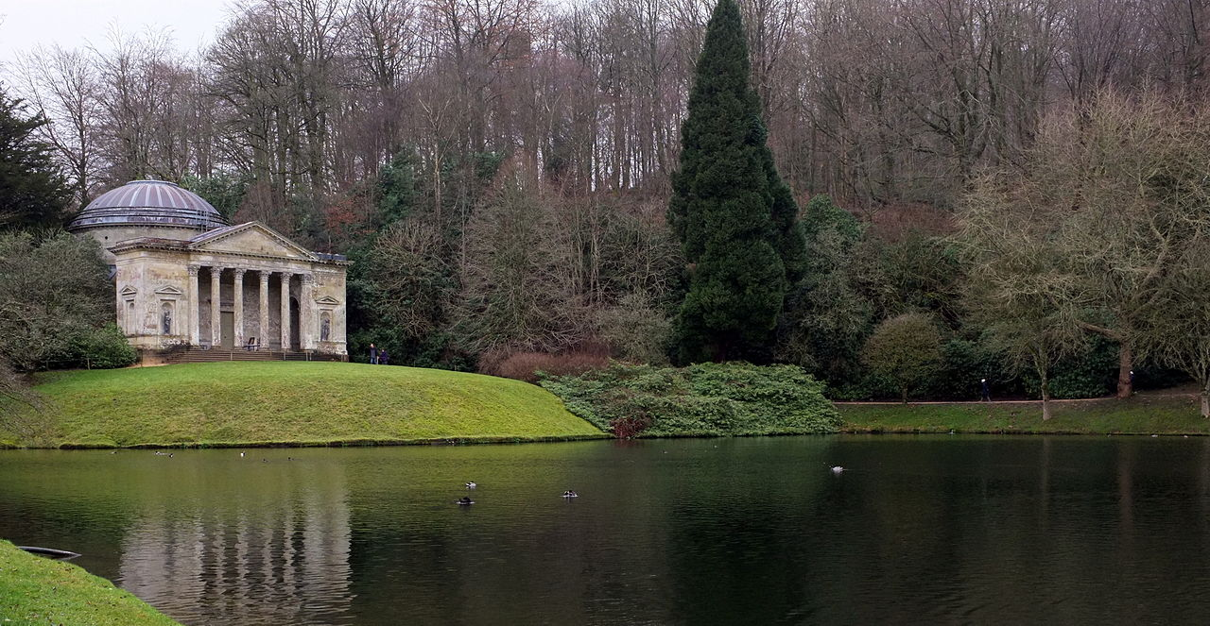
WORD HISTORY of “Landscape”
Landscape, first recorded in 1598, was borrowed as a painters' term from Dutch during the 16th century, when Dutch artists were pioneering the landscape genre.
The Dutch word landschap had earlier meant simply "region, tract of land" but had acquired the artistic sense, which it brought over into English, of "a picture depicting scenery on land.“
34 years pass after the first recorded use of landscape in English before the word is used of a view or vista of natural scenery. This delay suggests that people were first introduced to landscapes in paintings and then saw landscapes in real life
Stourhead in Wiltshire, England, designed by Henry Hoare (1705–1785)

Slide 11
Lecture 1. Theories, Methods & Strategies for Landscape Planning
Definition of LP
LP prescribes alternative spatial configurations of land uses, which is widely understood as a key factor in planning for sustainability. Planning is an activity intent on integrating three sectors across social, economic and environmental arenas (Jack Ahern, 2005).
LP as defined is closely related with physical planning, which aims to optimize the distribution and allocation of land, often in a space-limited context (Van Lier 1998; Botequilha Leitão 2001).

Slide 12
Definition of LP
LP is a branch of landscape architecture (Frederick Law Olmsted). Urban park systems and greenway of the type planned by Frederick Law Olmsted are key examples of urban landscape planning.
LP is defined as an activity concerned with reconciling competing land uses while protecting natural processes and significant cultural and natural resources (Erv Zube (1931–2002)).

Slide 13
Working projects of LP:
are of broad geographical scope;
concern many land uses or many clients;
are implemented over a long period of time.

Slide 14
LP vs LA vs LD
Landscape architecture
Landscape design
Landscape planning

Slide 15
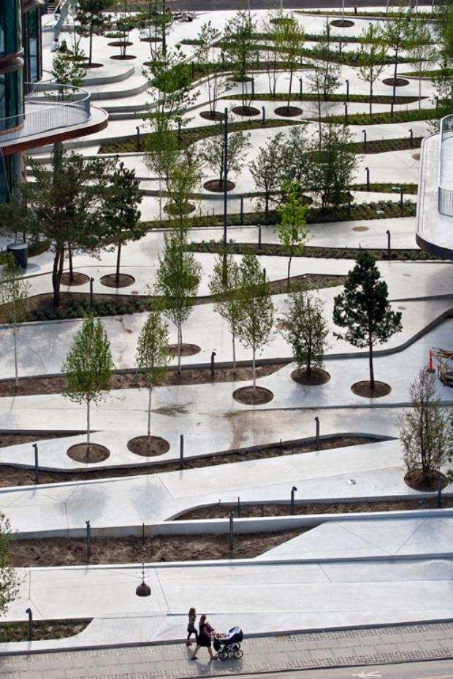
Landscape architecture
Landscape architecture is the art and profession of designing and planning landscapes (Barron's Real Estate Dictionary).
Originally the design of gardens. This term now also covers the planning and management of a landscape in order to meet aesthetic standards while also fulfilling some functions (Oxford Dictionary of Geography).
Landscape Architecture "SEB Bank"

Slide 16
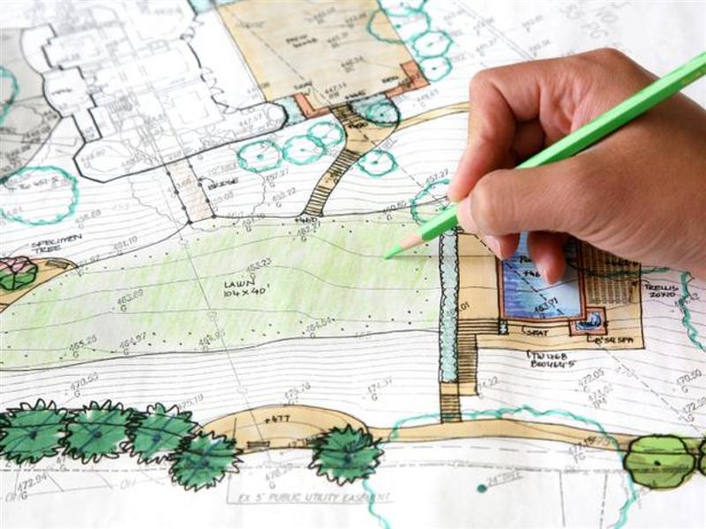
Landscape Architecture is both the art and profession of landscape design, in which topographical, horticultural, and other elements are arranged to suit human use (Gale Encyclopedia of US History).
While humans have shaped landscapes since antiquity, landscape architecture developed as a profession only in the mid-1800s. The term "landscape architecture" was invented by Gilbert Laing Meason in 1828 and was first used as a professional title by Frederick Law Olmsted in 1863.
Landscape Architecture Places Associates Inc

Slide 17
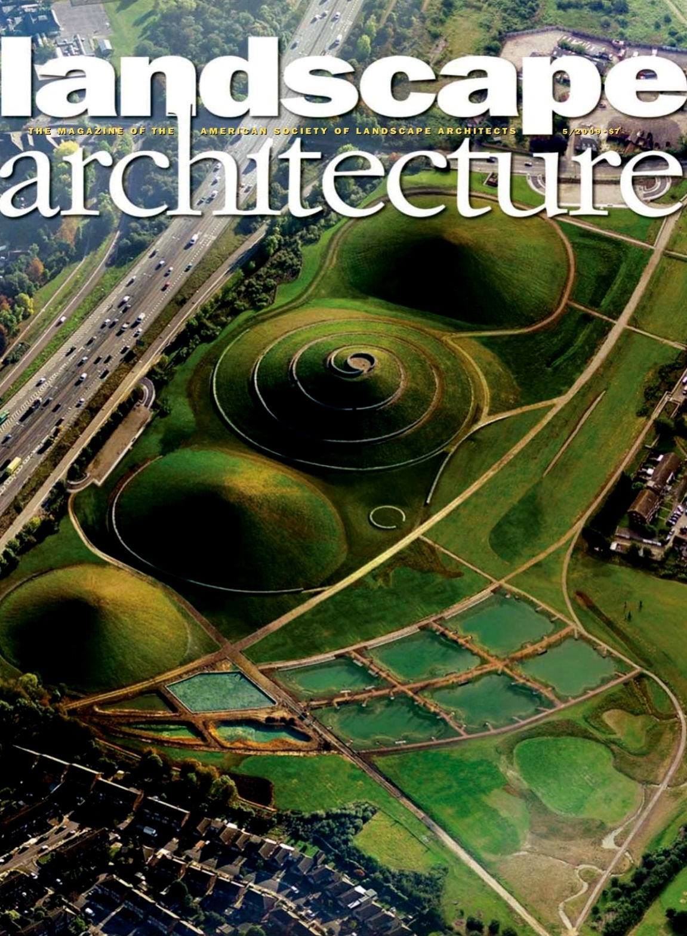
Landscape architecture is a multi-disciplinary field, incorporating aspects of: botany, horticulture, the fine arts, architecture, industrial design, geology and the earth sciences, environmental psychology, geography, and ecology.
The activities can range from the creation of public parks and parkways to site planning for campuses and corporate office parks, from the design of residential estates to the design of civil infrastructure and the management of large wilderness areas or reclamation of degraded landscapes such as mines or landfills. Landscape architects work on all types of structures and external space - large or small, urban, suburban and rural, and with "hard" (built) and "soft" (planted) materials, while integrating ecological sustainability.
Landscape Architecture is an organized profession. Its members have approved qualifications and work on Garden Design, Landscape Design, Landscape Planning and other specialized activities.
Landscape Architecture - May 2009 #5_01

Slide 18
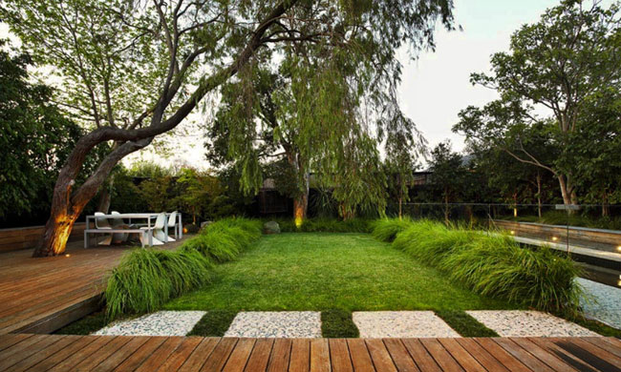
Landscape design
Landscape design means shaping land forms, plants, and site features such as walls or water courses for utilitarian and aesthetic purposes.
The objects are the same as LA but smaller in sizes.
Landscape Design is the art of arranging elements to make good outdoor space.
Landscape Design

Slide 19
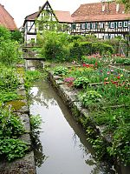
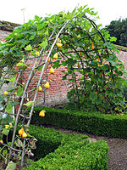
Examples of LD
Entrance to walled kitchen garden (Norfolk, England)
Bebenhausen Abbey monastery garden (Baden-Württemberg, Germany)

Slide 20
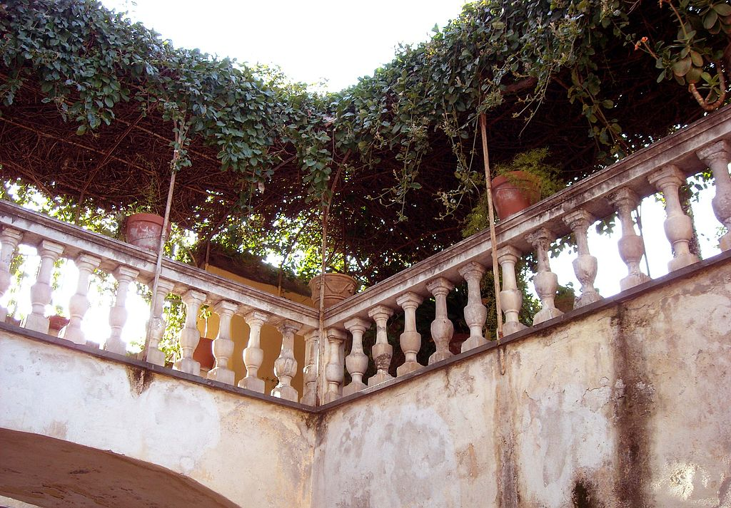
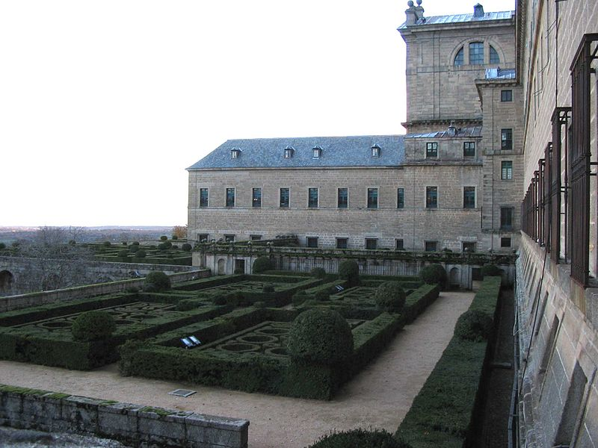
Hanging gardens in the historical center of Ventimiglia, Liguria, Italy.
Formal palace garden Escorial (Madrid, Spain)

Slide 21
Glossary
Aesthetics
Landscape
Landscape planning
Landscape Architecture
Landscape Design
Natural and Social processes
Space: natural, urban, suburban, rural
etc.

Slide 22
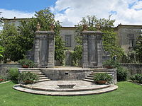
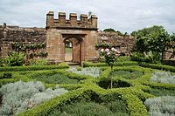
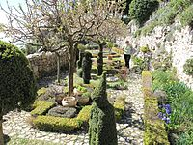
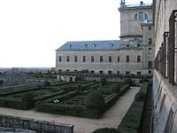
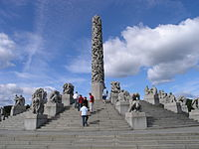
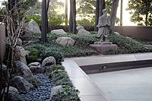
Objects of LP
Individual and collective landscapes (public good): “health” of the landscape and creation of new public goods.
Aim of LP
to develop a special land use plan;
to make recommendations for what can be done to enhance its productivity/ diversity etc.

Slide 23
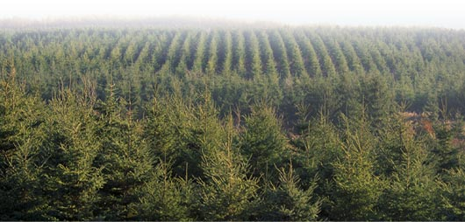
Objects
Landscape of roads .The landscape treatment of roads is concerned with the planning and design of roads and highways with regard to their environmental impact on the surrounding landscape (Design with nature, Ian McHarg ).
Landscape of forestry . The landscape treatment of forests is concerned with the non-timber objectives which can be obtained by conserving and developing forests: scenic quality, water quality, recreation, wildlife conservation and other environmental goods.
Forestry, forest management. Glatfelter Pulpwood Company

Slide 24
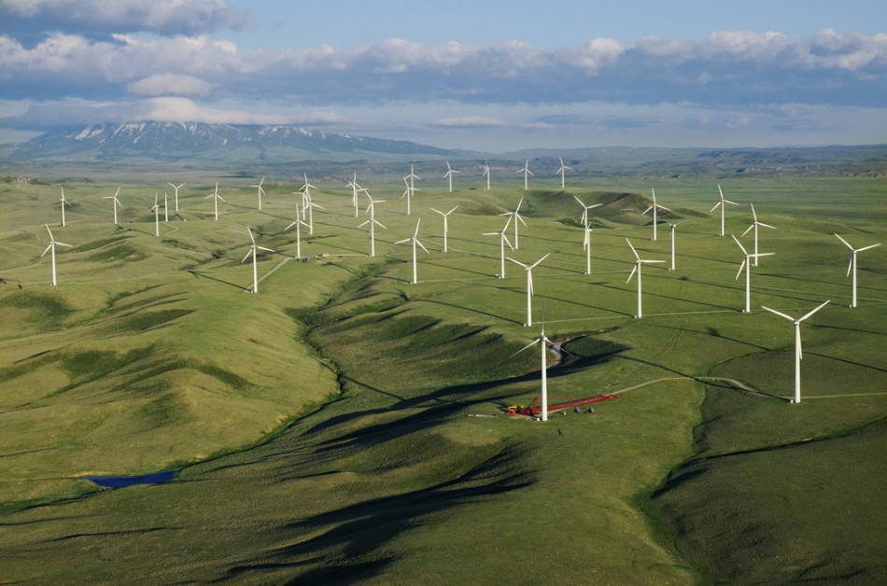
Landscape of energy.
The generation of energy has become a major land use with consequent environmental impacts upon the landscape. Landscape planning for energy is concerned with designs and plans to mitigate the impact of power generation upon the landscape. This includes landscape planning for: power stations, power transmission lines, hydroelectric power, tidal power, solar power and wind power.
Foote Creek Rim Wind Farm near Arlington, in Carbon County, Wyoming

Slide 25
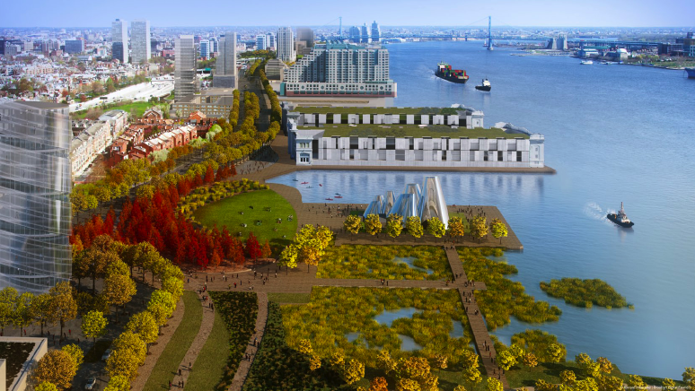
Landscape of urbanization. Landscape planning for urbanization is concerned with the conservation and development of landscape resources as urbanization takes place. Landscape planners have proposed greenways and green belts, GIS as a means of urban growth management.
Master Plan for the Central Delaware

Slide 26
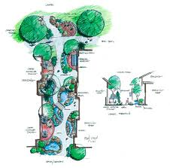
Landscape of recreation.
In the coastal regions of many countries (e.g. Spain and Denmark) it is the dominant land use and has had an enormous impact on the natural landscape. landscape planners work on the landscape of recreation to:
reclaim landscapes which have been damaged by recreational use
carry out environmental impact assessments of recreational development proposals
prepare landscape plans and designs for recreation projects.
Northwoods Landscape & Recreation

Slide 27
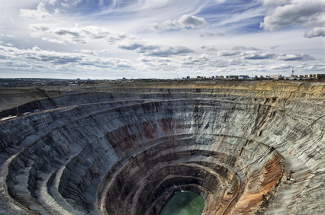
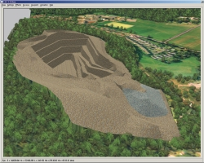
Landscape of mineral extraction .
Harm has been caused to scenic quality, water quality, habitat quality and other environmental goods. The landscape treatment of mineral workings is concerned with:
the reclamation of abandoned mines and quarries;
the planning and design of future mineral workings to minimize their harmful environmental impact and achieve as many positive impacts on the environment as possible.

Slide 28
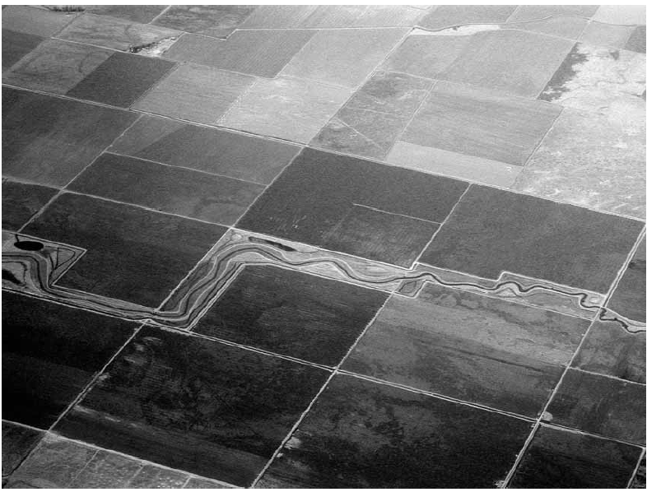
Landscape of agriculture.
Landscape planners are involved with the preparation of agricultural landscape plans for the achievement of non-food objectives from agricultural land.

Slide 29
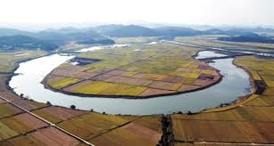
Landscape of rivers.
The construction of new buildings and new roads accelerates the discharge of surface water runoff and raises flood peaks in the lower reachers of river catchments. River banks therefore have to be raised and flood channels have to be constructed. The adoption of sustainable urban drainage systems facilitates the reclamation of rivers. When water is detained, infiltrated and transpired near to the where it falls, flood peaks are lowered and rivers can be reclaimed. The high concrete walls in which they were confined can be replaced by vegetated embankments. Water quality is improved and wildlife returns to the river. Projects to achieve these objectives are described as River Reclamation or River Restoration.
Restoration of major rivers to reinvent Korean landscape

Slide 30
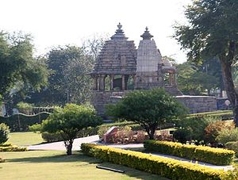
Landscape of archaeology .
The landscape of archaeology is concerned with the landscape treatment of archaeological sites.
In Britain the former Ministry of Public Works and Buildings (MPBW) (now English Heritage, Historic Scotland and Northern Ireland Environment and Heritage Service) had a policy of treating archaeological sites like highly manicured gardens.
The western group of Khajuraho temples (2005) set in an archaeologically inappropriate parkland landscape

Slide 31
Methodology of landscape planning.
Identification of problems and opportunities.
Establishment of goals.
Inventory and analysis of the biophysical environment.
Human community inventory and analysis.
Development of concepts and the selection of options.
Adoption of a plan.
Community involvement and education.
Detailed design.
Plan implementation.
Plan administration.

Slide 32
A typology for classifying landscape planning methods
Subcategories:
theoretical orientation: substantive or procedural;
resource or goal orientations;
interdisciplinary / transdisciplinary;
strategic orientation;
spatial concepts.

Slide 33
Fundamental types of theory in landscape planning
Substantive
Procedural
Substantive theories are descriptive and originate from basic research in the natural and social sciences and the humanities.
Island biogeography and metapopulation theory are examples of substantive theories that are increasingly applied in landscape-ecological planning. The application of these theories has led to criticism by ecologists who argue, for example, that conservation corridors are not a panacea to solve the biodiversity crisis, and that corridors may cause unintended negative effects on biodiversity for example by enabling the spread of diseases or invasive species (Simberloff and Cox 1987).
Procedural theories offer recommendations for putting substantive theory into practice. They focus on methodological issues, such as suitability analysis, optimal land-use allocation, and applied landscape-ecological planning. Planners draw on substantive theories for information and guidelines but use procedural theories as a framework to organize information in a form that readily permits the more direct application of information in addressing landscape-planning problems (Ndubisi 1997).

Slide 34
Resource or goal orientation
The abiotic–biotic–cultural (ABC) model is useful to describe the specific goals addressed in planning and the level of integration between these goals (Ahern 1995).
In this model, abiotic goals include water resources, soil and air quality. Biotic goals focus on biodiversity in general, including individual species and habitat protection and ecological restoration.
Cultural goals are human-based and include: transportation, land use, recreation, historic preservation and economic goals.

Slide 35
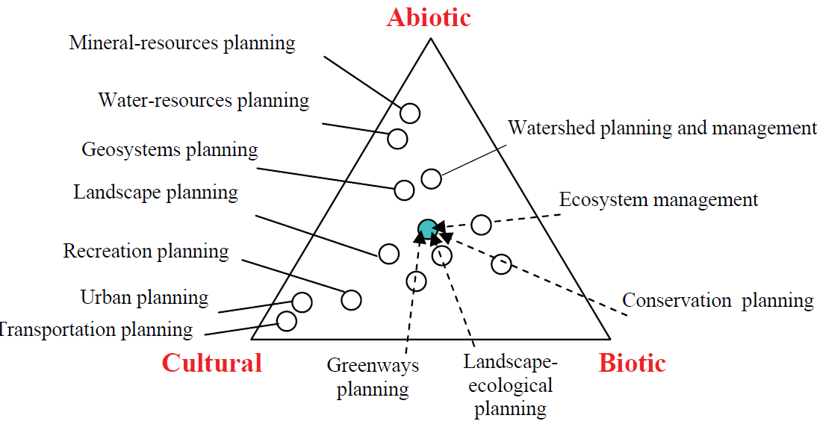
The abiotic–biotic–cultural (ABC) model
Figure presents an array of planning types graphically organized within a triangle that represents the ABC model. In this diagram a number of planning sectors or themes are located according to their emphasis and level of integration within the ABC resources. The figure shows that an evolution is occurring towards a more integrated planning perspective as represented by the central circle.

Slide 36
Interdisciplinarity and transdisciplinarity
Planning is evolving towards an integrated or balanced approach wherein multiple abiotic, biotic and cultural goals are simultaneously pursued. Historically, this integration has involved knowledge and participation from multiple disciplines, initially under a multidisciplinary approach in which disciplines operated with minimal interaction and collaboration.

Slide 37
Interdisciplinary approach
researchers and professionals from multiple disciplines collaborated, shared information and achieved a higher level of synthesis and integration.
Transdisciplinary approach represents a yet higher level of integration in which professionals, non-academic and academic participants participate in a process in which knowledge is shared across disciplines and all participants are engaged in decision making

Slide 38
Strategic orientation
Defensive strategy is employed when the existing landscape is already fragmented, and core areas already limited in area and isolated. This strategy seeks to arrest / control the negative processes of fragmentation or urbanization. The defensive strategy is often necessary, but it can also be seen as a reactionary strategy which attempts to “catch up with” or “put on the brakes” against the inevitable process of landscape change (Sijmons 1990).
Protective is applied when the existing landscape supports sustainable processes and patterns. Essentially, this strategy defines an eventual or optimal landscape pattern that is proactively protected from change while the landscape around it may be allowed to change.
Offensive strategy differs from protective and defensive strategies in that it employs restoration, or reconstruction, to re-build landscape elements in previously disturbed or fragmented landscapes. This strategy is often practiced in locations where intensive land use has produced a cultural landscape with limited opportunities for nature protection or defence. It is rarely practiced because it is expensive and often politically sensitive (Ahern 1995).

Slide 39
Spatial concepts
Spatial concepts are essential tools for proactive or innovative planning, and can structure and inspire the planning process, particularly with respect to public participation – a key factor in transdisciplinary planning.
Examples include: “green heart”, “ring city” and “edge city”. Spatial concepts are well accepted in planning, but less so in science since they are by definition subjective and derived from intuitive thinking.

Slide 40
Spatial concepts
Comprehensive spatial concept “Aggregate with-Outliers Principle”, which addresses the provocative question ”What is the optimum arrangement of land uses in a landscape?” (Forman 1995, p. 437).
Forman’s concept states that land uses should be aggregated, yet maintain small corridors and small patches of nature throughout developed areas, as well as outliers of human activity spatially arranged along major boundaries.
This strategic model for spatial planning addresses multiple landscape-ecological goals: maintains large patches of native vegetation; accommodates human needs / preferences; contains a variance of grain size; supports generalist and specialist species, spreads risks; supports genetic variation; and accommodates outliers located along a boundary zone.

Slide 41
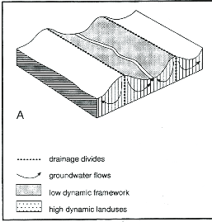
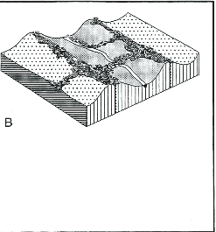
Spatial concepts “Framework Concept”
“Framework Concept”is based principally on abiotic geo-hydrological landscape patterns that can be isolated and managed to provide for a linked network or framework of “low-dynamic” functions (i.e. nature development; see Figure).
Within the “gaps” of the framework there are complementary opportunities for “high-dynamic”land uses (e.g. “intensive agriculture”or “urbanization”(Van Buuren and Kerkstra 1993).
A version of the framework concept is represented in the Plan Stork for restoration of floodplain forests in The Netherlands (De Bruin, Hamhuis and Van Nieuwenhuijze 1987).
The Framework Concept (Van Buuren and Kerkstra 1993).
3A illustrates the concept of a hydrological unit defined by surficial topography and subsurface hydrology;
3B shows how the hydrological unit defined in 3A can be managed to support ‘low-dynamic’
nature / habitat redevelopment

Slide 42
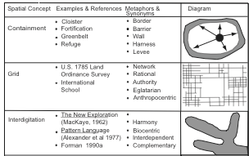
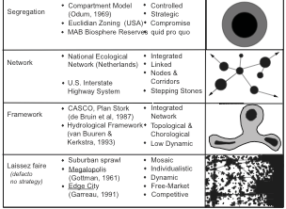
Spatial concepts: “strategic tool box”
Figure presents a series of basic spatial concepts for planning.
These can be understood as a kind of “strategic tool box” with which planners can articulate strategies that respond to the given landscape context and configuration and the forces and dynamics of landscape change with the intention of planning a more sustainable spatial pattern.

Slide 43
Selected landscape planning methods
Ecological Planning Model is an 11-step procedure for studying the biophysical and socio-cultural systems of a place/landscape to reveal where specific land uses may best be practiced.
The Ecological Planning Model includes an emphasis on goal establishment, implementation, administration and public participation through systematic education and citizen involvement throughout the process.
It can be considered transdisciplinary as it involves professionals, experts and citizens in a highly interactive process.

Slide 44
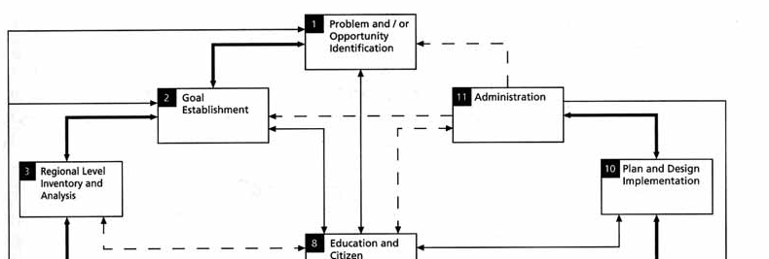
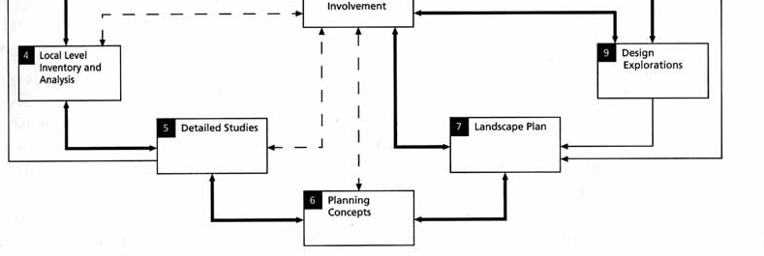
Ecological Planning Model
The Ecological Planning Model (Steiner, 2000)

Slide 45
Framework Method for Landscape Planning
Steinitz’ Framework Method for Landscape Planning (1990; 1995) is presented as a series of six questions that are fundamental to landscape planning:
1. Representation: How should the state of the landscape be described in terms of content, boundaries, space and time?
2. Process: How does the landscape work? What are the functional and structural relationships among its elements?
3. Evaluation: How does one judge whether the current state of the landscape is working well? The metrics of judgment include: beauty, habitat diversity, cost, nutrient flow, public health or user satisfaction.

Slide 46
Steinitz’ Framework Method for Landscape Planning
4. Change/Intervention: By what actions might the current representation of the landscape be altered (whether conserving or changing the landscape)?
5. Impact: What predictable differences might the changes cause (i.e., using process models to simulate change)?
6. Decision: How is the decision to change (or conserve) the landscape to be made? How is a comparative evaluation to be made among the alternative courses of action?

Slide 47
Steinitz’ framework provides
1) a robust and flexible process for assessing a landscape and for engaging scientific experts, professionals and stakeholders in an informed, iterative and participatory planning process.
2) The framework is suited to address multiple ABC goals, and is adaptable to any strategic planning context. It can be considered transdisciplinary as it integrates public and expert participation.
3)The framework does not include spatial concepts, however in practice it develops alternative future scenarios that represent a form of spatial concept.

Slide 48
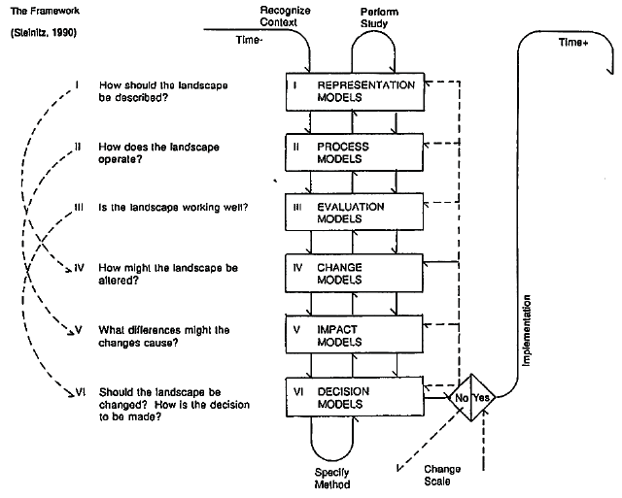
Steinitz’ framework
Framework Method for Landscape Planning (Steinitz, 1995)

Slide 49
Framework Method for Landscape Ecological Planning (Ahern 1995; 1999)
This Framework is presented as a linear process, but actually is nonlinear, cyclical and iterative and may be entered at any point in the process (e.g. planning could start with a reevaluation of an existing plan).
This method is based largely on landscape-ecological theory and concepts, as understood and applied through spatial assessments and spatial concepts.

Slide 50
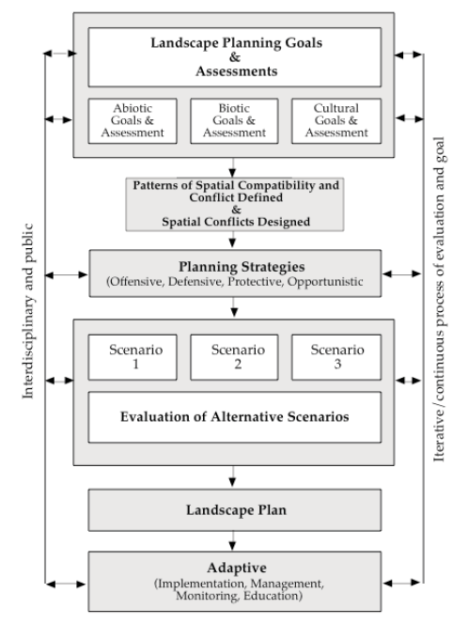
As with Steinitz’ method, this framework guides the planning process through a series of alternative future scenarios, to inform, inspire and challenge the decision-making process to link planning actions with potential outcomes.
The scenarios describe a current situation, some alternative future(s) and the necessary steps or actions needed to link the present with the future. These scenarios are not intended to be complete plans, but are appropriate for encouraging informed discussion of alternatives.
The scenarios are evaluated, with public, expert and stakeholder input. The discussion leads to a landscape plan that is adaptive in terms of implementation, monitoring and education.
Framework Method for Landscape Ecological Planning (Ahern, 1999)

Slide 51
Barriers, challenges and strategies to implement landscape planning
Uncertainty and adaptability
Uncertainty is inherent in multipurpose planning. Uncertainty exists in several principal forms relative to planning: geographical/spatial, temporal, process, transferability, and human input unpredictability. Strategies from science are helpful to aid planners in reducing uncertainty, including: replication of data, the use of data analogues, developing multiple hypotheses, and monitoring.
Planners operate in the ‘real world’ where there is an imperative to act. The world doesn’t stop or wait while planners work to collect data to reduce uncertainty.

Slide 52
Uncertainty and adaptability
traditional management
adaptive management
hesitated to apply new policy decisions until proof of efficacy was obtained through long- and short-term empirical studies
Under a traditional planning/decision-making approach, decisions on each of these areas of uncertainty (appropriate systems or populations of study, spatial-temporal scales and geographic extent) would be made before a plan was implemented and before a monitoring programme could be designed.
is a proactive method under which projects and policy decisions are used as “experimental probes”, to learn by doing (Holling 1978; Walters 1986). Data made available upon the outcome of each policy decision or model implemented are used to structure alternative and future choices (Walters and Holling 1990), attempting to reduce the amount of uncertainty and improving ecological knowledge and understanding over time.
Principle areas of uncertainty (appropriate systems or populations of study, spatial-temporal scales and geographic extent) can become part of adaptive hypotheses, which can then inform both planning and monitoring actions and interpretations.

Slide 53
Guidelines for land-use planning and management (Dale et al. (2000))
1. Examine the impacts of local decisions in a regional context.
2. Plan for long-term change and unexpected events.
3. Preserve rare landscape elements and associated species.
4. Avoid land uses that deplete natural resources over a broad area.
5. Retain large contiguous or connected areas that contain critical habitats.
6. Minimize the introduction and spread of non-native species.
7. Avoid or compensate for effects of development on ecological processes.
8. Implement land-use and land-management practices that are compatible with the natural potential of the area.

