Slide 1
Basic concepts
Landscape (geogr.) - rather homogeneous site of a terrestrial surface with specific homogeneous surface layer, vegetation, ground, type of climate within all natural components and human activity are interconnected and interrelated.
Landscape (paint.) - “view”, external appearance of nature.

Slide 2
Landscape planning can be defined as the scientific study of landscapes to assess past, current, and future capabilities to support different land uses that also accounts for environmental and ecological health.
It has evolved into a scientific discipline practiced by landscape architects, planners, and natural resource scientists. In practice, landscape architects who use overlay analysis and assessment as part of their design process are doing landscape planning.

Slide 3
Procedural model of lp
1. Examine the impacts of local decisions in a regional context.
2. Plan for long-term change and unexpected events.
3. Preserve rare landscape elements and associated species.
4. Avoid land uses that deplete natural resources over a broad area.
5. Retain large contiguous or connected areas that contain critical habitats.
6. Minimize the introduction and spread of non-native species.
7. Avoid or compensate for effects of development on ecological processes.
8. Implement land-use and land-management practices that are compatible with the natural potential of the area.

Slide 4
Scope of lp
LP ≈ Regional Planning,
Community Planning,
Urban Planning,
Smart Growth,
Sustainable Planning
and any other planning exercise that ultimately plays a role in defining how land is used.

Slide 5
LP = LA +principles of Landscape Ecology
Principles of Landscape Ecology:
Patches
Corridors
Edges
Mosaics

Slide 6
Landscape architecture is the design of outdoor public areas, landmarks, and structures to achieve environmental, social-behavioral, or aesthetic outcomes. It involves the systematic investigation of existing social, ecological, and geological conditions and processes in the landscape that will produce the desired outcome. The scope of the profession includes: urban design; site planning; stormwater management; town or urban planning; environmental restoration; parks and recreation planning; visual resource management; green infrastructure planning and provision; and private estate and residence landscape master planning and design; all at varying scales of design, planning and management. A practitioner in the profession of landscape architecture is called a landscape architect.

Slide 7
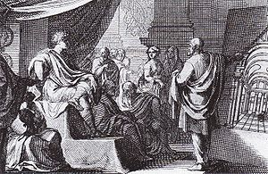
histoRy. Scholars
Vitruvius, was a Roman author, architect, and civil engineer during the 1st century BC perhaps best known for his 10 books work entitled De Architectura.
He emphasized importance of microclimates, vegetation, and hydrology in the planning of new settlements and cities.
A 1684 depiction of Vitruvius (right) presenting De Architectura to Augustus

Slide 8
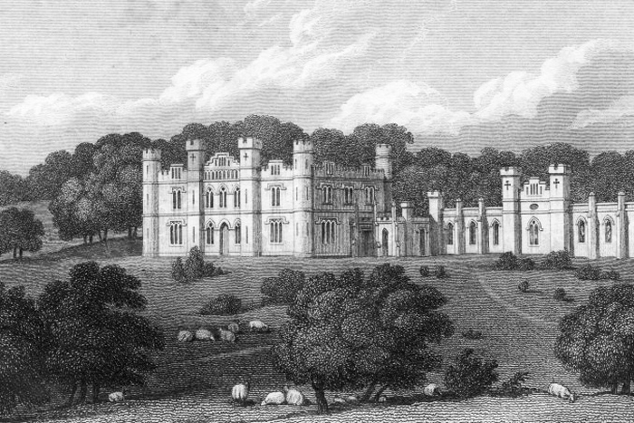
Gilbert Laing Meason (3 July 1769 – 14 August 1832)[a Scottish gentleman, best remembered as the originator of the term landscape architecture.
In 1828 he published a book called On The Landscape Architecture of the Great Painters of Italy (London, 1828).
It dealt with the way that buildings and structures were sited within landscapes to produce beautiful compositions.
The book sold poorly. Although essentially a work of art criticism, Laing Meason touched on subjects, such as the placing of buildings and their surroundings, which form a central part of the modern landscape architect's work.
Lindertis House (belonged to Gilbert Laing Meason)

Slide 9
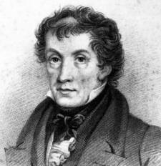
John Claudius Loudon (8 April 1783 – 14 December 1843) was a Scottish botanist, garden designer and cemetery designer, author and garden magazine editor.
When working on the layout of farms in South Scotland, he described himself as a landscape planner. This was a time when open field land was being converted to the landscape of enclosure, which now dominates British agriculture.
John Claudius Loudon

Slide 10
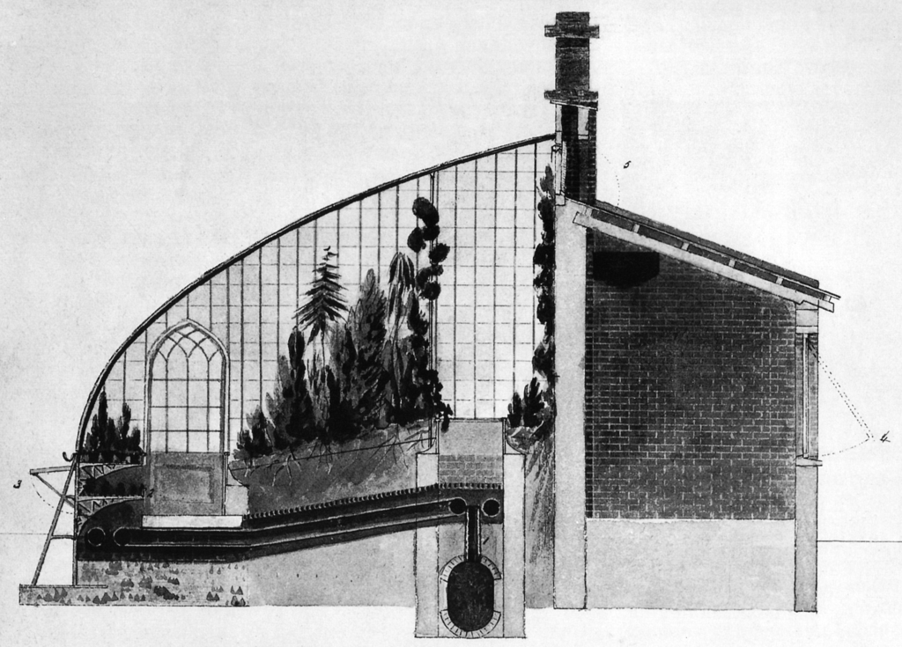
After traveling through Europe from 1813 to 1814, Loudon began to focus on the improvement of the construction of greenhouses and other agricultural systems. He ultimately developed a design for hinged surfaces that could be adjusted depending on the angle of the sun. Loudon also developed plans for industrial worker housing and solar heating systems.
He envisioned city growth being carefully shaped and circulation influenced by the inclusion of green belts (Hints for Breathing Places for Metropolis, 1829).
In 1832, Loudon established the design theory entitled Gardenesque.
Design greenhouse for Royal Horticultural Society, 1818

Slide 11
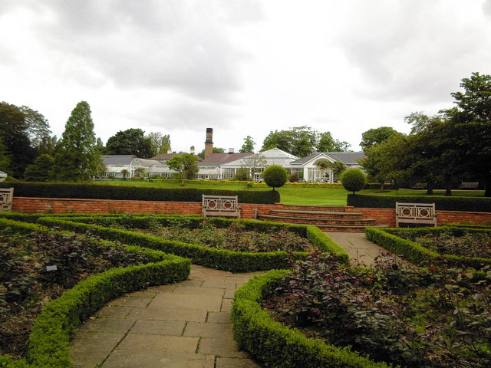
John Claudius Loudon
Prominent designs by Loudon
Birmingham Botanical Gardens, Birmingham
Derby Arboretum, Derby City
Harewood House, West Yorkshire
Bath Abbey Cemetery, Bath and North East Somerset, Bath
Histon Road Cemetery, Cambridge
Ditchley, Oxfordshire
Books :
1806. A treatise on forming, improving, and managing country residences, Vol. I, Vol. II
1822. An Encyclopædia of Gardening
1824. The green-house companion
1838. Suburban Gardener
1842. The Encyclopedia of Trees and Shrubs
1843. On the Laying Out, Planting and managing of Cemeteries
Magazines1826– Gardener's Magazine
1828– Magazine of Natural History
Birmingham Botanical Gardens

Slide 12
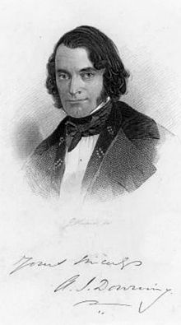
Andrew Jackson Downing
Downing believed that architecture and the fine arts could affect the morals of the owners, and that improvement of the external appearance of a home would help "better" all those who had contact with the home.
Downing saw that the family home was becoming the place for moral education and the focus of middle class America's search for the meaning of life.
Downing developed his view that country residences should fit into the surrounding landscape and blend with its natural habitat. He also believed that architecture should be functional and that designs for residences should be both beautiful and functional.

Slide 13
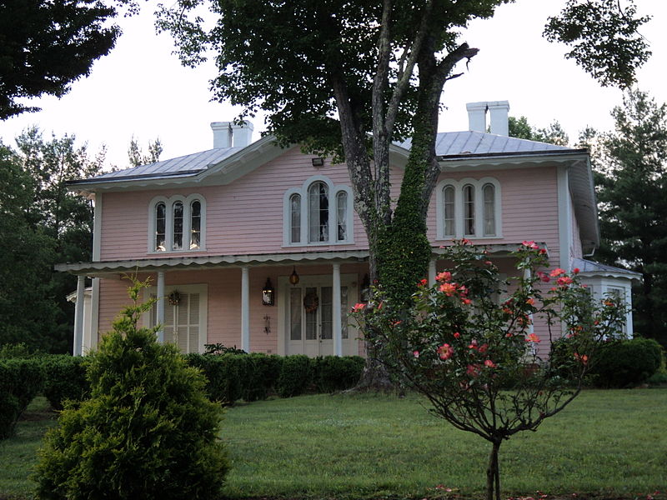
Selected works
A Treatise on the Theory and Practice of Landscape Gardening, Adapted to North America, 1841.
Cottage Residences: or, A Series of Designs for Rural Cottages and Adapted to North America, 1842; reprinted as Andrew Jackson Downing, Victorian Cottage Residences, Dover Publications, 1981.
The Architecture of Country Houses: Including Designs for Cottages, and Farm-Houses and Villas, With Remarks on Interiors, Furniture, and the best Modes of Warming and Ventilating, D. Appleton & Company, 1850; reprinted as Andrew Jackson Downing, The Architecture of Country Houses, Dover Publications, 1969.
"On the Moral Influence of Good Houses“ (2. Horticulturist. February 1818. pp. 345–47. Archived from the original on September 13, 2010. Retrieved August 30, 2010.)
Aurora, Penn's Store, Patrick County, Virginia. Built in 1853 and Influenced by Downing's designs

Slide 14
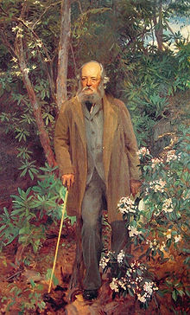
Frederick Law Olmsted (April 26, 1822 – August 28, 1903)
What architect so noble...as he who, with far-reaching conception of beauty, in designing power, sketches the outlines, writes the colors, becomes the builder and directs the shadows of a picture so great that Nature shall be employed upon it for generations, before the work he arranged for her shall realize his intentions. - Frederick Law Olmsted
He is popularly considered to be the father of American landscape architecture, although many scholars have bestowed that title upon Andrew Jackson Downing. Olmsted was famous for co-designing many well-known urban parks with his senior partner Calvert Vaux, including Central Park and Prospect Park in New York City.
Frederick Law Olmsted, oil painting by John Singer Sargent, 1895, Biltmore Estate, Asheville, North Carolina

Slide 15
In addition to designing for urban life, Olmsted was anxious to preserve areas of natural beauty for future public enjoyment.
He served as the first head of the commission in charge of preserving Yosemite Valley and was a leader in establishing the Niagara Reservation, which he planned with Calvert Vaux, in 1887.

Slide 16
Frederick Law Olmsted: works
Public parks and parkways in Buffalo, New York;
the Niagara Reservation in Niagara Falls, New York;
one of the first planned communities in the United States, Riverside, Illinois;
Mount Royal Park in Montreal, Quebec;
the Emerald Necklace in Boston, Massachusetts; also the Emerald Necklace of parks in Rochester, New York;
the Belle Isle Park, in the Detroit River for Detroit, Michigan;
the Presque Isle Park in Marquette, Michigan;
the Grand Necklace of Parks in Milwaukee, Wisconsin;
the Cherokee Park and entire parks and parkway system in Louisville,
Kentucky; Springfield, Massachusetts' 735-acre Forest Park, featuring America's first public "wading pool“;
the George Washington Vanderbilt II Biltmore Estate in Asheville, North Carolina;
the master plans for the University of California, Berkeley and Stanford University near Palo Alto, California; and the Montebello Park in St. Catharines, Ontario.

Slide 17
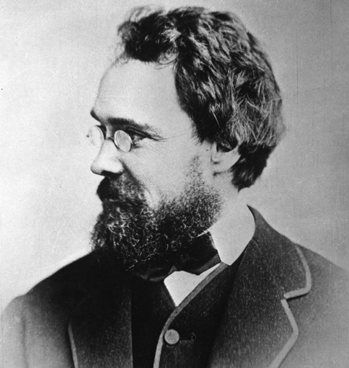
Calvert Vaux
Calvert Vaux (December 20, 1824 – November 19, 1895) was a British-American architect and landscape designer. He is best remembered as the co-designer of what would become New York's Central Park.

Slide 18
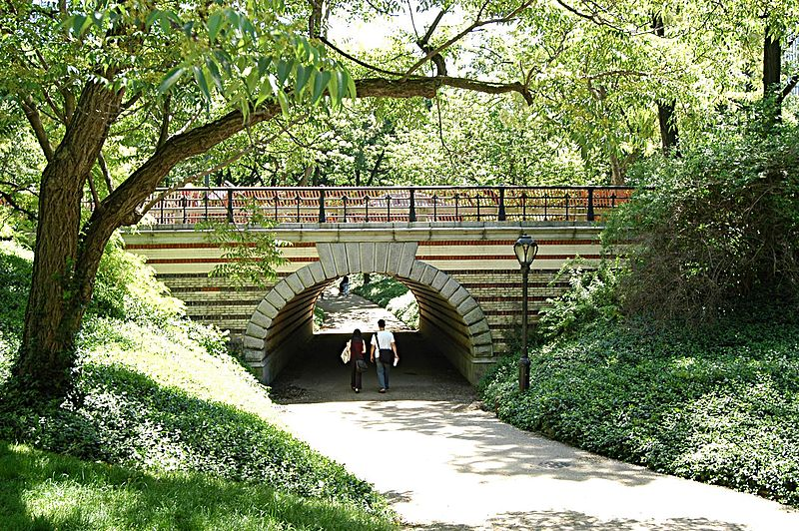
Calvert Vaux
Calvert Vaux
approached F. L. Olmsted to work with him to prepare an entry for the competition to design Central Park, NYC, which they won in 1858: their professional partnership was to last until 1872. Their plan, combining aspects of the English Picturesque style, and embracing ingenious segregation between vehicles and pedestrians, was very influential. Following this success, Vaux prepared further plans for landscapes (including Prospect Park, Brooklyn, NYC (1866–73) ), which introduced the concept of parkways
An unobtrusive bridge in Central Park, designed by Calvert Vaux, separates pedestrians from the carriage drive.

Slide 19
Olmsted and Vaux gave a different slant to the meaning of 'landscape architecture', using the term to describe the whole professional task of designing a composition of planting, landform, water, paving and other structures.
Their first use of this term was in the winning entry for the design of Central Park in New York City. Olmsted and Vaux then adopted 'landscape architect' as a professional title and used it to describe their work for the planning of urban park systems.

Slide 20
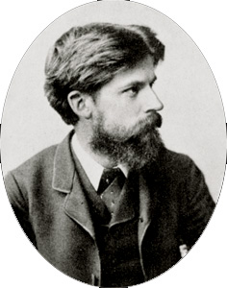
Patrick Geddes
A Scottish biologist, sociologist, geographer, philanthropist and pioneering town planner .
He is known for his innovative thinking in the fields of urban planning and sociology.
He introduced the concept of "region" to architecture and planning and coined the term "conurbation“.
Geddes was keenly interested in the science of ecology, an advocate of nature conservation and strongly opposed to environmental pollution. Because of this, some historians have claimed he was a forerunner of modern Green politics
Sir Patrick Geddes
(2 October 1854 – 17 April 1932)

Slide 21
Patrick Geddes: school
Conservative surgery" versus the gridiron plan
Geddes championed a mode of planning that sought to consider "primary human needs" in every intervention, engaging in "constructive and conservative surgery “rather than the "heroic, all of a piece schemes“popular in the nineteenth and early twentieth centuries. He continued to use and advocate for this approach throughout his career.

Slide 22
Patrick Geddes: school
The "civic survey“
Geddes advocated the civic survey as indispensable to urban planning: "diagnosis before treatment". Such a survey should include, at a minimum, the geology, the geography, the climate, the economic life, and the social institutions of the city and region.
He was particularly critical of that form of planning which relied overmuch on design and effect, neglecting to consider "the surrounding quarter and constructed without reference to local needs or potentialities".
Geddes encouraged instead exploration and consideration of the "whole set of existing conditions", studying the "place as it stands, seeking out how it has grown to be what it is, and recognising alike its advantages, its difficulties and its defects“

Slide 23
Patrick Geddes: school
The regional plan
In 1909, Geddes assisted in the early planning of the southern aspect of the Zoological Gardens in Edinburgh. This work was formative in his development of a regional planning model called the "Valley Section”.

Slide 24
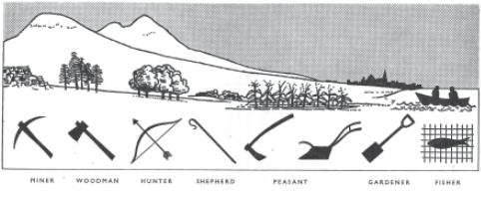
Patrick Geddes, Valley Section, 1909
This model illustrated the complex interactions among biogeography, geomorphology and human systems and attempted to demonstrate how "natural occupations" such as hunting, mining, or fishing are supported by physical geographies that in turn determine patterns of human settlement. The point of this model was to make clear the complex and interrelated relationships between humans and their environment, and to encourage regional planning models that would be responsive to these conditions

Slide 25
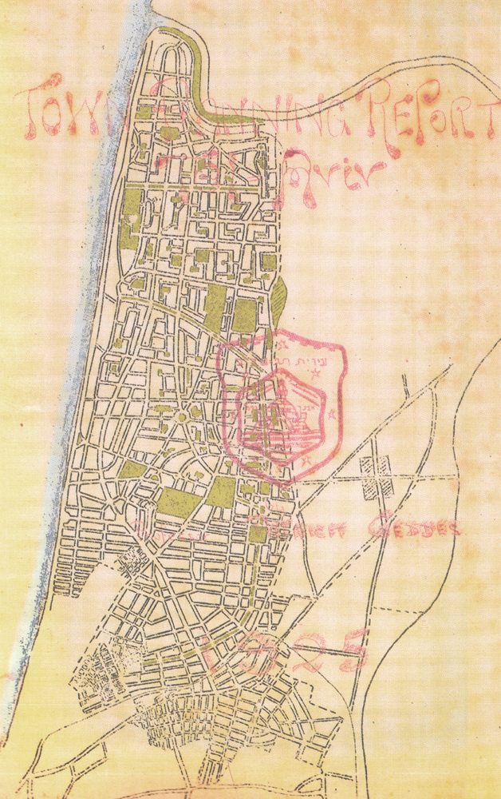
Patrick Geddes: Work in Palestine
In 1919, Geddes was commissioned by the British Mandate to draw up a masterplan for Jerusalem
In 1925, he also submitted a master plan for developing Tel Aviv, called "Geddes Plan for Tel Aviv" . It was adopted by the city council led by Meir Dizengoff. Tel Aviv is the only known city whose core is entirely built according to Geddes' plan.
Master Plan for Tel Aviv, 1925 by Patrick Geddes

Slide 26
Bombay Town Planning Act of 1915
Geddes' work in improving the slums of Edinburgh led to an invitation from Lord Pentland (then Governor of Madras) to travel to India to advise on emerging urban planning issues, in particular, how to mediate "between the need for public improvement and respect for existing social standards".
Between 1915 and 1919 Geddes wrote a series of "exhaustive town planning reports" on at least eighteen Indian cities.
His principles for town planning in Bombay demonstrate his views on the relationship between social processes and spatial form, and the intimate and causal connections between the social development of the individual and the cultural and physical environment.

Slide 27
Bombay Town Planning Act of 1915
Principles for town planning in Bombay included:
Preservation of human life and energy, rather than superficial beautification.
Conformity to an orderly development plan carried out in stages.
Purchasing land suitable for building.
Promoting trade and commerce.
Preserving historic buildings and buildings of religious significance.
Developing a city worthy of civic pride, not an imitation of European cities.
Promoting the happiness, health and comfort of all residents, rather than focusing on roads and parks available only to the rich.
Control over future growth with adequate provision for future requirements.

Slide 28
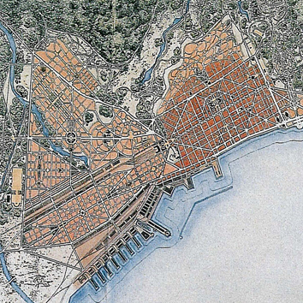
Thomas Hayton Mawson (1861-1933)
 |  | LOCATION: Greece
 |  | DETAILS: Town planning
NAME: Salonika | DATE: 1917 | CLIENT: City of Athens and Greek government
He emphasized a strong association between built form and the immediate landscape.

Slide 29
Thomas Hayton Mawson
Writings
1900: The Art and Craft of Garden Making, 1st edn 1900, 5th edn (recommended), 1926.
1908: "The Designing of Gardens", article in The Studio Year Book of Decorative Art 1908
1911: Civic Art Covers the principles of town planning
1927: The Life and Work of an English Landscape Architect
Works
designed gardens in various parts of Britain,
Peace Palace gardens at The Hague,
Great Smoky Mountains National Park in the United States,
unaccepted designs including for Wascana Centre in Regina, Brockton Point lighthouse, Coal Harbour and Lost Lagoon in Vancouver,
unaccepted urban design plans for Banff and downtown Calgary.

Slide 30
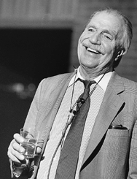
Ian L. McHarg (20 November 1920 – 5 March 2001)
A Scottish landscape architect and a renowned writer on regional planning using natural systems. He was the founder of the department of landscape architecture at the University of Pennsylvania in the United States.
Ian McHarg

Slide 31
Ian L. McHarg
Ian McHarg reintroduced the concept of overlay analysis with an emphasis on ecology and conservation of natural resources. The evolution of overlay analysis by McHarg was instrumental in the design and development of geographic information systems (GIS) as an invaluable analysis and assessment tool in all fields of planning. The field of landscape planning has evolved into a first step in the regional or land use planning process.

Slide 32
Ian L. McHarg
A book of step-by-step instructions on how to break down a region into its appropriate uses
He promoted an ecological view, in which the designer becomes very familiar with the area through analysis of soil, climate, hydrology, etc. Design With Nature was the first work of its kind "to define the problems of modern development and present a methodology or process prescribing compatible solutions“. The book also had an impact on a variety of fields and ideas: environmental impact assessment, new community development, coastal zone management, brownfields restoration, zoo design, river corridor planning
Design with Nature had its roots in much earlier landscape architecture philosophies.
Design with Nature, 1969

Slide 33
Ian L. McHarg
To Heal the Earth: Selected Writings of Ian L. McHarg, 1998
A Quest for Life: An Autobiography Ian L. McHarg, 1996
Design with Nature, 1969
Dwelling in Nature: Conversations with Students, 2007

Slide 34
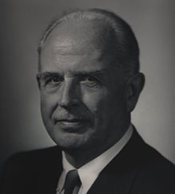
Norman T. Newton (21 April 1898 – 12 September 1992)
An American landscape architect and winner of the Prix de Rome.
"Design on the land: the development of landscape architecture“, 1971
The book has 42 chapters: Ancient Times, The Middle Ages, and The World of Islam etc. The last three chapters are on Urban Open-Space Systems, Variations in Professional Practice and the Conservation of Natural Resources.
This reflects the development of landscape architecture from a focus on private gardens, in the ancient world, to a focus on the planning and design of public open space in the modern world. Since kings used to be responsible for the provision of public goods (irrigation, streets, town walls, parks and other environmental goods) the distinction between public and private was not quite the same in the ancient world as it is in the modern world.
Pioneer landscape architect, professor, WWII hero, and historian Norman T. Newton

Slide 35
George B .Tobey
A comprehensive history of landscape architecture was published, in 1973, with the title " A History of Landscape Architecture: The Relationship of People to Environment ".
It extends from 5,000 BC, through the development of agriculture and towns to the design of gardens, parks and garden cities. This represents a broader view of landscape architecture than that of Newton and would have been well suited to Newton's title 'Design on the land'.

Slide 36
Geoffrey and Susan Jellicoe
"The landscape of man: shaping the environment from prehistory to the present day" (Thames and Hudson, 1975).
The book has 27 chapters and is more comprehensive than its predecessors, geographically, artistically and philosophically.

Slide 37
Geoffrey Jellicoe
Geoffrey Jellicoe introduced the term collective landscape inspired by Carl Jung's use of the term collective unconscious.
Collective landscape matters to the community, like other public goods, does not belong to any individual

