Slide 1
Application of Time-continuous Approximation of Vegetation Activity Indicators Obtained from Multispectral Satellite Imagery to Monitoring of Lower Volga Arid Wetlands
Alexander Kozlov¹, Maria Kozlova², Olga Gorelits², Igor Zemlianov²
¹Lomonosov Moscow State University, Russian Federation; ²N.N. Zubov State Oceanographic Institute, Russian Federation

Slide 2
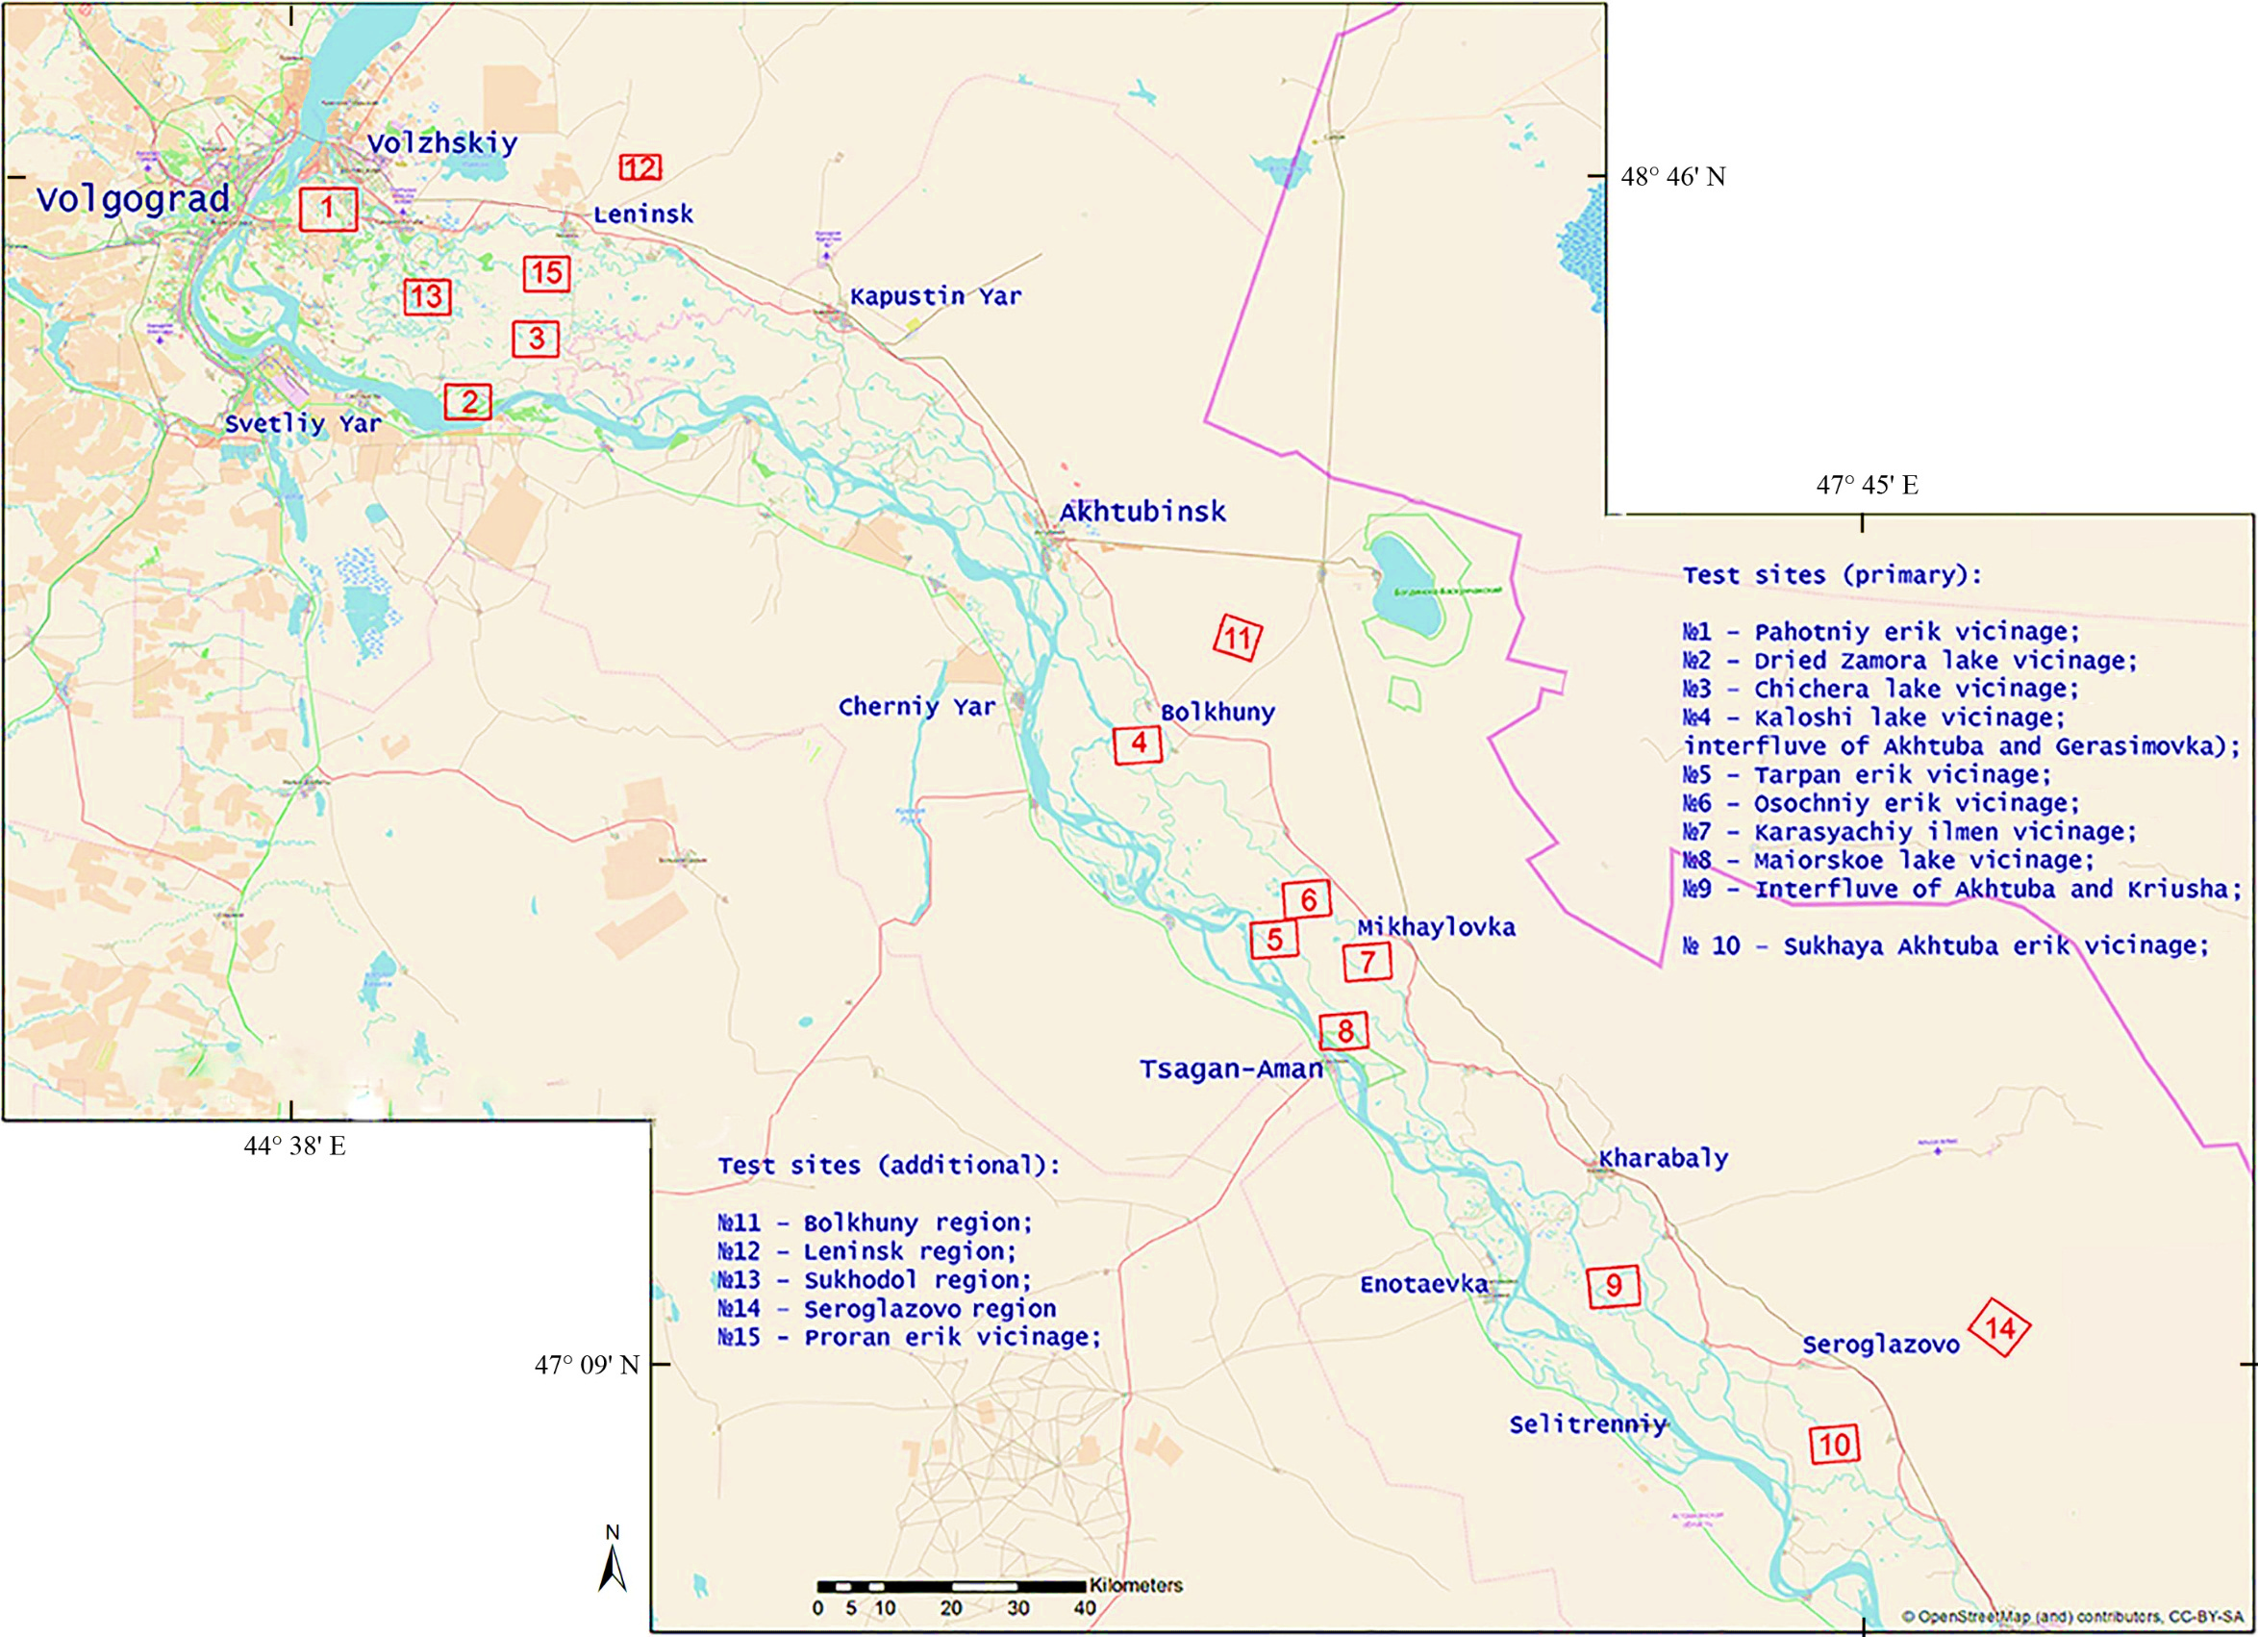
Region under study
Application of Time-continuous Approximation of Vegetation Activity Indicators Obtained from Multispectral Satellite Imagery to Monitoring of Lower Volga Arid Wetlands
Akhtuba river
Volga river
1-10,13,15 – arid and semi-arid wetlands;
homogeneous, but different
vegetation types;
11,12,14 – desert;

Slide 3
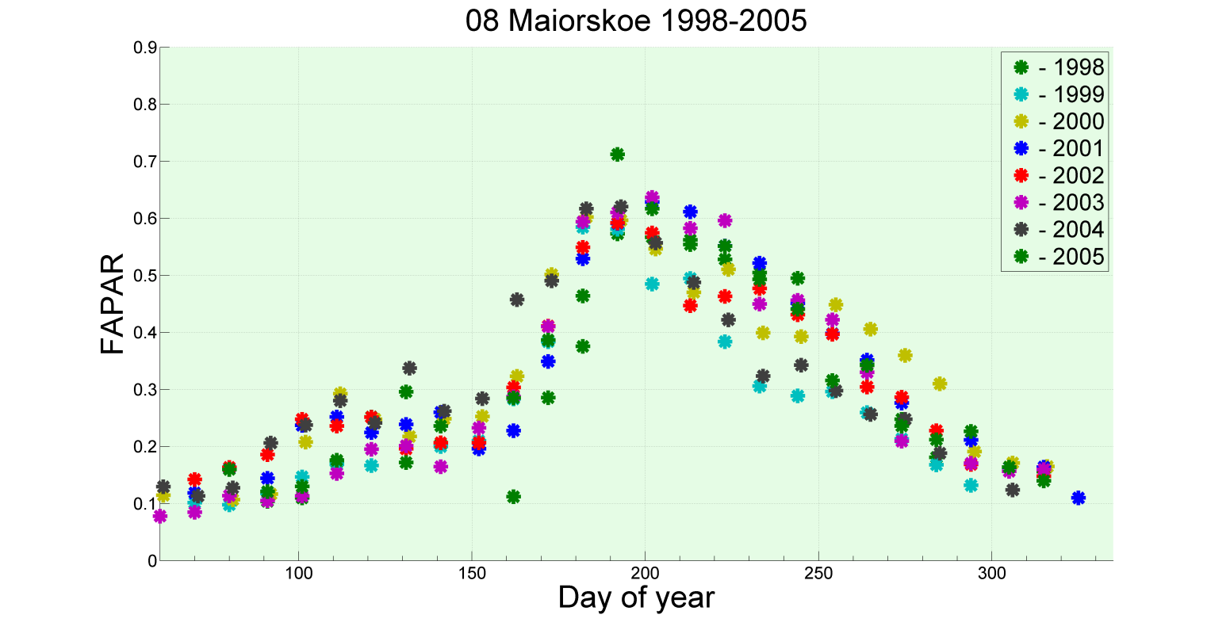
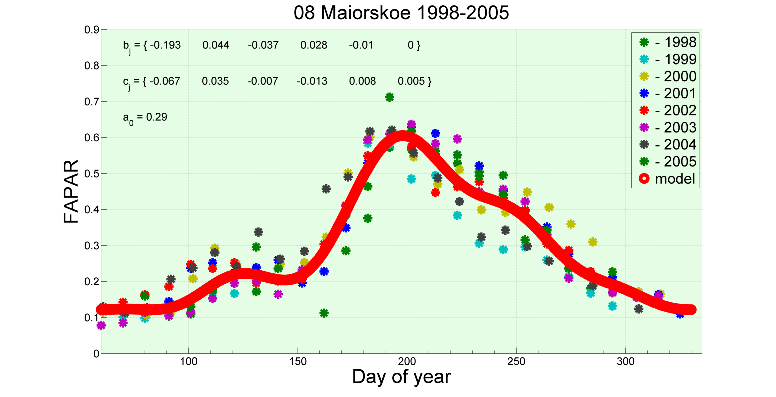
FAPAR, its harmonic time-continuous approximation and derived indicators
Application of Time-continuous Approximation of Vegetation Activity Indicators Obtained from Multispectral Satellite Imagery to Monitoring of Lower Volga Arid Wetlands
model function for the normal vegetation yearly cycle
…and derived metrics:
mean FAPAR value;
maximum FAPAR value and its day;
secondary harmonics amplitude;
“weighted” period of active vegetation
…
data from several years
normal year-to-year steady cycle

Slide 4
Contribution from the variation of temperature and its derivative
Application of Time-continuous Approximation of Vegetation Activity Indicators Obtained from Multispectral Satellite Imagery to Monitoring of Lower Volga Arid Wetlands
temperature data not included
temperature data included
approximation of temperature

Slide 5
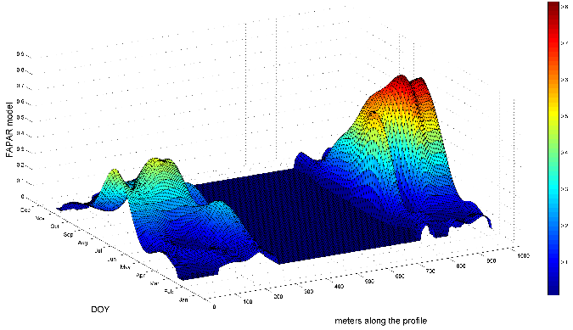
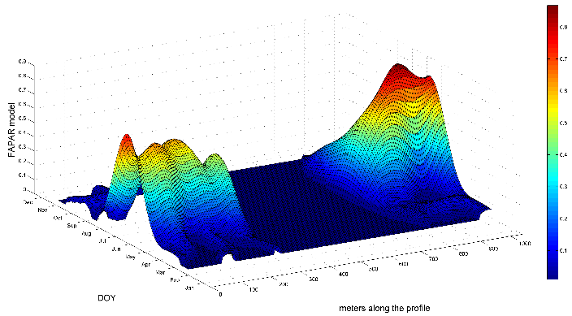
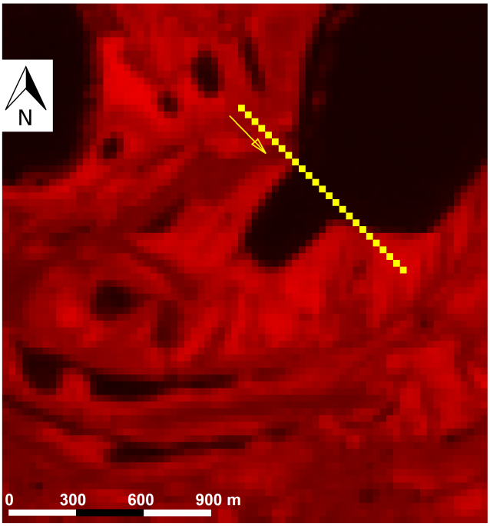
Visualization
Application of Time-continuous Approximation of Vegetation Activity Indicators Obtained from Multispectral Satellite Imagery to Monitoring of Lower Volga Arid Wetlands
Mixed space-time graphs along profiles
Mapping changes
FAPAR 1998-2005
FAPAR 2007-2014
Visible
Landsat 7 ETM+ Red

Slide 6
Time series of the Fraction of Absorbed Photosynthetically Active Radiation - FAPAR
outliers
R and NIR channels; B channel for atm. correction;
Publicly available, but:
- not continuous in time;
- contain gaps;
- include outliers;
- can be noisy.
Comparing data for different years becomes a challenge.
Hard to analyze important temporal features.
gaps
not continuous
secondary fluctuations
noise
day of max. value
period of active vegetation
FAPAR time series data are 10-day composites courtesy of ESA JRC, derived from Envisat MERIS and OrbView-2 SeaWiFS imagery

