Slide 1
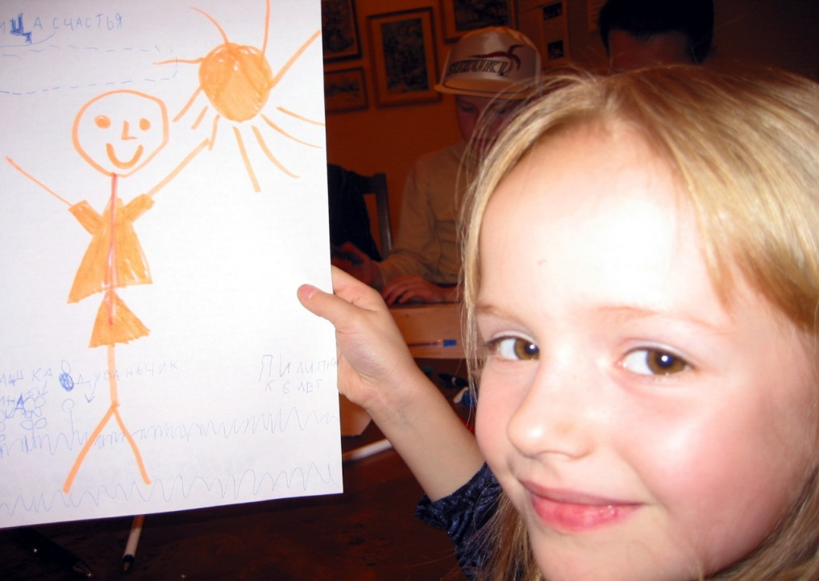
Prof. Larisa Retyunskikh Moscow State University named after M.Lomonosov, Russia
Kid’s philosophizing in a paradigm of “family resemblance”

Slide 2
Language, games and family resemblances
Philosophizing is language’s practice using principle of family resemblances
Philosophizing is a play with weaning of words
Children philosophizing is a way of creation of the world
“Family resemblances” is non-classical paradigm of thinking

Slide 3
FAMILY RESEMBLANCES
Instead of producing something common to all that we call language, I am saying that these phenomena have no one thing in common which makes us use the same word for all, – but that they are related to one another in many different ways. And it is because of this relationship, or these relationships, that we call them all “language”
I can think of no better expression to characterize these similarities than “family resemblances“; for the various resemblances between members of a family: build, features, color of eyes, gait, temperament, etc. etc. overlap and cries-cross in the same way. – And I shall say: ‘games’ form a family
Ludwig Wittgenstein

Slide 4
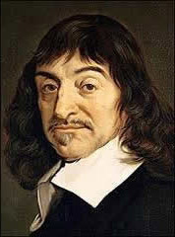
Cogito ergo sum. Rene DE Cart
The way of knowledge start from doubt
We could doubt everything besides the fact of our thinking
Thinking starts from doubt

Slide 5
Critical philosophy as a background of thinking
Pure reason is possibility to analyze reality!
Our sense give us information about outside reality!
Critical way of thinking is not the way of negotiation, but the way of analyzing.
Philosophy is the art of thinking
It is impossible to teach philosophy, where is it? Who do know it?
It is possible to teach philosophizing as a kind of training our rationality…. (I.Kant The critique of pure reason)

Slide 6
DOUBDT, CRITIC AND FAMILY RECAMBLENCES
Truth is the aim of thinking. It exists.
Truth is limited. It exists. Thinking has a strong rules in space of .
Truth is an ideal. It is constructed by language,
thinking is a language game
Thinking has strong rules

Slide 7
Philosophy starts from surprising (Aristotle) or Is there deference between kid’s and adult philosophizing?

Slide 8
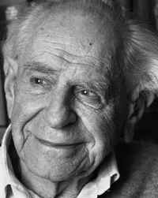
All People are Philosophers Karl Popper
Everybody is philosopher because everybody thinks about life and death
If we want to know something well, we need to try to make the falsification of our theory. It is the way of critical thinking

Slide 9
Philosophizing is completely thinking
There are two components of philosophical thinking
Rational
Emotional

Slide 10
What is play?
Phenomenon of human being which has:
Multi –complex character
Existential nature
Socio-cultural forms
Action or behaviour?
It is not as much an action or behaviour, as it is the state of consciousness and for this reason can be understood as existence.

Slide 11
Play has:
1. Empirical attribute
2. Existential attributes of play
1.presence of rules, time limits, place restrictions, etc.
2. To play means to realize, feel, estimate her or him playing

Slide 12
“The portrait of love” Please, describe in your own words the image of love, every next description should add something new to a previous one. Someone should draw every part of description of the nature. Two painters are to draw the portraits.

Slide 13
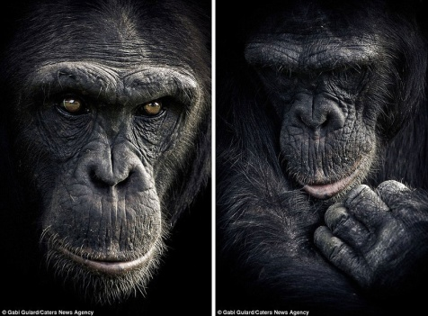
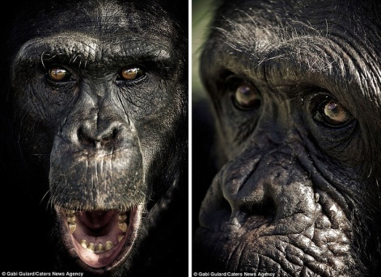
An example of an exercise COMPARING
Compare these pictures – can you see something in common?

Slide 14
The family portrait of Novelty : mother – revolution , mother in law – distraction, husband – creativity etc.

Slide 15
Philosophical Family Club “Socrates' school” exists from 1992

Slide 16
Children’s philosophical newspaper “Owl”

Slide 17
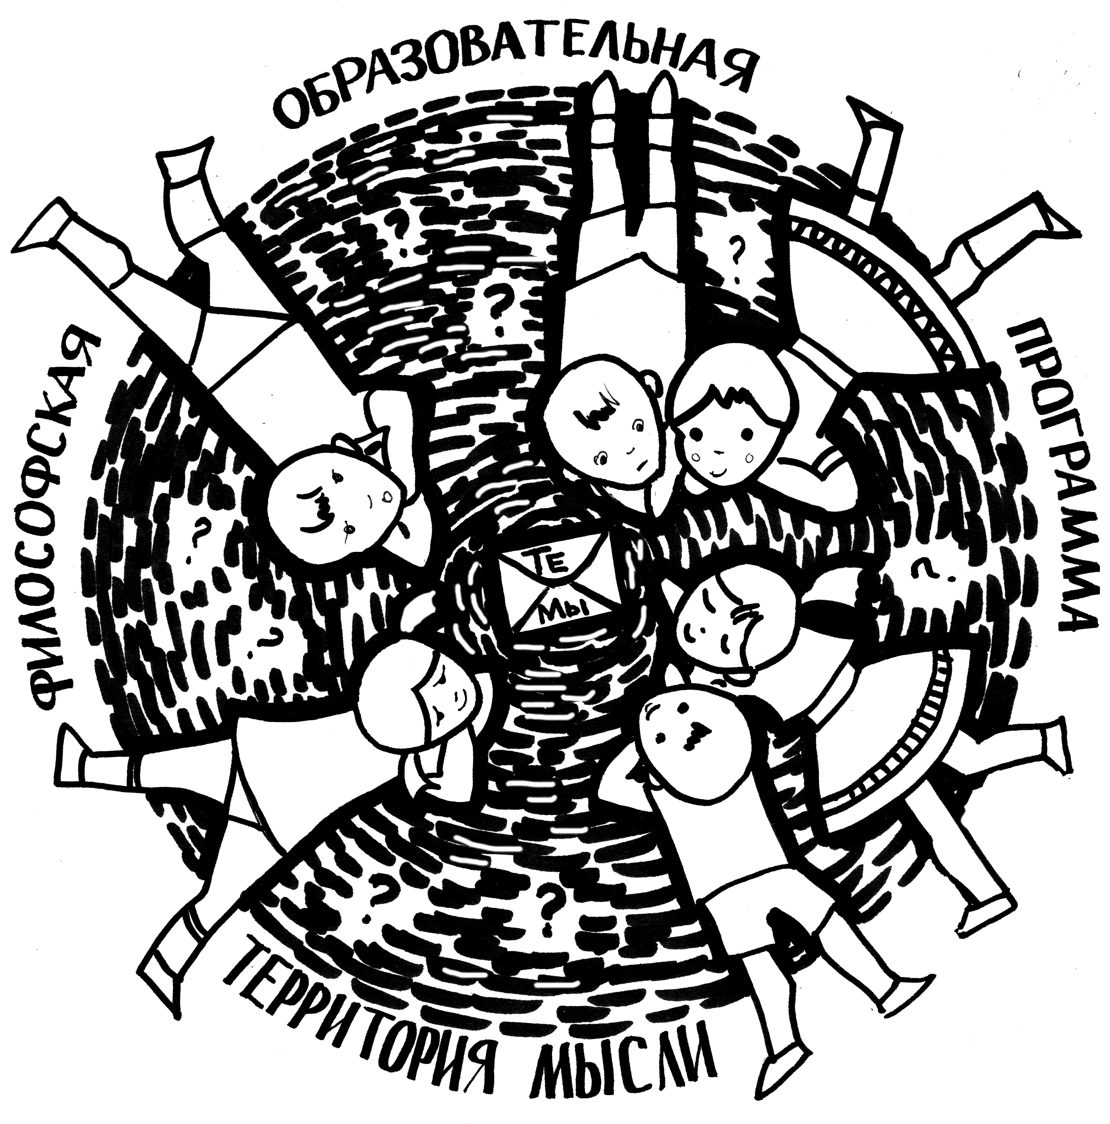
Philosophical camp
Creativity
The program “A territory of Thinking” of a philosophical camp in Russia was founded in 2009. Firstly we invited some members of Family Club “Socrates School” to spend a weekend together and organized some classes and activities. Now we do three programs a year: two philosophical weekends in March and November and one 10-days program in August.
Play and thinling

Slide 18
Philosophy is funny!

Slide 19
Thank you for attention
Larisa Retyunskikh
www.phil4chil.ru
larisa@phil4chil.ru

